Slide 1
Using Canadian War Posters to Develop Critical Thinking
Propaganda:
Date: 202602v1
Notes:
Thank you for choosing to attend this session.
This session is titled Propaganda: Using Cdn War Posters to Develop Critical Thinking. It’s about Canadian war posters from WW1 & WW2, and how we can use them in our classrooms to educate our students about propaganda and how to think critically within our shared informational environment.

Slide 2
Who is Valour Canada:
Vision:
Valour Canada is a nationally-recognized, charitable, not-for-profit organization dedicated to connecting Canadians, especially youth, to Canada’s military heritage.
Mission:
Valour Canada will create engaging and effective programs to educate Canadians, with a focus on youth, about Canada’s military history.
www.ValourCanada.ca
Notes:
.

Slide 3
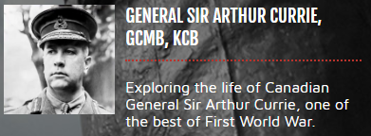
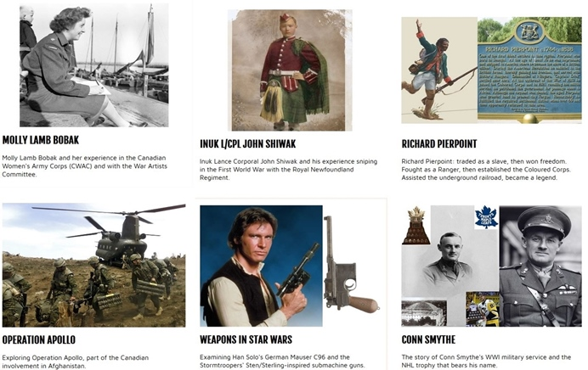
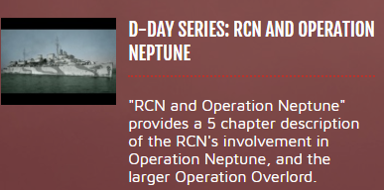
Resources:
Valour Canada has almost 40 years of experience delivering military history education programs in museums and classrooms.
Educational documentaries (190+ short videos)
Online military history library (290+ youth-accessible articles)
Notes:
.

Slide 4
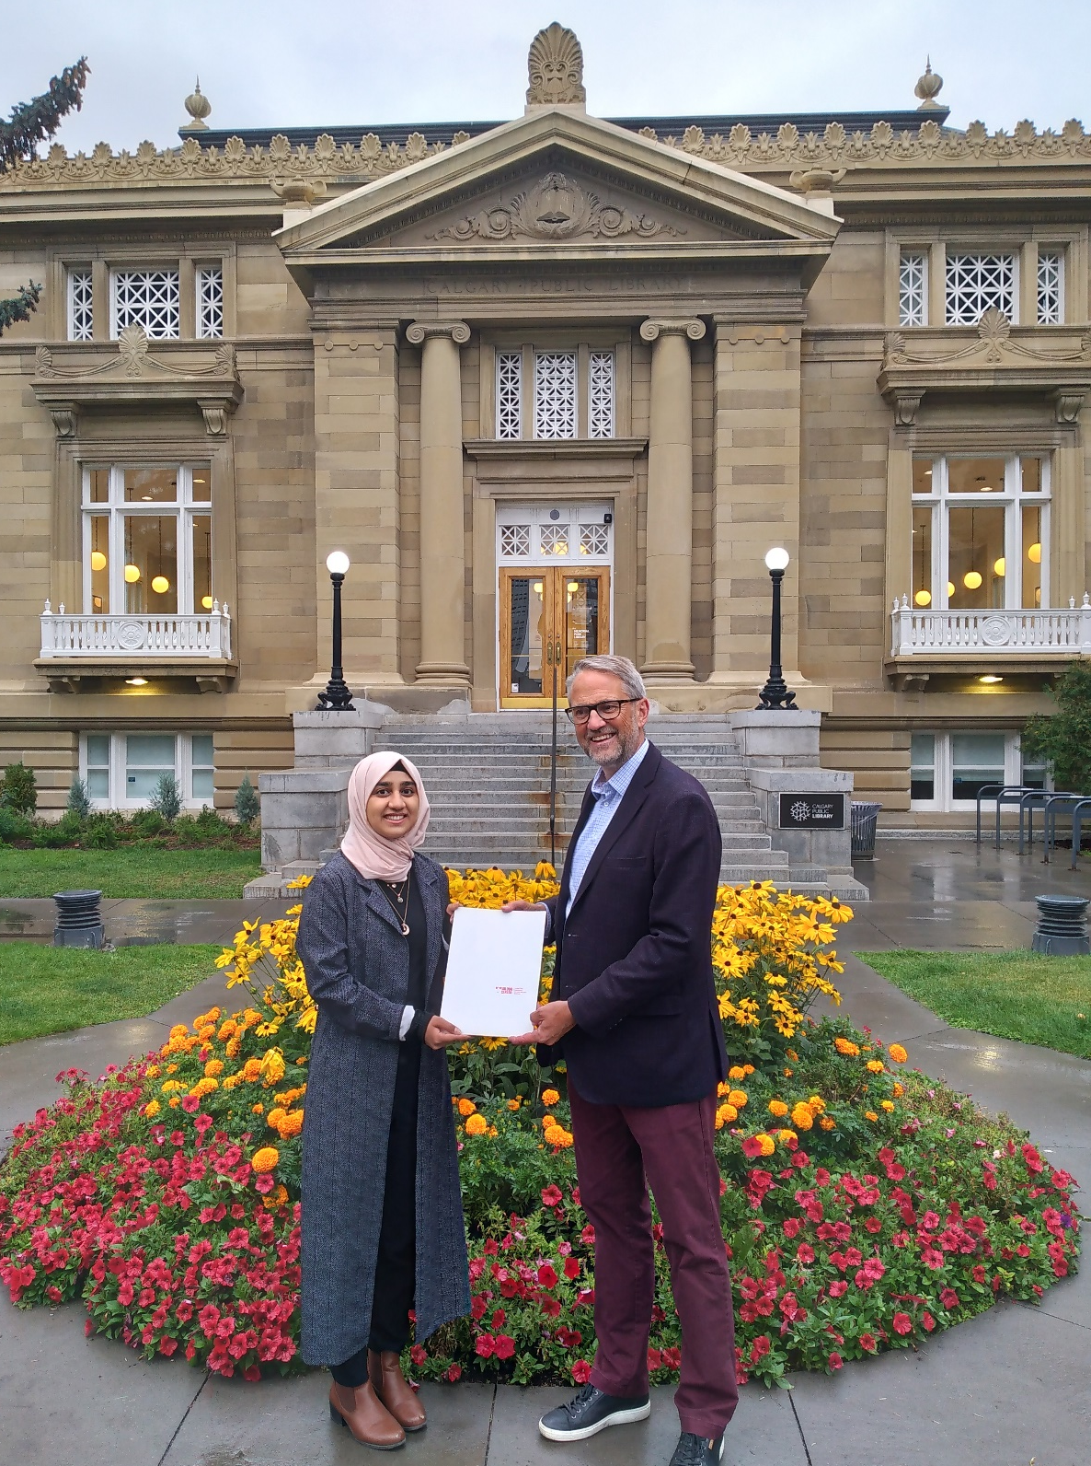
Resources (cont’d):
Juno Beach VR
Plus 10 other virtual tours
History and Heritage Scholarship
Annual; Contest ends in mid-June:
$2,000 1st place, $500 2nd place
Task: Create a 4 - 6 minute YouTube video
Girl Guides
Canadian Women of Valour Program
Speaker Series
2025 highlight: Historian Tim Cook
www.ValourCanada.ca/Education
Notes:
.

Slide 5
Full Session Outline:
Outline
1. Propaganda: Definitions, Devices, Complexity, Curriculum (1h)
2. 10-minute Break
Classroom-ready Activities; Transition to Groups (10 min)
Teacher Pair/Group Work (40-65 min)
Wrap-up & Takeaways (5 min)
Session Goals:
New perspective(s) and 2-3 things you can try in your class (Pt. 1).
Sharing of Resources (end of Pt. 1).
Draft Lesson Plan for 1-3 period(s) (Pt. 3&4).
Notes:
------- review slide ----------

Slide 6
Question:
What is a teacher’s ultimate goal regarding their students?
Granted, the age of the student is a big factor, so let’s say: for high school graduates.
Critical, , thinkers that have the courage to think for themselves.
diligent
Notes:
End with mom’s heart health and smart watch story.

Slide 7
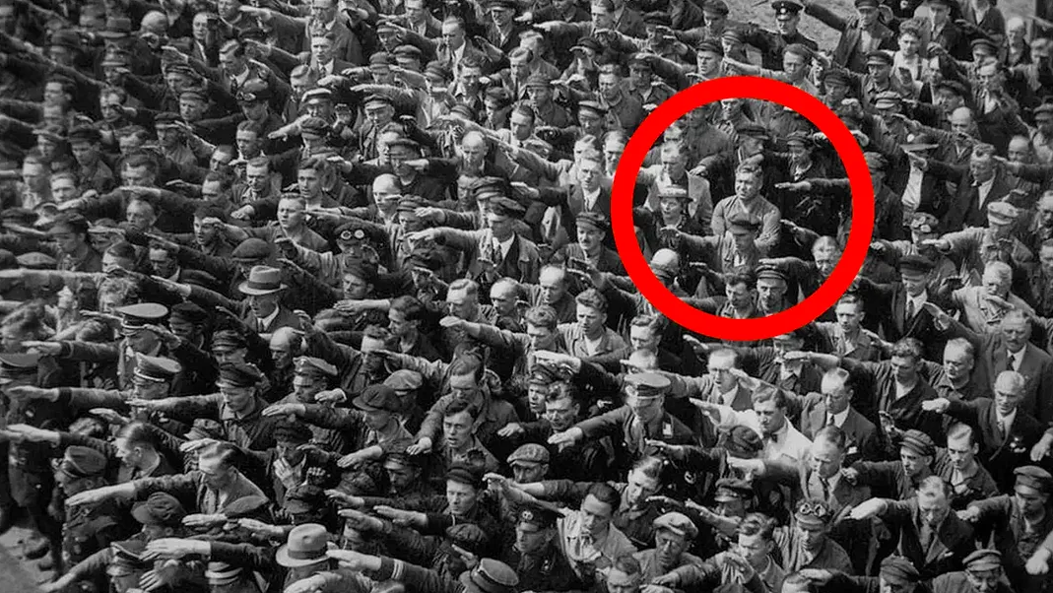
Social Psychology p.1
August Landmesser, 1936, Hamburg, Germany
MaryFisherArt.Medium.com
Notes:
Landmesser joined the Nazi Party in 1931 (to become more employable).
In ‘34 he fell in love with a Jewish woman, in ‘35 marriages betw Jews and non-Jews were outlawed.
1937- they tried to escape to Denmark but were arrested. He was released in May ‘38 due to lack of evidence and was arrested again in July and sentenced to 2.5 yrs of hard labour.
He never saw his wife or children again.
Drafted in Feb. ‘44. KIA Oct. ‘44.
His wife was killed in a Euthanasia Centre (Bernburg) in ‘42.

Slide 8
Pluralistic Ignorance:
Social Psychology p.2
Aiming to defend against:
“. . . occurs when people mistakenly believe that everyone else holds a different opinion from their own. This often leads to a false consensus, where people conform to the thought-to-be majority opinion, even though it . . . (is not the opinion of the) . . . majority of the people.” SimplyPsychology.org
Atomization:
“. . . the act or process of splitting into smaller parts, sections, groups, etc.; fragmentation or disintegration;
The atomization of society into isolated individuals . . . is largely a modern phenomenon.” Dictionary.com
Notes:
These two concepts feed into each other with positive feedback.
Ouroboros – snake eating its own tail. We need to break this cycle by talking to each other!

Slide 9
Social Psychology p.3
4 Important Experiments:
Asche Conformity (Which of the lines is longer?)
People often give a wrong answer just to fit in with the group
Stanford Prison (Inmate, guard, and warden all role playing (RP))
Some people quickly overstep social norms once given power
Milgram (supervisor (RP), shockee (RP), and shocker (non-RP))
Some will follow orders beyond what they thought they would do
Bobo’s Doll (Children watch an adult care for or abuse a doll)
Mimicry i.e., monkey see, monkey do VeryWellMind.com
Notes:
Asche Conformity: people will conform even if the group is wrong, esply if the response is public; 25% of people never conformed
Stanford Prison: power corrupts some quickly; role conformity
Milgram: authority legitimates obedience over personal morals/ethics
Bobo’s Doll: mimicry, aka observational learning; reward/punishment reinforcement

Slide 10
Activity:
4 Corners/Horseshoe Debate: Conspiracy Theories
(but for this we are going to imagine we do it)
> Topic 1: The pyramids were built by aliens.
> Topic 2: Hitler died in Argentina in 1962, not by suicide 30Apr45.
> Topic 3: Jeffrey Epstein did not kill himself.
Group has good rapport.
The space is safe and facilitates open & respectful discussion.
The teacher is consistent and is also a learner.
Notes:
.

Slide 11
Content to be covered:
Outline
1. Propaganda: Definitions and Purpose
2. Susceptibility: Who is ripe to be influenced?
Devices – with Canadian wartime poster examples
Assessing Information & Adding Complexity
Curricular Connections & Resources
Name-calling Euphemism Loaded Language
Plain Folks Transfer Bandwagon Testimonial Fear (FUD) Dehumanize Repetition
Notes:
------- review slide ----------

Slide 12
Definitions
Propaganda defined:
Propagare
“information, ideas, opinions, or images, often only giving one part of an argument, that are broadcast, published, or in some other way spread with the intention of influencing people's opinions” Cambridge Dictionary
“dissemination of information—facts, arguments, rumours, half-truths, or lies—to influence (or manipulate) public opinion . . . beliefs, attitudes, or actions” Britannica.com
Notes:
Latin origin: ‘propagare’ meaning to ’propagate’ – created in the early 1600s by the Catholic Church to spread the faith.
To provide a simple meaning for “Propaganda” – information presented that aims to manipulate the audience
Note that the first definition has neither positive nor negative connotation, while the second subtly presents the idea of not being forthright/completely honest – More on this in a bit.
The best propaganda has a bunch of truth that is simply ‘spun’ in a certain direction.

Slide 13
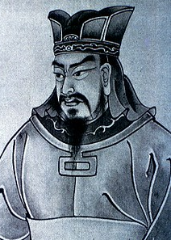

Propaganda: Why use it? What’s its purpose?
Purpose
The goal is to influence a person of group of people to think a certain thought or train of thought.
This can be toward positive outcomes (e.g., healthy behaviour) or negative (e.g., hurtful behaviour)
Militaries have used propaganda for centuries – “All warfare is based on deception.” – Sun Tzu
During everyday life, everyone is a target! Mostly to Mostly to sell us consumer products.
Notes:
Propaganda can be ‘good’ in the sense of positive behaviour (e.g., prevent fires, don’t do drugs, etc.), but for the most part propaganda has a negative association.
Other Sun Tzu quotes:
“The supreme art of war is to subdue the enemy without fighting.” What might that look like? Info/propaganda warfare?
“Appear weak when you are strong, and strong when you are weak”
“In the midst of chaos is also opportunity”

Slide 14
A person/population is more susceptible to propaganda when:
Susceptibility
Fatigued (tired) and/or stressed
More intuitive (feelings) than analytical (facts) thinkers
Weaker in numeracy skills
More frequently exposed to social media (repetition & confirmation)
There is no clear evidence that highly educated people are less susceptible (because they can rationalize their thinking)
Here are 10 propaganda devices to watch for:
Notes:
Like almost everything, people who are tired, complacent, or not paying attention, tend to make more errors (in action and thinking).
Conditions favourable to propagation of ideas can be created (sensory overload/deprivation- overload e.g. shellshock ) or can arise ‘naturally’ (living paycheque to paycheque).

Slide 15

Name-calling
Devices
Use of negative words or labels to elicit prejudice against something without looking at facts/evidence. Often this is “ad hominem” i.e., ‘towards the person’, a personal attack rather than an attack on the opposition’s argument or statement.
E.g., “that person is a jerk”, so
all their ideas must be bad.
Notes:
WW2 poster
> This is a strategy that aims to diminish the argument made or the fact presented by attacking the person making the claim
Note that many of the upcoming images use 2 or more of the techniques we’re going to cover.

Slide 16
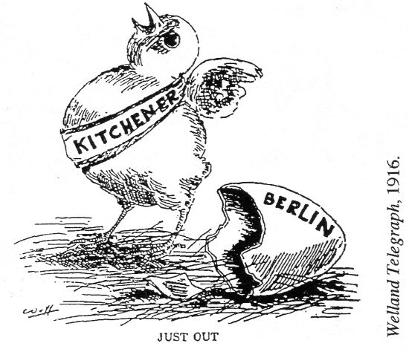
Devices
Euphemism
Use of a more bland/innocuous word or phrase in place of something more unpleasant. The goal is to reduce the chance that the audience will have a negative association to the topic at hand.
E.g., ‘shell shock’(WW1) →
‘battle fatigue’ (WW2) →
‘PTSD’ (post-traumatic stress
disorder)
George Carlin video
Notes:
WW1 cartoon
> The use of less offensive language/words to decrease the chance of negative associations
During the early 1900’s, many of German heritage lived in the area between Toronto and Windsor. Once of the towns had an unfortunate name at the beginning of the war. Outsiders did not want to buy anything from Berlin, Ontario, and due to the rising anti-German sentiment, community members voted to change the town’s name. It was a very close vote. Kitchener, a last-minute addition to the list, was the winning name (it was added in recognition of Lord Kitchener who died months earlier). In another curious twist, “Corona” was also in the running.
George Carlin on Veteran PTSD – WW1- Shell shock; WW2- Battle fatigue; Korean War- Operational Exhaustion; Vietnam- Post-traumatic stress disorder

Slide 17
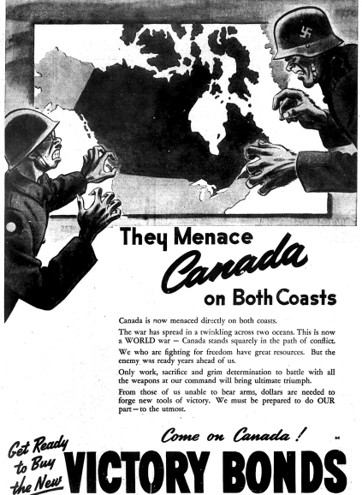
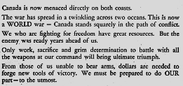
Loaded language
Aka “Weasel words”. Use of overly positive or negative words, e.g., fantastic, horrible, perfect,
disgusting, etc.
The goal is to elicit an emotional response that is not based on facts or evidence.
Notes:
WW2 poster
> Use of carefully selected vocabulary and/or hyperbolic statements to better elicit an emotional response targeted by the propagandist
Examples: “menaced on both coasts” – but no direct attacks on Canadian soil; “spread in a twinkling” implies that the enemy has far-reaching and can act quickly; “Canada stands squarely in the path of conflict” – another group of words that suggests we are going to get hit on our home soil; if we are “squarely in the path of conflict”, what does that make Europe?; “ultimate triumph” – suggests that if you/we buy bonds, you/we can end the war
Bandwagon: “WE must be prepared to do our part”

Slide 18

Plain folks/normal-linking
Devices
Subtle association of normal or moral people to elicit connection to a group, most often the common people. It can also be a speaker/ leader trying to appear to be ordinary (i.e., normal) to gain trust.
E.g., Obama’s use of “folks” and Trump’s use of “patriots”.
Notes:
WW1 Cdn poster
> Where an attempt to connect or associate an idea or person to “normal” ‘good people, to gain trust
e.g. a politician appearing at a local, small-scale coffee shop, or putting on a hard hat in a factory

Slide 19
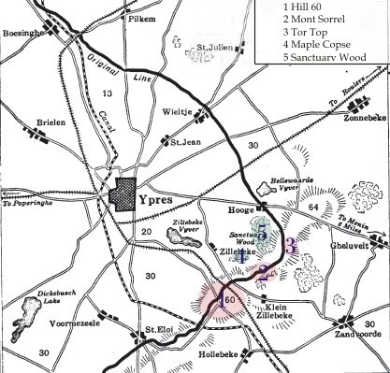
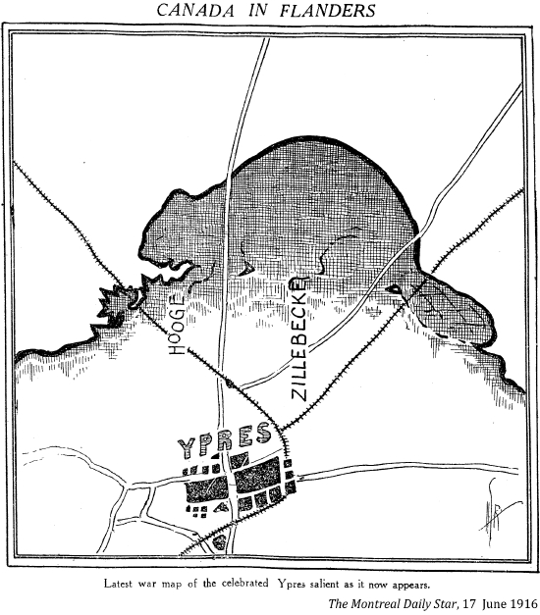
Devices
Transfer/symbol-linking
Subtle association of positive or negative symbols (e.g., flags, flowers, etc.) to elicit emotion about a person, idea, etc.
Other examples include: finishing a speech with a prayer or song, or linking to an “undeniable” truth.
Notes:
WW1 cartoons
> Non-direct (covert) association of an often archetypal, good or bad, symbol to a person or idea
A common modern version used by politicians is to have a circular logo behind them and, at the appropriate distance, the ring appears like a halo/golden crown/Jesus/sun god.
> Beaver & Maple Leaf = Nationalism

Slide 20
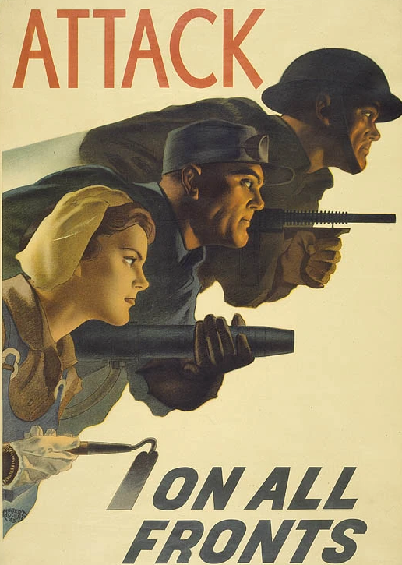
Bandwagon
Devices
Exploits the desire to fit in with a certain group; “everyone else is doing it”
E.g., McDonald’s has served hamburgers to billions; Mr. Beast is the most followed YouTube channel; --- So get on board!!!
‘Sock puppets’ and ‘Bots’ online media can easily make it appear that an idea, concept, statement, etc., is much more/less popular than it really is.
Notes:
WW2 poster shows a soldier, industrial worker (w/ rivet gun), and a farmer (woman).
> The message behind “Bandwagon” propaganda is basically that ‘if you’re not a part of the group, you’re an outsider, and who wants to be an outsider . . .’

Slide 21
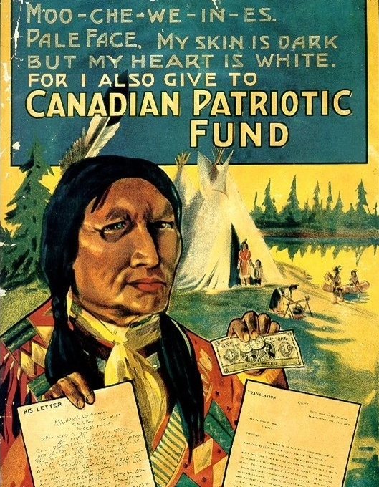
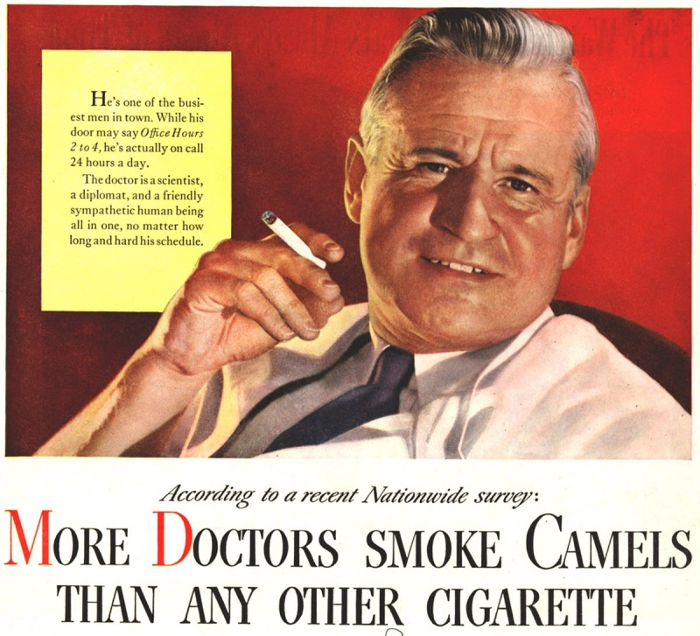
Devices
Testimonial
Using a person, often a celebrity and/or someone widely known, to ‘sell’ a product or idea.
We see this everywhere, often as paid promotion.
E.g., A doctor speaking about a
medical treatment. (Note that
a doctor also has ‘authority’.)
‘Influencers’ on social media provide testimonials whether paid or not.
1946: R.J. Reynolds Tobacco Co.
Notes:
WW1 poster – the target audience was white men (not FN, Metis, Inuit) – to shame them into donating
> The use of social cred/influence to promote a certain idea or person
Celebrities and Experts are commonly employed, paid or not, for testimonials.

Slide 22
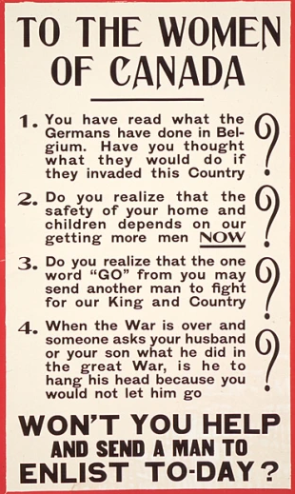
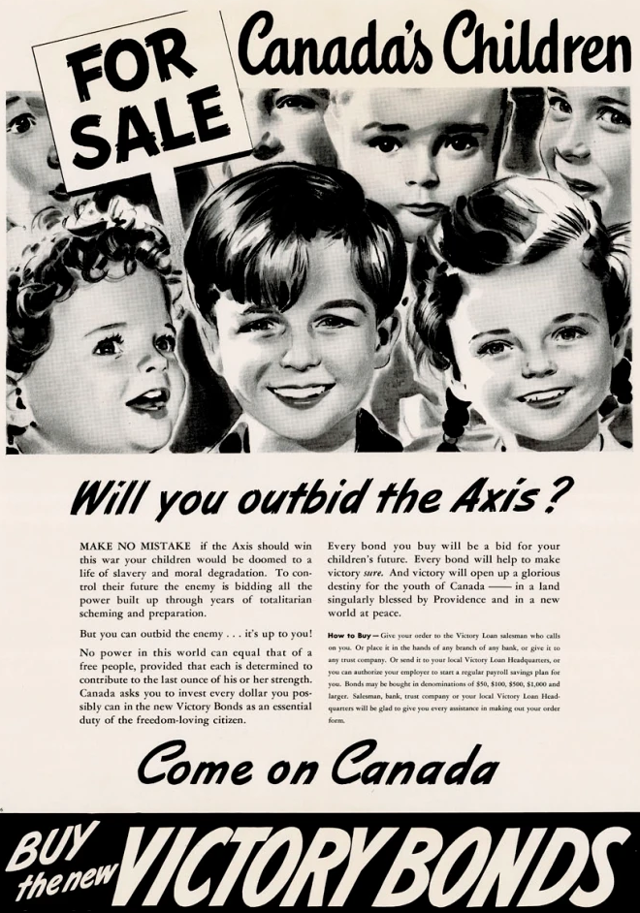
Fear
Use of FUD (fear, uncertainty, doubt) to ensure better compliance for action X, e.g., if you don’t do X
then this horrible
thing will happen.
This is often used when people have incomplete info about a topic.
Notes:
Left poster – WW1
Right poster – WW2, first para: “MAKE NO MISTAKE if the Axis should win this war your children would be doomed to a life of slavery and moral degradation. To control their future, the enemy is bidding all the power built up through years of totalitarian scheming and preparation. But you can outbid the enemy . . . It’s up to you!”
> Use of scare tactics to instill fear in order to drive behaviour or ideas.
Keep in mind that excessive fear tends to overwhelm the logical faculties of people

Slide 23
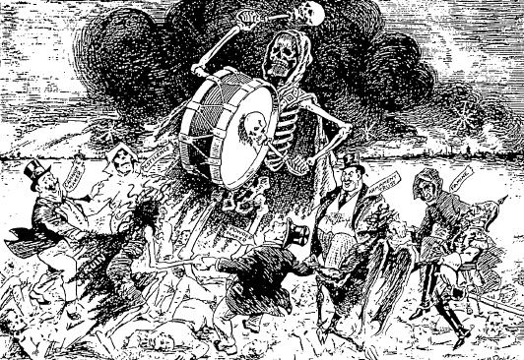
FUD
(cont’d)
Devices
Propaganda Techniques
“The Dance of Death”
- Grain Growers’ Guide, Winnipeg, MB, Oct. 1914
Notes:
Counter-clockwise from left of drum: Pestilence, Cannon maker, ruin, Powder maker, Armament trust, Famine.

Slide 24
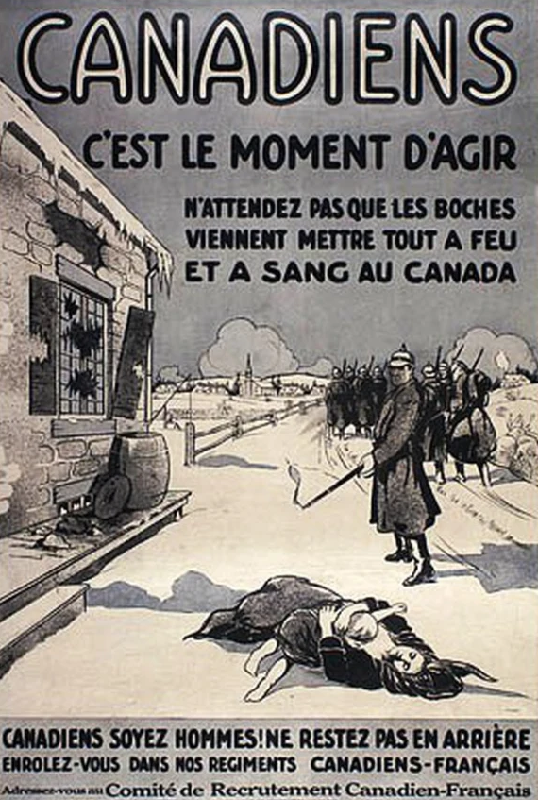
Devices
Dehumanize
Similar to name-calling, but this specifically tries to frame a person/people as less worthy of respectful treatment due to their ‘badness’. Often seen are references to the opposition being animals, vermin, or diseases.
Note that Genocide researchers see dehumanization as one of the steps.
The goal is to justify that since they did X, we need to do Y.
When both belligerents repeatedly do this to their opponent, the result can be catastrophic.
Notes:
WW1 poster
> Similar to name-calling, but “Dehumanize” aims to delegitimize another’s actions/idea and to legitimize opposition against those who are targeted
Translation - Main text: Canadians, It’s time to act. Do not wait until the Huns wreak havoc in Canada. Below picture: Canadians man up! Do not stay behind. Enlist in our French-Canadian regiments.
Internment example, WW2: “Japanese-Canadians put Canadian lives at risk (i.e., They’re untrustworthy people whose loyalties lie elsewhere), so we should remove them from the coast to interior internment camps.”

Slide 25
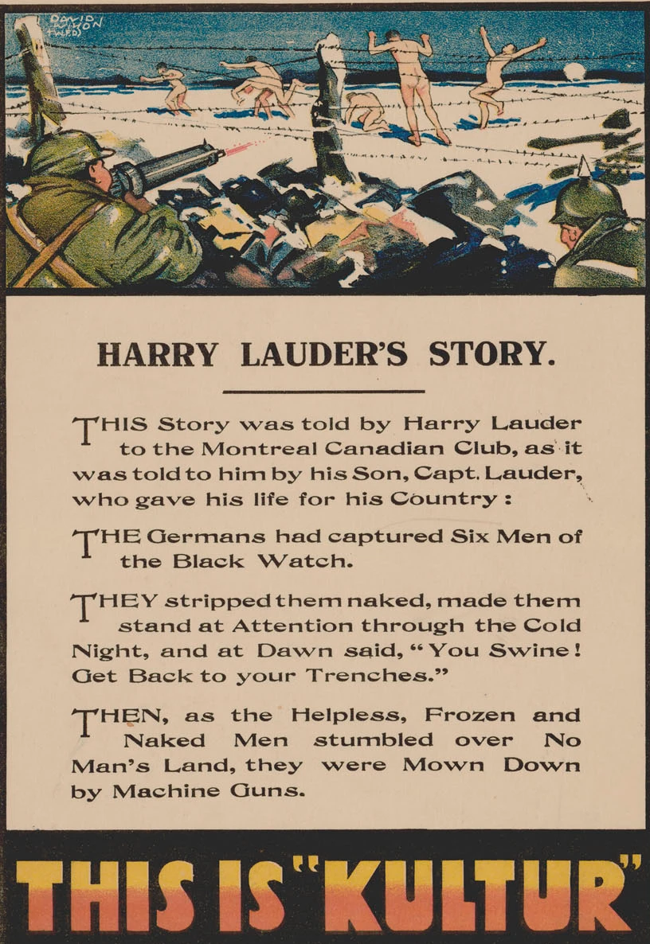

Devices
Repetition
Utilizes the belief that something said or heard repeatedly, irrespective of truth, will eventually be perceived as truth
E.g., the “Kultur” posters from WW1.
“Kultur” in this context implies that all Germans are evil, uncaring people who will stop at nothing to promote their way of life AND the more “Kultur” is repeated, the more people will believe it.
SirHarryLauder.com BBC.com
Notes:
WW1 posters
> Choosing a word or a message, creating a positive or negative association, and then presenting it over and over and over. In time, the message is normalized and is much more easily perceived as truth (aka the Big Lie – outlined in Hitler’s Mein Kampf). In addition, there can be a Pavlov effect (stimulus -> response).
Harry Lauder – lost his son John, killed at the Somme. Harry was a famous musician who used his platform to convince many men to enlist. Also raised tons of money for Canada’s Victory Loan.
Llandovery – Hospital ship sunk by U-86, June 1918. Only 24 survived in one lifeboat.
/Kool toor/ - (def) - German civilization and culture (sometimes used derogatorily to suggest elements of racism, authoritarianism, or militarism).
There is also a lot of “Dehumanization” in both these posters

Slide 26
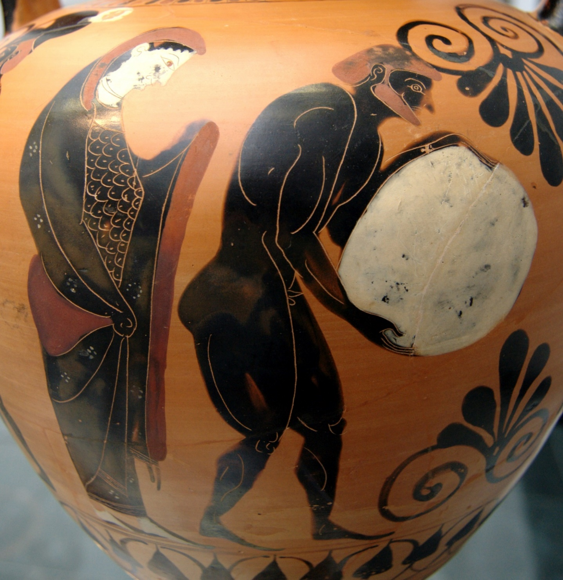
Conclusion
Propaganda is widespread, continuous, and can be used for good or bad.
It is unescapable!
How can we protect ourselves?
Notes:
Amphora (530 BC) – “Persephone supervising Sisyphus pushing his rock in the Underworld.” in the Munich Art Museum (Germany).
> Everyone has bias to varying degrees, thus, everything must be assessed.
> Greek myth of Sisyphus: Sisyphus cheated death twice and was punished by the Gods to push a boulder up hill for eternity. - futile/hopeless/laborious tasks are hence called “Sisyphean”.
> Communications industry – The Nazis and Soviets were very adept at propaganda, especially internally to legitimize their respective leadership. How much have the methods and devices improved since the end of the Second World War?

Slide 27
Tips for assessing information
Assessment of Information
Try to keep the following in mind:
Who is presenting the info? Is it recent? Is recency good?
Does the author’s record show accuracy? Are they reputable?
Who paid/who received? Are there any conflicts of interest or incentives to present a certain perspective?
Who benefits? (Qui bono)
Does the info make you feel a certain way? Why might that be?
Is the math/data plausible?
Logic and Occam’s Razor
Notes:
Pt. 1 – The author/publisher/etc – is it recent? Is recent good? What’s the author’s record? Are they reputable? Be careful with those who are ‘reputable’ or are mainstream ‘experts’ because of the Testimonial technique.
Pt. 2 – Conflict of interest. Compensation (money, position, etc.).
Pt. 3 – Who is helped/hurt by the information/message?
Pt. 4 – Pavlov’s stimulus -> response . . . To what end?
Pt. 5 – Data – take a moment to ‘run the numbers’ in your head or with a pocket calendar. Are the data plausible?
Pt. 6 a – Logic: are there any assumptions/connections made and are they feasible or backed up by data?; are the definitions used sound?; are there any apparent fallacies? (a fallacy is a faulty/invalid argument, e.g. Ad Hominem, aka ‘name-calling’)
Pt. 6b – Occam’s Razor: the simplest explanation is frequently the most likely

Slide 28
Switching gears . . .
Notes:
.

Slide 29
Adding complexity 1: Standard/traditional tools
MSM, social media, Big tech
Tools:
Objective reporting - striving towards non-bias . . . really?
- Omission
- Manufacturing Consent (Chomsky)
Public relations, marketing, and advertising
Polling firms - “Push” Polls
Interviews and focus groups
Astro-turfing
<< Normative psychology >> (basic social conformity)
Notes:
Objective reporting- def - “to portray issues and events in a neutral and unbiased manner, regardless of the writer's opinion or personal beliefs”; Propaganda by inclusion, avoidance, vocabulary
PR, Marketing, Advertising- their goal is to convince you to buy a product (or an idea);
Polling Firms- used to hide, demoralize, support
Interviews, focus groups – their goal is to get valuable feedback on products, terminology, presentation, etc., from group of people. This info/data is often used to increase client success
Astro-turfing – the deceptive packaging of a movement to make it appear like a ‘grassroots’ campaign (i.e., ‘grassroots’ suggests widespread support by normal people, whereas astroturfing is often one or a few big donors creating an organization that promotes a solution that benefits the big donors, hence the connection to the synthetic)
For the most part, these use Normative Psych – basic social conformity = keeping up w Jones’, FOMO, etc.

Slide 30
Adding complexity 2: Modern Digital Media
MSM, social media, Big tech
Recent additions to the propaganda toolkit:
Advocacy journalism
Likes & Dislikes; The comment section
Algorithms: Social media & Big Tech (Dopamine exploit)
Shadow-banning
Censorship
Bots & Sock Puppets
AI (Artificial Intelligence)
Your data . . . Used to keep your attention or sell you goods
<< Dark psychology >> (hacking brains)
Notes:
Recent additions to the propagandist’s toolkit
Advocacy reporting- def - to portray issues and events in a “non-objective viewpoint, usually for some social or political purpose”
Likes/Dislikes, Comment sections- up and downvotes can be adjusted; comments can be deleted; some articles do not allowed comments; bad faith actors; trolls; agent provocateurs
Algos – are corporate trade secrets/protected; they operate to shift or add/remove content that appears in your results or updates page
Shadow-banning – where content is blocked unknowingly, or people are unsubscribed; similar to censorship
Censorship – def - “the changing or the suppression or prohibition of speech or writing that is deemed subversive of the common good.” i.e., removal, blocking, or deplatforming of information or authors of information that is seen as not promoting positive outcomes – but who decides?
Bots & sock puppets – illegitimate accounts, often counterfeit and automated, that post certain messages that aim to promote, detract from, confuse, or purposely look bad
AI – text, audio, & visual; garbage in – garbage out
Your data – recording your data is packaged as improving your online experience, but remember that anything you do online is tracked and recorded (clicks, view time, mouse motion, etc.), plus various devices have been caught recording video and audio of you/your home/etc. – Big tech can begin to know you better than you know yourself.
These at getting into Dark Psych – hacked brains via exploiting vulnerabilities (e.g. elderly, FUD, misrepresenting authority, ‘Yes’ laddering, etc.)

Slide 31
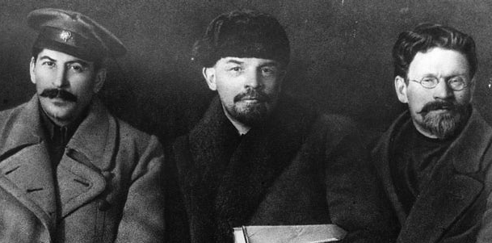
Adding complexity 3: The Biggest Hitters
MSM, social media, Big tech
Governments, businesses, and military have always used traditional propaganda tools.
They have had decades to perfect them and now they have the internet!
Other things to be aware of:
False flags
Operation Mockingbird
Agitation and agitprop
‘Nudge’ units
Psy-ops (psychological operations),
e.g., CF 36 and 37 Cdn Bde Groups, US: INSCOM Cyber Brigade
Notes:
Stalin, Lenin, Trotsky
False Flags – def – “a hostile act that obscures the identity of the participants carrying out the action while implicating another group or nation”, e.g. Gulf of Tonkin incident – USS Maddox was allegedly torpedoed twice by North Vietnamese torpedo boats
Operation Mockingbird – CIA’s large-scale control and/or recruitment of major journalists, editorial depts, television studios, clergymen, etc. in order to use mass media to influence people around the world
Agitation and agitprop – def - “political strategy in which the techniques of agitation and propaganda are used to mobilize the public , i.e., convince to act”, most often via literature, film, music, etc. The key part of this definition is ‘mobilize’’ – the goal is to subtly incite action. Every soviet group had an agitprop section. War posters are a good example of agitprop
Nudge units – groups that use behavioural psychology and social theory to drive people to act in a given way
Psychological Operations – military initiated propaganda with the goal of influencing the enemy’s mental state; i.e., information warfare; e.g. dropping airborne leaflets – WW1 postcards from POWs showing human conditions

Slide 32
Curricular Connections:
Specific Subject Areas: (often ‘Media Literacy’)
- Social Studies 4-5, 7-9, 10, 20, 30
- ELA 5-6, 7-9, 10, 20, 30
- Knowledge and Employability 10 & 20
- Sociology 20 & History 20
General:
- Dimensions of Thinking (Critical & Historical)
- Communication (Visual & Written)
Notes:
.

Slide 33
Resources: Imagery
Canadian Primary Sources: FWW – SWW – Cold War and much more! Posters, cartoons, images, quotations, etc. (BC Social Studies Teachers) http://canadianprimarysources.org/canadianPS.htm ← This has an overwhelming amount of high-quality content!
McGill Digital Library: FWW/SWW searchable. https://digital.library.mcgill.ca/warposters/search/search.php
Canadian History Bits:
WW1 Posters https://cdnhistorybits.wordpress.com/2015/03/24/canadian-ww1-propaganda/
WW2 Posters https://cdnhistorybits.wordpress.com/2015/03/31/canadian-ww2-propaganda/
Library and Archives Canada: Search Results for “propaganda”. https://recherche-collection-search.bac-lac.gc.ca/eng/Home/Search?q=propaganda&num=50&start=0&enviro=prod&DataSource=Images
Archives Ontario: A selection of posters from the FWW. https://www.archives.gov.on.ca/en/explore/online/posters/index.aspx
Digital Archives Ontario: A selection of posters from the SWW. https://digitalarchiveontario.ca/collections/objects/103
Canadian War Museum: A digital exhibit with a limited selection of posters.
https://www.warmuseum.ca/cwm/exhibitions/propaganda/index_e.html
Notes:
.

Slide 34
Resources: Additional Info
Propaganda Critic:
https://propagandacritic.com/
Centre for Inquiry: Critical Thinking Resources.
https://centreforinquiry.ca/wiki/critical-thinking-resources/
Southern Methodist University (TX): A thorough list of propaganda devices. https://www.physics.smu.edu/pseudo/Propaganda/alldevices.html
Note: Following the Questions & Discussion slide, there are an additional 4 slides with sources and references.
Notes:
.

Slide 35
Questions
and/or
Comments?
- Followed by a 10-minute break -
Notes:
.

Slide 36
Notes:
.

Slide 37
Part Two: Group Work
Classroom-ready Activities; Transition to Groups (10 min)
Teacher Group Work (40-65 min)
Wrap-up & Takeaways (5 min)
Notes:
.

Slide 38
Examples of Classroom-ready Activities:
“Spot the Device/Fallacy” scavenger hunt
Sorting activity (propaganda or not)
Create your own propaganda (including an ethical reflection)
Analyzing Propaganda (ads, posters, TikToks, book covers, song lyrics, etc.)
Freeze-frame deep analysis
Audience swap test
Truth sandwich
I’ve provided a list of 16 possible activities.
Notes:
“Spot the Device/Fallacy” scavenger hunt: Students actively search for propaganda techniques across multiple media examples, rather than passively identifying them one at a time.
Sorting activity (propaganda or not): Students categorize messages to clarify what propaganda is and what it isn’t, focusing on intent and technique rather than topic.
Create your own propaganda (including an ethical reflection): Students design a propaganda message for a fictional or low-stakes topic, then reflect on the ethical implications of persuasion.
Analyzing Propaganda (ads, posters, TikToks, book covers, song lyrics, etc.): Students apply propaganda analysis skills to media they already consume, making learning immediately relevant.
Freeze-frame deep analysis: Students examine a single image, headline, or short video clip that’s paused (“frozen”) and unpack it layer by layer.
Audience swap test: Students analyze how the same message would change depending on the intended audience.
Truth sandwich: Students evaluate whether a message is structured around truth, distortion, or omission.

Slide 39
Pair/Group work:
Task: Create a draft plan for 1-3 periods, by grade and/or subject
KIM: doesn’t need to be perfect; focus on student thinking, not polish
- Please sit with alike grade-bands or subjects.
- At each table are some writing utensils, LP templates, graph paper, post its, etc.
Handouts (5):
Blank LP template - List of activities
Assessing Info: (i) Div 2 worksheet, (ii) Div 3 worksheet, (iii) Teacher Notes
I’d also like to save 5 minutes at the end for
a wrap-up & some takeaways.

Slide 40
Wrap-up and some Takeaways:
This portion is audience led.
Thank you!

Slide 41
Notes:
.

Slide 42
Sources
“Agitprop | Soviet History.” Encyclopedia Britannica, 11 July 2002, www.britannica.com/topic/agitprop. Accessed 10 Aug. 2021.
Anastaplo, George. “Censorship.” Encyclopedia Britannica, 26 Oct. 2018, www.britannica.com/topic/censorship. Accessed 10 Aug. 2021.
Army, UK. “77th Brigade.” Www.army.mod.uk, 2020, www.army.mod.uk/who-we-are/formations-divisions-brigades/6th-united-kingdom-division/77-brigade. Accessed 15 June 2021.
Asmolov, Gregory. “The Effects of Participatory Propaganda: From Socialization to Internalization of Conflicts.” Journal of Design and Science, (6), 7 Aug. 2019, jods.mitpress.mit.edu/pub/jyzg7j6x/release/2. Accessed 10 June 2021.
Bicheno, Scott. “Massive Twitter Hack Reveals Evidence of Shadow Banning Tools.” Telecoms.com, 16 July 2020, telecoms.com/505597/massive-twitter-hack-reveals-evidence-of-shadow-banning-tools/. Accessed 10 Aug. 2021.
Bruce Lannes Smith. “Propaganda | Definition, History, Techniques, Examples, & Facts.” Encyclopedia Britannica, 22 Jan. 2019, www.britannica.com/topic/propaganda. Accessed 10 June 2021.
Cadeau, C. “All about Canadian History.” All about Canadian History, 2018, cdnhistorybits.wordpress.com/. Accessed 10 June 2021.
Cambridge Dictionary. “PROPAGANDA | Meaning in the Cambridge English Dictionary.” Cambridge.org, 2019, dictionary.cambridge.org/dictionary/english/propaganda. Accessed 10 June 2021.
Carlin, George. “George Carlin on Veteran PTSD.” Www.youtube.com, HBO, 2005, www.youtube.com/watch?v=98R2NCNUOhE. Accessed 15 June 2021.
Notes:
.

Slide 43
Sources
Casey, Ralph D. “EM 2: What Is Propaganda? (1944).” Historians.org, American Historical Association, 1944, www.historians.org/about-aha-and-membership/aha-history-and-archives/gi-roundtable-series/pamphlets/em-2-what-is-propaganda-(1944). Accessed 10 June 2021.
“Definition of False Flag | Dictionary.com.” Www.dictionary.com, www.dictionary.com/browse/false-flag. Accessed 10 Aug. 2021.
Delwiche, Aaron, and Mary Margaret Herring. “Propaganda Analysis — Home Page — Propaganda Critic.” Propaganda Critic, 2018, propagandacritic.com/. Accessed 10 Aug. 2021.
Government of Canada. “Homepage | Impact Canada.” Impact.canada.ca, impact.canada.ca/en/. Accessed 10 Aug. 2021.
Grind, Kirsten, et al. “How Google Interferes with Its Search Algorithms and Changes Your Results.” WSJ, Wall Street Journal, 15 Nov. 2019, www.wsj.com/articles/how-google-interferes-with-its-search-algorithms-and-changes-your-results-11573823753. Accessed 10 Aug. 2021.
Guay, Jennifer. “The 10 Governments Leading in Behavioural Science.” Apolitical, 1 Mar. 2019, apolitical.co/solution-articles/en/these-10-governments-are-leading-the-world-in-behavioural-science. Accessed 10 Aug. 2021.
Hub, Innovation. “About Us.” Www.canada.ca, 26 June 2017, www.canada.ca/en/innovation-hub/services/about-us.html. Accessed 10 Aug. 2021.
Notes:
.

Slide 44
Sources
Kramer, A. D. I., et al. “Experimental Evidence of Massive-Scale Emotional Contagion through Social Networks.” Proceedings of the National Academy of Sciences, vol. 111, no. 24, 2 June 2014, pp. 8788–8790, www.pnas.org/content/111/24/8788.full, 10.1073/pnas.1320040111. Accessed 15 June 2021.
Kramer, A. D. I., et al. “Experimental Evidence of Massive-Scale Emotional Contagion through Social Networks.” Proceedings of the National Academy of Sciences, vol. 111, no. 24, 2 June 2014, pp. 8788–8790, www.pnas.org/content/111/24/8788.full, 10.1073/pnas.1320040111. Accessed 15 June 2021.
Marwick, Alice, and Rebecca Lewis. Media Manipulation and Disinformation Online, 15 May 2017, https://datasociety.net/library/media-manipulation-and-disinfo-online/. Accessed 10 Aug. 2021.
Matthews, Jeanna. “How Fake Accounts Constantly Manipulate What You See on Social Media – and What You Can Do about It.” The Conversation, 24 June 2020, theconversation.com/how-fake-accounts-constantly-manipulate-what-you-see-on-social-media-and-what-you-can-do-about-it-139610. Accessed 10 Aug. 2021.
Outhit, Jeff. “June 28, 1916: Exactly 346 People Voted for Berlin to Be Renamed Kitchener.” Therecord.com, 27 June 2016, www.therecord.com/news/waterloo-region/2016/06/27/june-28-1916-exactly-346-people-voted-for-berlin-to-be-renamed-kitchener.html. Accessed 15 June 2021.
Perry, B.P. “The Truth about ‘False Flags’ from Nazi Germany, to the Vietnam War.” Sky History TV Channel, www.history.co.uk/article/the-truth-about-false-flags-from-nazi-germany-to-the-vietnam-war. Accessed 10 Aug. 2021.
Notes:
.

Slide 45
Sources
Roozenbeek, Jon, et al. “Susceptibility to Misinformation about COVID-19 around the World.” Royal Society Open Science, vol. 7, no. 10, Oct. 2020, p. 201199, 10.1098/rsos.201199.
Ryan, Haley. “Nova Scotia Army Reserves behind Fake Letter of Released Wolf Pack.” CBC.ca, 12 Oct. 2020, www.cbc.ca/news/canada/nova-scotia/nova-scotia-army-reserves-behind-fake-letter-of-loose-wolf-pack-1.5759266. Accessed 15 June 2021.
Shpancer, Noam. “The Con of Propaganda.” Psychology Today, 15 Feb. 2017, www.psychologytoday.com/ca/blog/insight-therapy/201702/the-con-propaganda. Accessed 15 June 2021.
Stanton, Gregory H. “The Eight Stages of Genocide.” Www.keene.edu, 17 Oct. 2013, www.keene.edu/academics/ah/cchgs/resources/educational-handouts/the-eight-stages-of-genocide/. Accessed 10 June 2021.
U.S. Government Printing Office. SELECT COMMITTEE on INTELLIGENCE of the UNITED STATES SENATE ONE HUNDRED FOURTH CONGRESS SECOND SESSION on CIA’S USE of JOURNALISTS and CLERGY Printed for the Use of the Select Committee on Intelligence, 1996.
Unknown. “Public Relations and Propaganda Techniques | GWU PR Online.” The George Washington University Online Degrees, 6 Dec. 2017, gspm.online.gwu.edu/blog/public-relations-and-propaganda-techniques/.
Wikipedia Contributors. “Sisyphus.” Wikipedia, Wikimedia Foundation, 8 May 2019, en.wikipedia.org/wiki/Sisyphus. Accessed 15 June 2021.
Notes:
.

Slide 46
Notes:
.

