Slide 1
Effective & Inspiring Canadian Military History Learning Activities
in the Classroom
Date: 202602v1

Slide 2
Overview
Introduction: Aaron Curtis & Valour Canada
Challenges: Educating about Military History & War
Pedagogical Approach
CCMH Program: Description
Benchmark Skills & Processes
Activities & Curricular Connections
Resources

Slide 3
What does Valour Canada do?
Vision:
Valour Canada is a nationally-recognized, charitable, not-for-profit organization dedicated to connecting Canadians, especially youth, to Canada’s military heritage.
Mission:
Valour Canada will create engaging and effective programs to educate Canadians, with a focus on youth, about Canada’s military history.
www.ValourCanada.ca

Slide 4
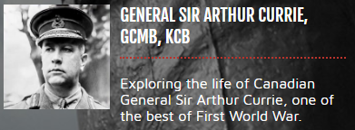
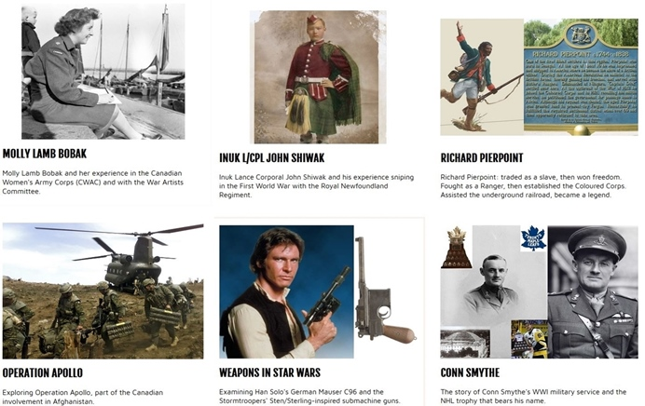
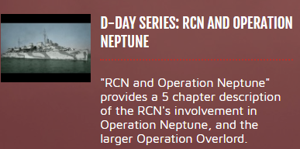
Valour Canada:
Valour Canada has almost 40 years of experience delivering military history education programs in museums and classrooms.
Educational documentaries (190+ short videos)
Online military history library (290+ youth-accessible articles)

Slide 5
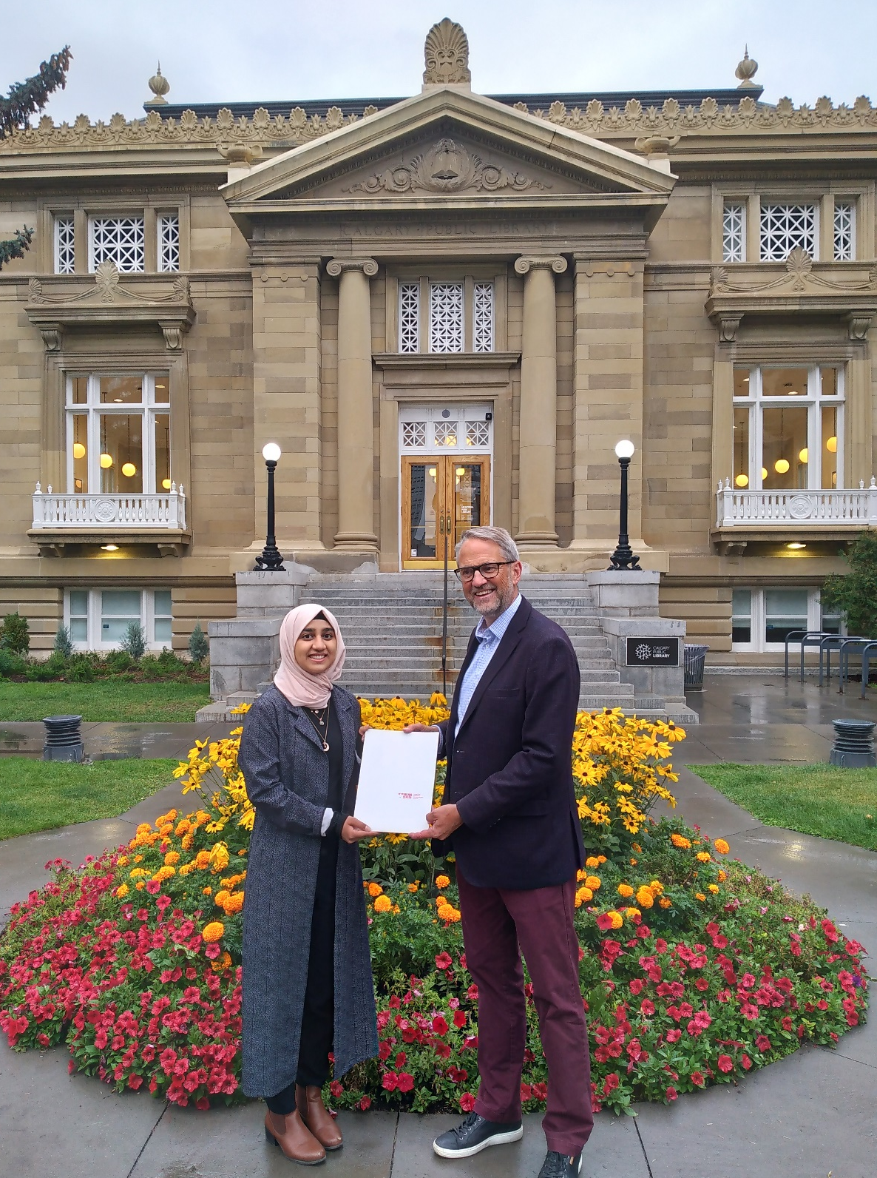
Valour Canada:
Juno Beach VR
Plus 10 other virtual tours
History and Heritage Scholarship
Annual; Contest ends in mid-June:
$2,000 1st place, $500 2nd place
Task: Create a 4 - 6 minute YouTube video
Girl Guides
Canadian Women of Valour Program
Speaker Series
2025 highlight: Historian Tim Cook
www.ValourCanada.ca/Education

Slide 6
Teaching about Military History & War
What do you find most challenging?
Take 3 minutes with your group and be prepared to share the 1 or 2 of the most challenging things when it comes to teaching about MH & war.
What should our overarching goal(s) be when teaching about MH & war?
Take another 3 minutes with your group and be prepared to share what your overarching goal(s) is/are.
I have 3 learning goals:
War is nasty; it’s the most serious thing a country can decide to do.
Citizens, members of the electorate, have a responsibility to vote.
Think for yourself (Do your due diligence and beware of propaganda).

Slide 7
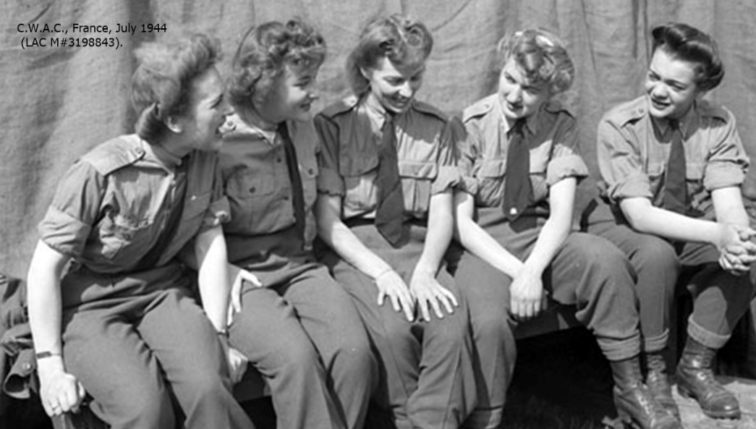
Some Common Challenges when Educating Youth:
Pedagogical Approach:
Most youth have/are:
- short attention span - little interest in the topic - restless when immobile
- want to socialize - dislike “traditional” learning methods, etc.
Therefore, to best ensure successful learning the program should be:
Social and collaborative
Real experience
Flexible
Active
Local links
FUN !
“Experiential” Learning
with Problem Solving and Critical Thought

Slide 8
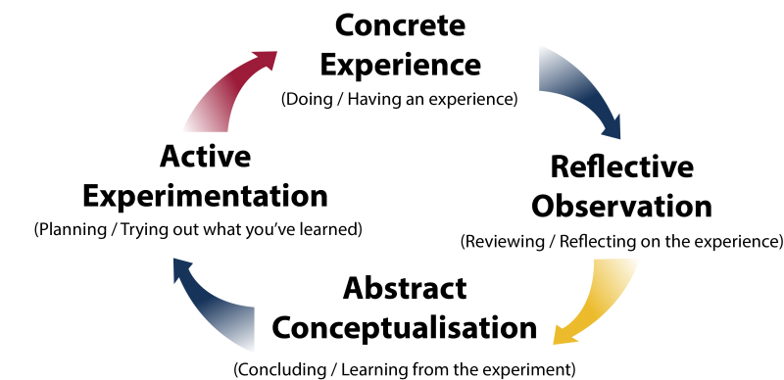
Experiential Learning: (i.e. Kolb)
We create and/or provide
Student’s day-to-day
We facilitate
Student’s Personal Takeaways
Credit: www.QueensU.ca/
ExperientialLearningHub

Slide 9
Experiential Learning:
How do I create a situated learning environment in the classroom?
Design and present activities:
- that require students to work together to solve a problem
- that are adaptable (scaffolding can be integrated) to different audiences so that learning is better ensured
- that are primarily run by the learners i.e., the “instructor” is a facilitator of learning rather than a presenter of information
- where the learners have an opportunity to debrief what they’ve just done (i.e., students have time to discuss, reflect, evaluate, and validate what they’ve produced solution-wise AND the process and experience they just went through)

Slide 10
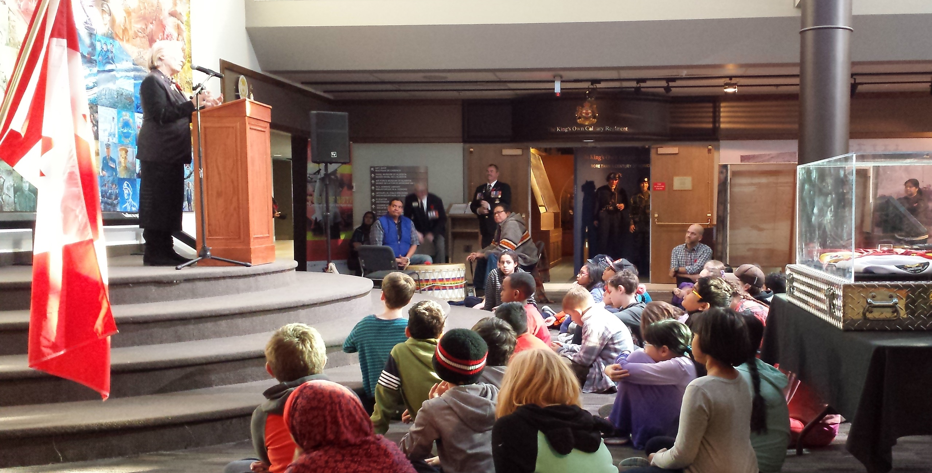
The Character of our Canadian Military History Program
A Grade 5 class experiencing the CCMH program at The Military Museum.

Slide 11
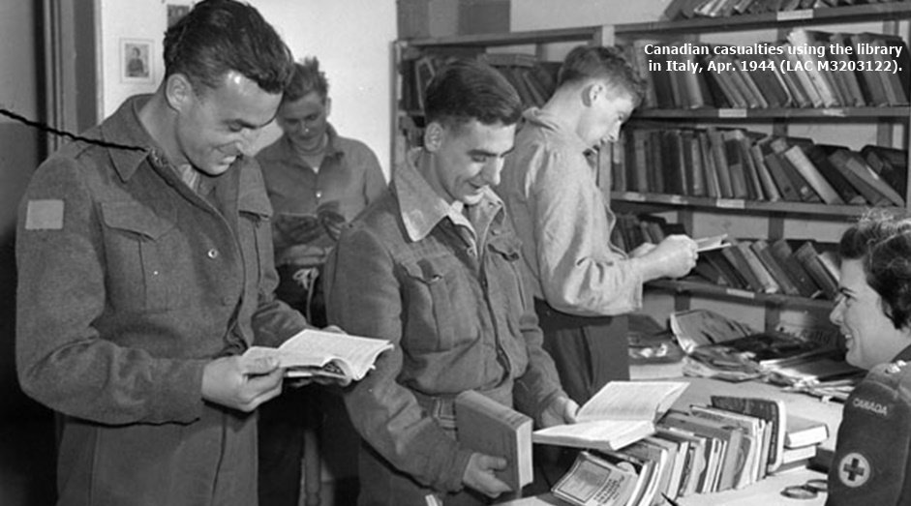
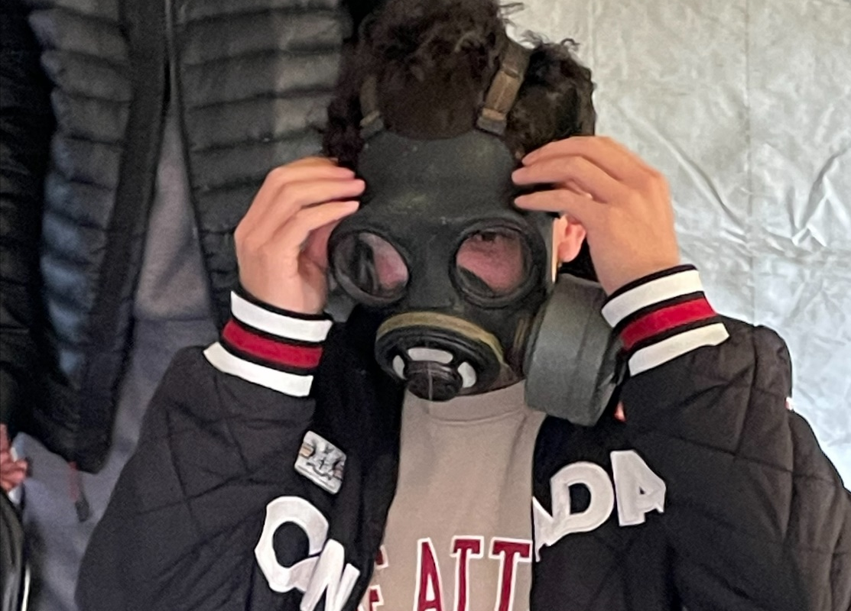
The Character of our Canadian Military History Program
What is it? A set of educational modules with curricular connections that present pieces of Canadian military history.
The program ties 3 important things together:
Canadian Military History • Group & cooperative learning • Character (Life Skills)
A series of interchangeable modules, each consisting of 3 basic parts:
1. History (15 min) 2. Activity/challenge (20 min) 3. Debrief (5 min)

Slide 12
General Curricular Connections:
Benchmark Skills and Processes: All Activities
Dimensions of Thinking
- Critical Thinking - Historical Thinking
- Geographic Thinking - Decision Making & Problem Solving
Social Participation as Democratic Practice
- Cooperation, Conflict Resolution, and Consensus Building
- Social Involvement as Responsible Citizens
Research for Deliberative Inquiry
- Apply the Research Process
Communication
- Oral, Written, and
Visual Skills
Communication Courage
Cooperation Responsibility
Resilience Thoughtfulness

Slide 13
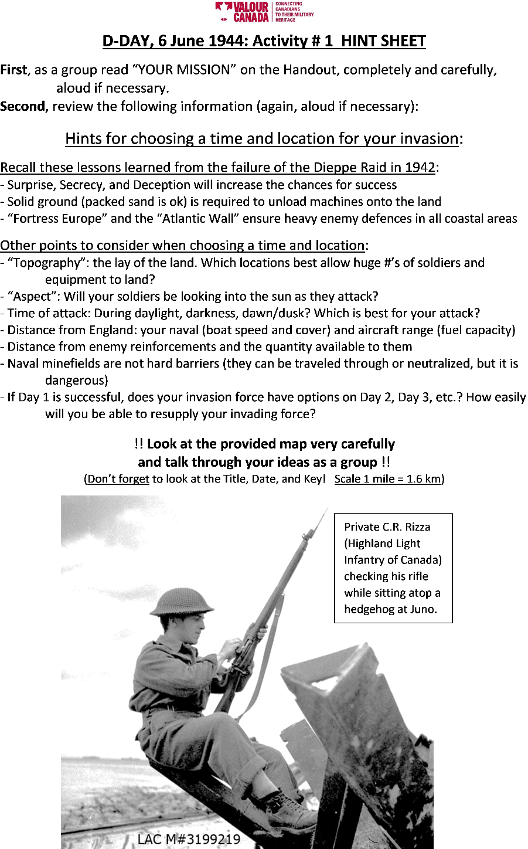
Resources,
CCMH Modules
&
Specific Curricular Connections

Slide 14
Article Library
Curriculum links:
Dependent on Social Studies grade & topic, e.g., Red Ensign, North-West Resistances, War of 1812, Fenian Raids, Louis Riel, Laura Secord, Plains of Abraham, Isaac Brock, Queenston Heights, etc.

Slide 15
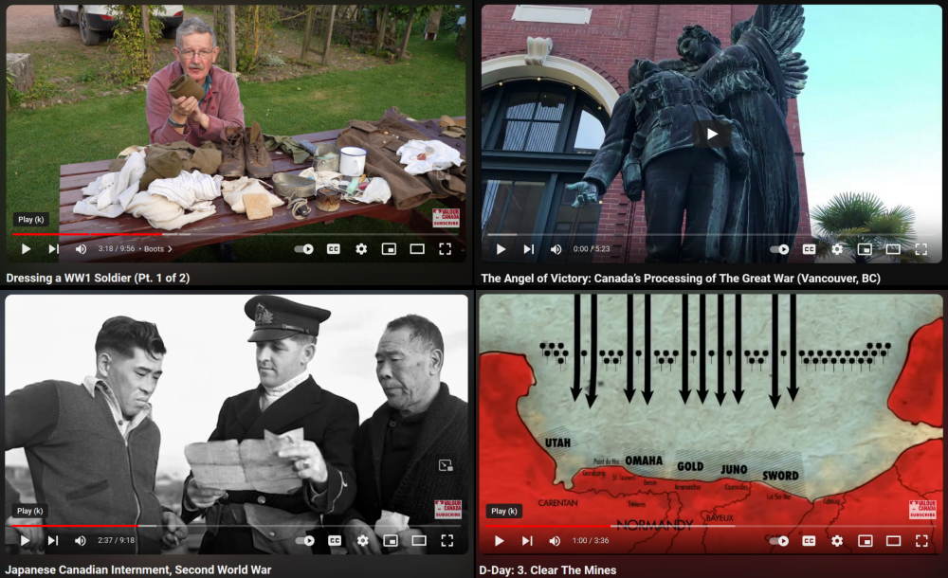
Documentary Videos
Curriculum links:
Dependent on Social Studies grade & topic, e.g., Tecumseh, Dieppe, D-Day, Vimy Ridge, Propaganda & War Posters, Trenches, CWAC, Chinese Labour Corps, Halifax Explosion, Victoria Cross Recipients, etc.

Slide 16
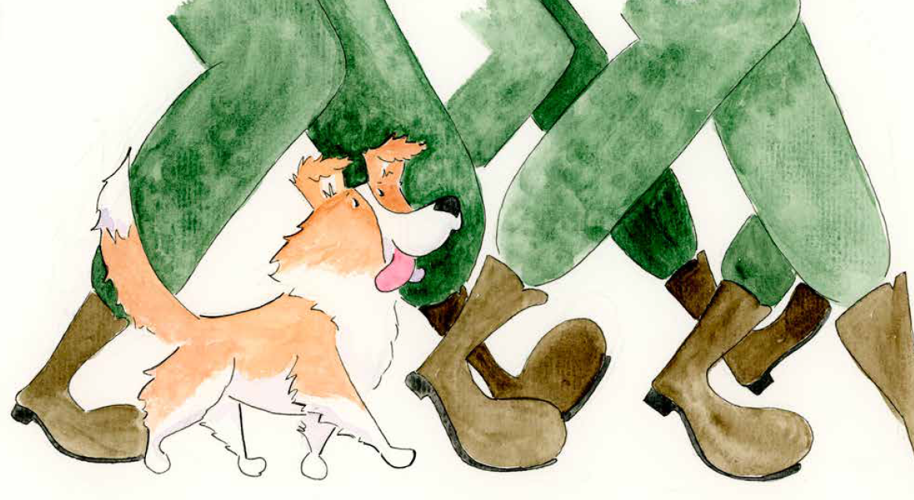
Whitey the Collie Dog’s Journey
Presentation:
• ELA & SS: K-1
• Collie Dog
• Fort Garry Horse Regiment
• WW2
Activity/task:
Nil, but I show Artifacts
Curriculum link:
K-1: ELA (Stories, Communication), SS (People, Places, Community)

Slide 17
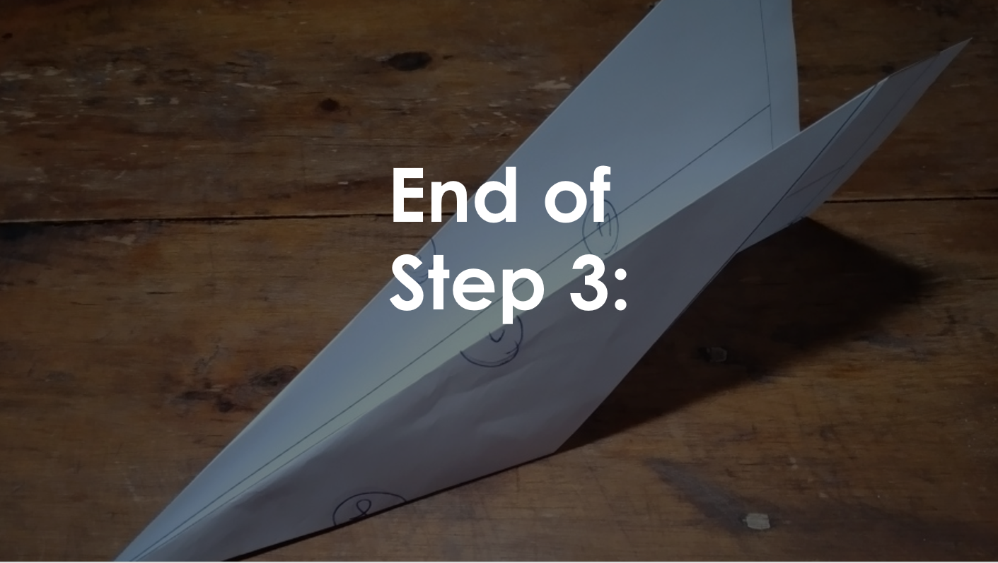
4 Forces of Flight
Presentation:
• Science 1 & 3
• Forces & Matter
• Cause & Effect
Activity/task:
Make a paper airplane, then test it
Curriculum link:
Gr. 1,3: Matter & Energy: Properties, Movement, Forces

Slide 18
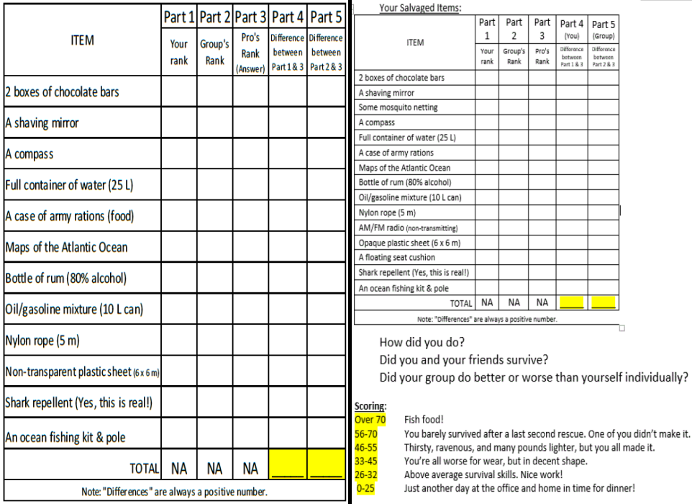
The Sinking of Llandovery Castle
Presentation:
• Social 4 and up
• WW1 context
• Rules of War
• Nursing Sisters
Activity/task:
Assess items for survival in a lifeboat
Curriculum link:
Gr. 4+: No specific grade, but the best fit is likely Gr. 7

Slide 19
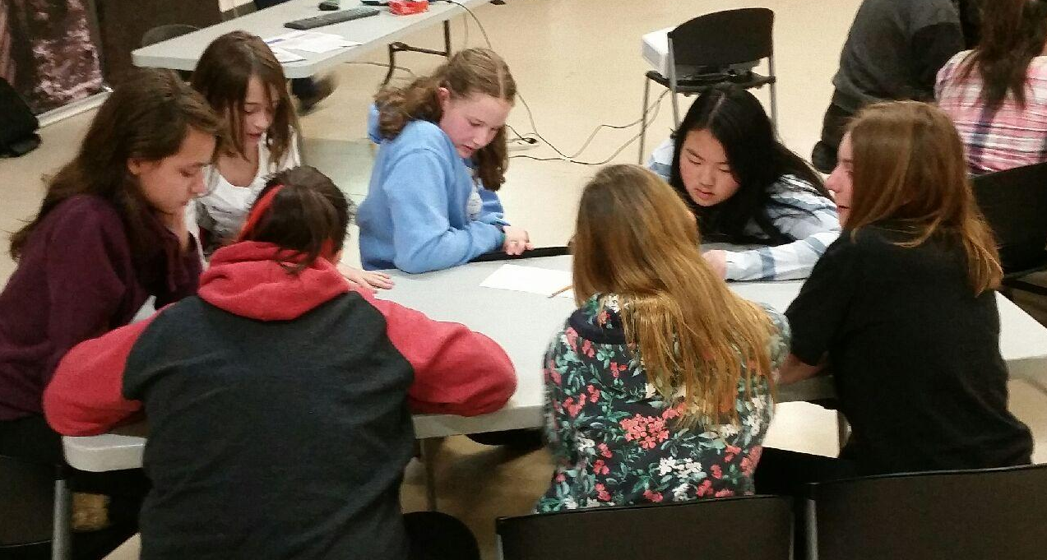
A Grade 8 class experiencing the CCMH program two years ago.

Slide 20
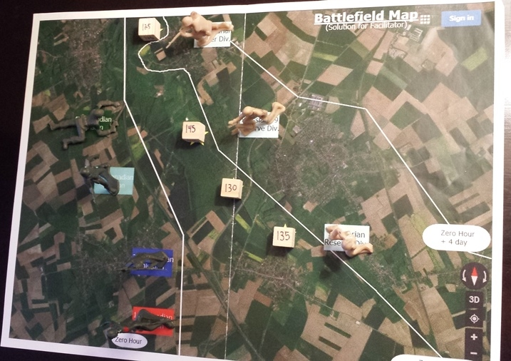
The Battle of Vimy Ridge
Presentation:
• Social 4 and up
• WW1 context
• Preparation
• Technological
Change
Activity/task:
Duplicate the positions on the battlefield
Curriculum link:
Gr. 7 & 8: WW1, Nationalism

Slide 21
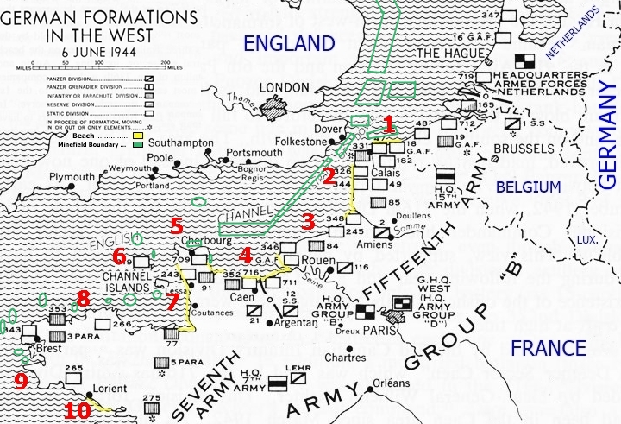
D-Day: Operation NEPTUNE
Presentation:
• Social 8 and up
• WW2
• Dieppe
• Atlantic Wall
Activity/task:
Where will your group attempt an invasion?
Curriculum link:
Gr. 8 & 9: Nationalism & WW2

Slide 22
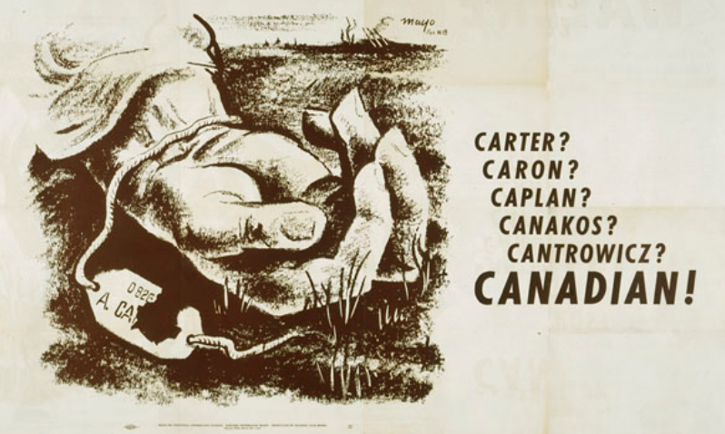
Propaganda: Using War Posters to Develop Critical Thinking
Presentation:
• Social 5 and up
• WW1 & 2 Posters
• Propaganda Devices
• Media Literacy
Activity/task:
Different options
Curriculum link:
Gr. 5 and up: Media Literacy, WW1 & WW2

Slide 23
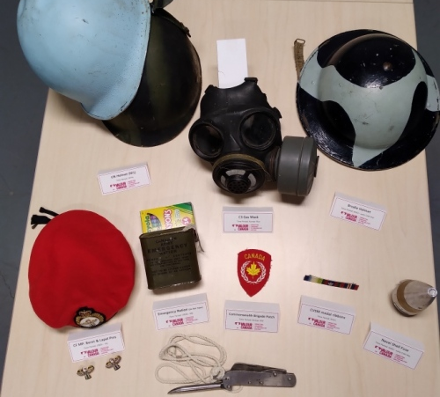
Artifact Handling
Presentation:
• All grades
• All conflicts
• Technological change through time
Activity/task:
Show & tell style; other
Curriculum link:
All grades: Dependent on artifacts and teacher

Slide 24
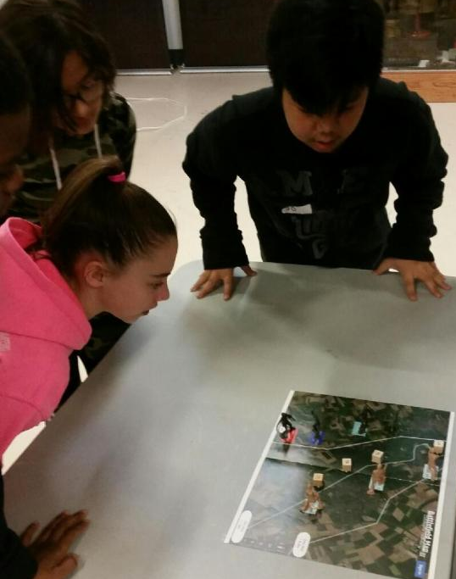
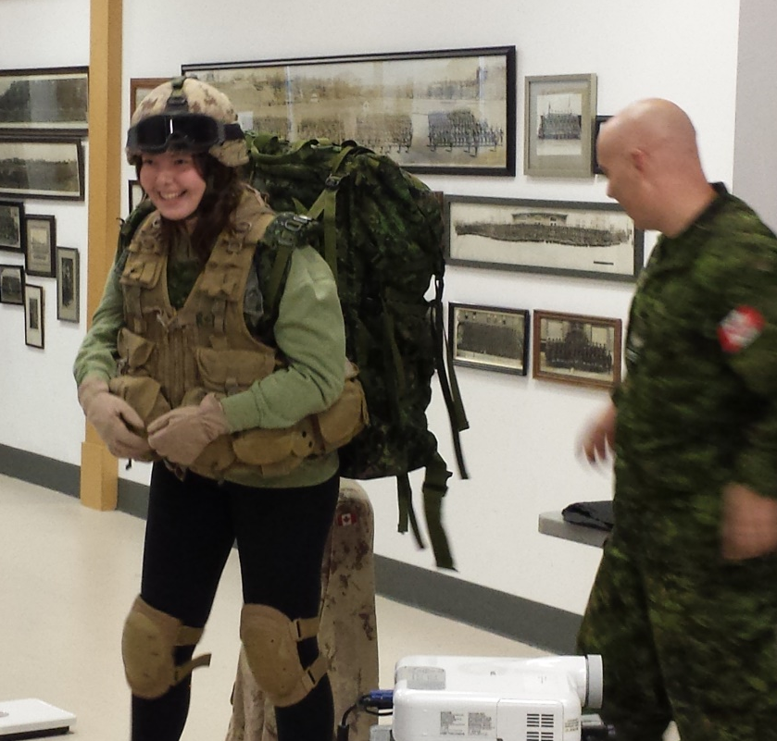
The Character of our Canadian Military History Program

Slide 25
The Character of our Canadian Military History Program
Survey Results and Feedback Received:
F.S.- Most memorable thing I learned:
“shorter, more portly men make better pilot” [sic]
P.R.- It was very fun and interesting - best field trip ever
K.D.- Favorite part of the day:
“watching Kyra put on military gear + learning about the equip used in war.”
D.M.- Most memorable thing I learned: "Too many things”
J.H.- This was a really fun field trip and I like it more than the boring zoo. [sic]
E.D.- Am new to Canada i learnt alot today [sic]
N.L.- Thank you for an amazing day.

Slide 26
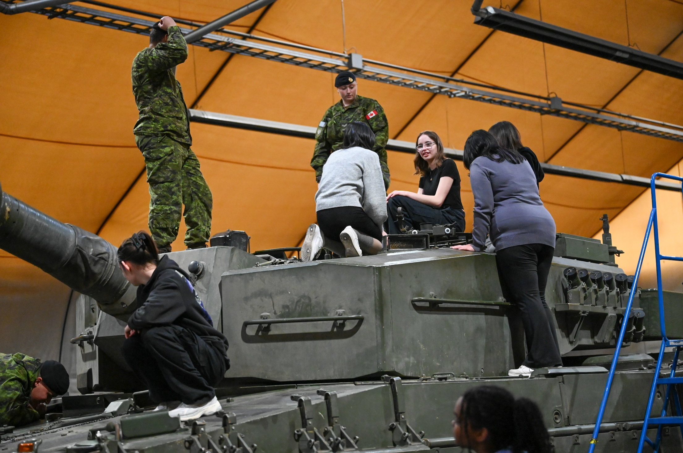
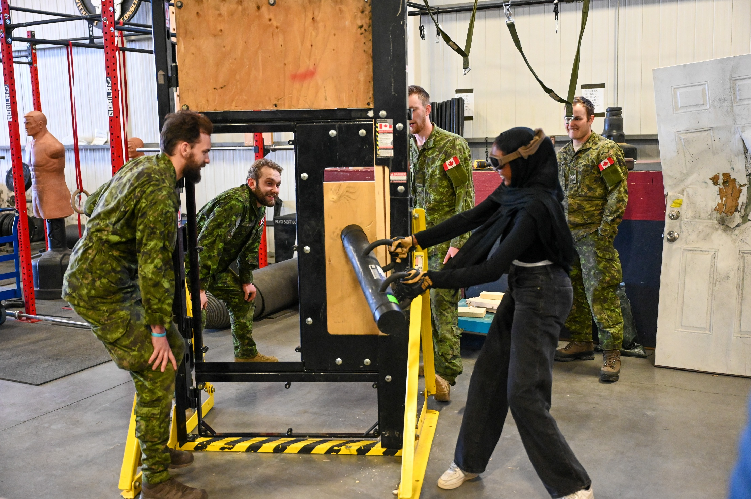
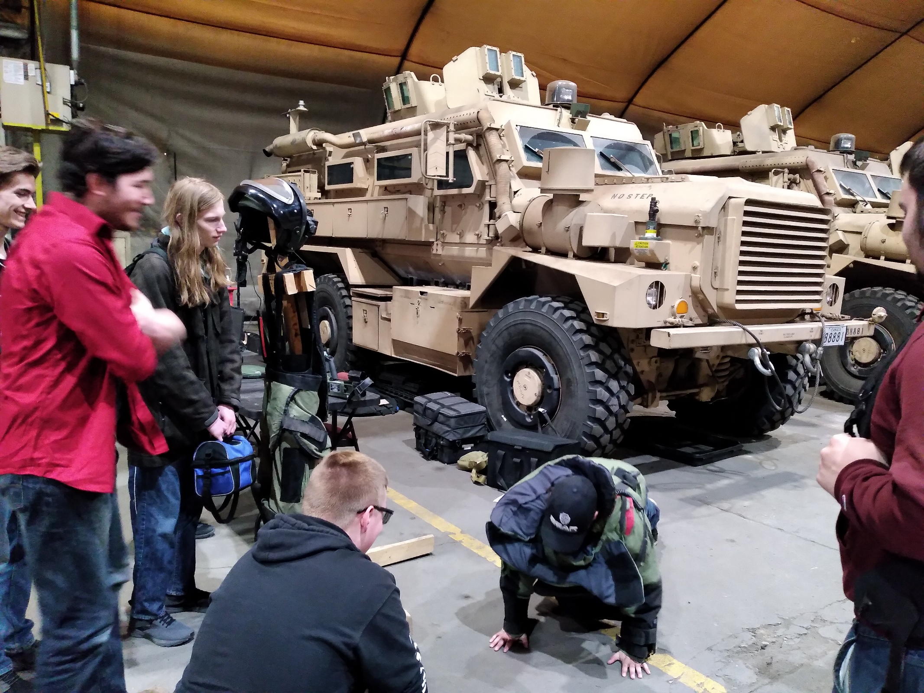
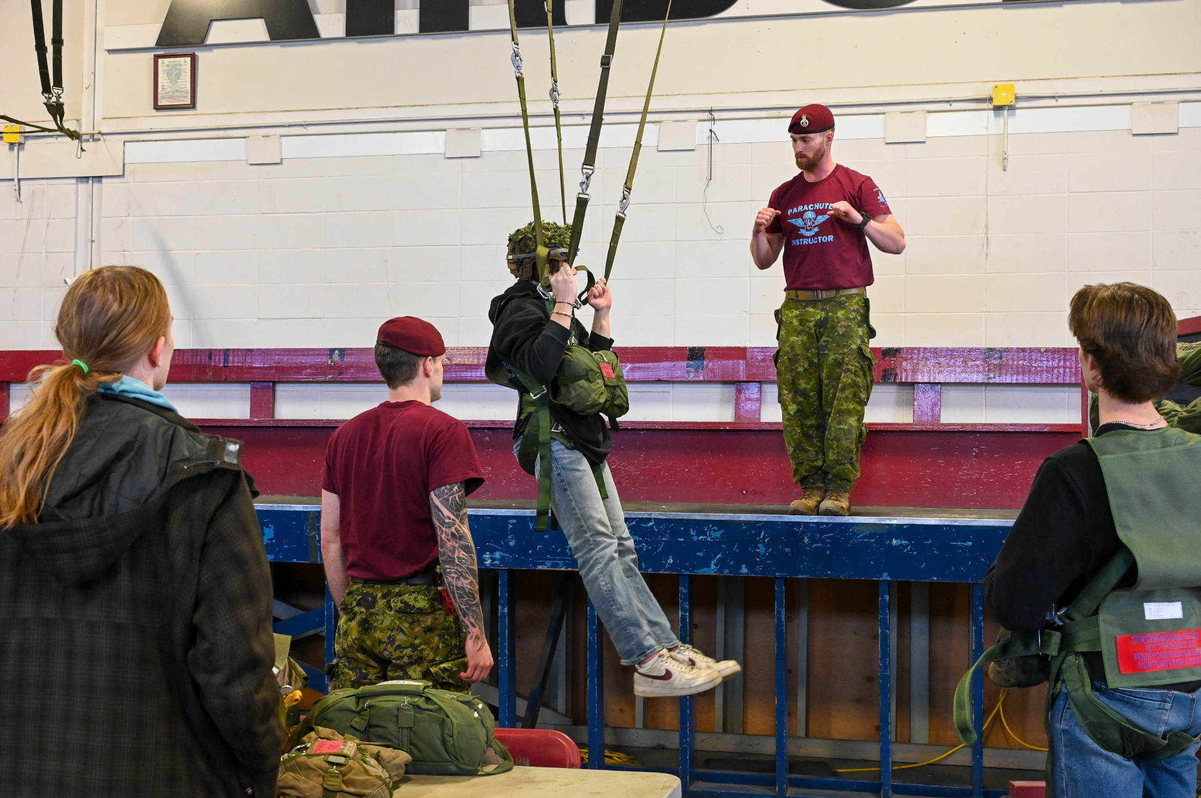
Field Trip to CFB Edmonton
Experience:
• High School
only (so far)
• Hands-on
• Interact with soldiers
Activities:
• Door breaching
• Para training
• Tank targeting

Slide 27
Questions?
Download the modules (Ppt, handouts, etc.) for free at:
https://valourcanada.ca/education/in-museum/#CCMH
Valour Canada’s Website: www.ValourCanada.ca
Aaron’s email address: aaron.curtis@valourcanada.ca
- Thank you -

Slide 28
Additional Resources
Website: www.ValourCanada.ca
For Lesson Plans, Draft Remembrance Day Programs, Educational Video series, Scholarship Information, Other Programs, visit: https://valourcanada.ca/education/
Diversity & Inclusivity themed materials, visit: https://valourcanada.ca/education/classroom-resources/diversity-inclusivity/
For our YouTube channel, visit: https://www.youtube.com/user/canadianvalour
For our Social Media, visit:
https://valourcanada.ca/education/websites-and-social-media/

