Slide 1
The Battle of Vimy Ridge
First World War. Northern France, April 9 – 12, 1917.
Canada’s flag in 1917: Canadian Red Ensign.
Notes:
= Point out that this is the Canadian Flag during the First World War: the Red Ensign.
Note (1) the Royal Union Flag (UK) in canton (top left quarter) that demarcates Canada as a dominion, and
(2) the badge/shield with portions representing the provinces (clockwise from top left: Ontario, Quebec, New Brunswick, Nova Scotia).

Slide 2
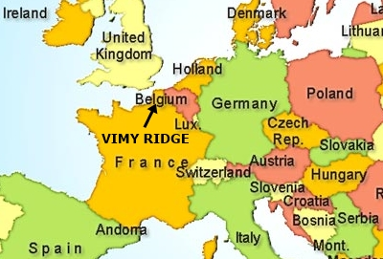
Vimy’s Importance:
1- It was the first battle in which all 4 Canadian Divisions together attacked the enemy on the same battlefield (60,000 men at the front line).
2- It was a success.
3- It is considered by some as the “birth” of Canada.
“I thought then that in those few minutes I witnessed the birth of a nation.”
Canadian Brigadier General A.E. Ross
But he was quoted in 1967!
Notes:
Notes:
= (1) There were more than 100,000 Cdns at Vimy, 60,000 of them were at the front line. The other thousands were maintaining the fighting soldiers (e.g. cooks, work battalions, nurses, doctors, horse minders, miners, etc.)
= (2) Countries generally remember victories long before losses.
= (3) There was a definite burst of Nationalism during WW1. E.g. there were tunnels at Vimy that the Cdns used to house people and supplies. During their time underground, the soldiers often carved maple leaves in the chalk rock walls. It appears that many thought that ‘Canada’ as a country might have some legs.
= Vimy’s location is just above the tip of the arrow. Paris’ location is halfway on arrow stem.
= Don’t forget that the British and the French had been fighting the Germans on the ridge for the years prior to our arrival in late 1916.
= (Optional) Illustrate opening of WW1 (Schieffen Plan) and subsequent trench/static warfare. Presenter can expand on this and discuss the differences between WW1 and WW2 in terms of Germany’s attack into France.

Slide 3
Context:
In 1917, Britain and France needed a breakthrough.
Sketched by Walter M. Draycott, PPCLI.
Vimy Ridge was a strong German position in the Arras area. The German army had repelled multiple large-scale attacks from the British and French forces during the preceding years.
Notes:
Compare sketch (this slide) with photo on next slide. We are looking east/northeast.
= Draycott was a PPCLI soldier who was at Vimy.
= Note that it wasn’t a very high ridge, but it was the highest position in the region. Cdn soldiers had to gain 10-20 metres to reach the top points on the ridge, but, on the backside, the drop in elevation is quite significant (50-80 metres).
= Ask the participants why defending from high ground is advantageous – 3 reasons: sightlines, difficult for enemy (aka Cdns) to attack uphill, after rain trenches can be drained into the enemy’s (aka Cdns) position.

Slide 4
Vimy Ridge Today:
Notes:
Compare this photo with Draycott’s sketch on the previous slide. We are looking east/northeast.
= Point out that the fence line in the photo is likely the foreground tree-line in the sketch.
Ask the participants if anything in the picture doesn’t belong (Vimy Monument, just left of centre), then explain that the monument was built on the highest point on the ridge, Hill 145 (m.a.s.l.) in the late 20s and early 30s.

Slide 5
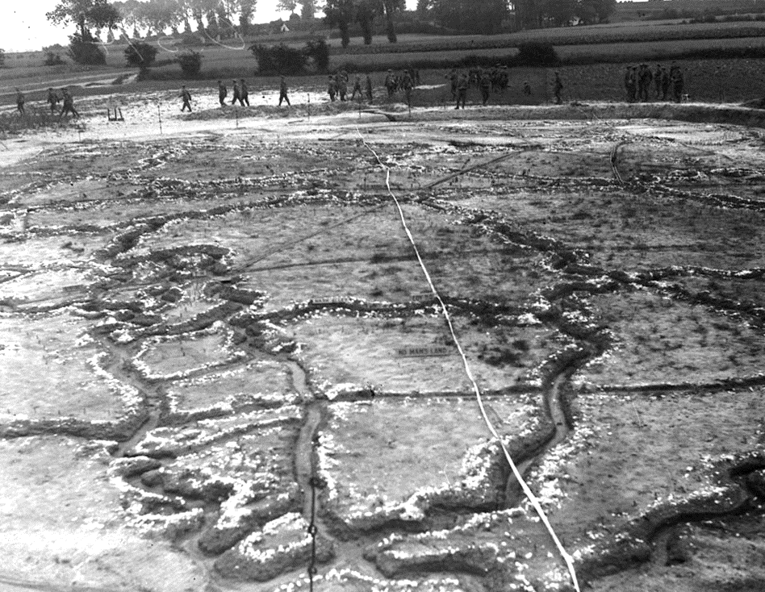
Preparation:
The soldiers received specialized training (bomb throwing, bayonet combat, marksmanship), learned platoon tactics, and practiced timing their movement in coordination
with the creeping
barrage.
Drilling and practice occurred in the days and weeks before the battle.
A replica of the battlefield complete with German trenches and known strong points was used.
Notes:
= Prior to the battle the Cdns practiced and prepared to ensure a better chance of success (platoon tactics, creeping barrage, tunnels to protect and move soldiers to the front line).
(There are many different sidebars to talk about on this slide).

Slide 6
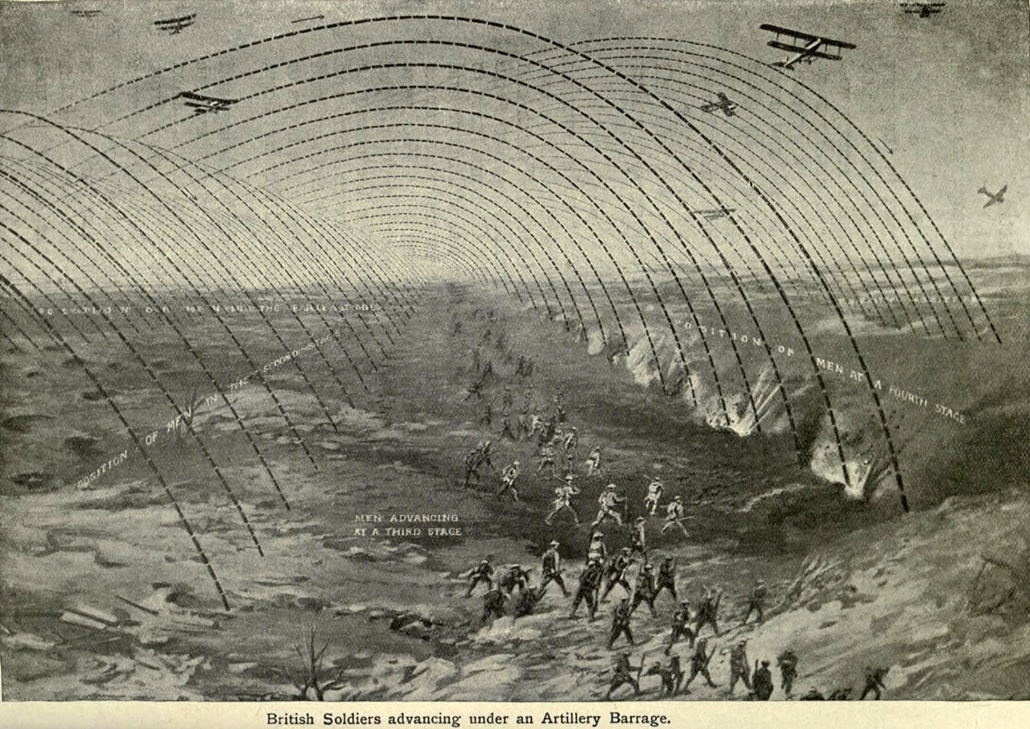
The Creeping Barrage:
Artillery guns firing at Vimy.
Notes:
= Explain that ‘artillery’ is just a fancy name for a cannon and that these guns (you have more than 1,000) fire shells that explode when they hit the ground.
= Describe how the creeping barrage works and its purpose (to provide a protective shield for advancing infantry).
= Ask the participants what happens if the attacking infantry is too fast (friendly-fire deaths) or too slow (sitting ducks in No-Man’s Land)

Slide 7
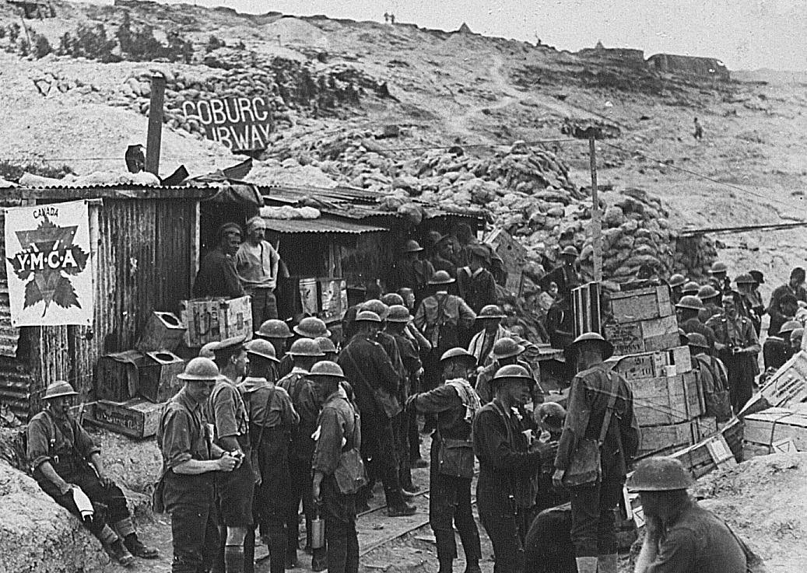
The Underground City
The YMCA outside of the Coburg Tunnel.
Tunnels were expanded so the Canadians could safely and secretly move 1000’s of men closer to the Germans than was possible on the surface.
There were more than 10 major tunnels at Vimy!
Notes:
= Note that the tunnels existed since medieval times. The British, French, and then the Cdns improved and expanded them while they were at Vimy.
A few of the tunnels were either very long or very deep. Each gave the attackers some big advantages: a covered/protected route to the front-line, a safe area to store materials, people, ammo, etc.

Slide 8
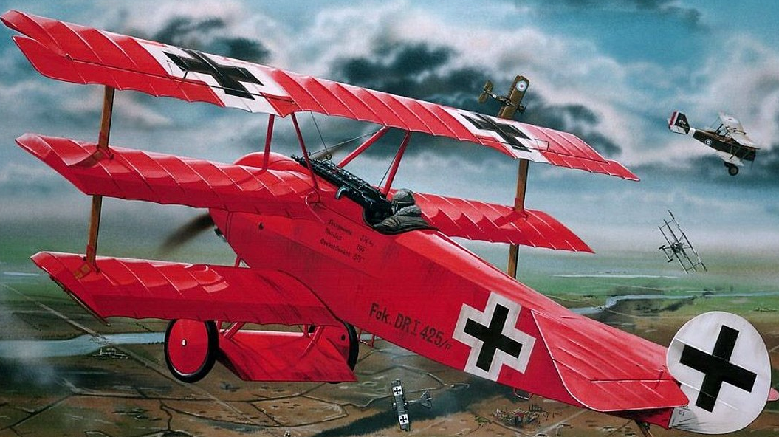
War above Vimy: Scouting the Battlefield
At this point in the war, the Entente’s air forces were beginning to get the upper hand on the Germans.
The Royal Flying Corps successfully performed aerial reconnaissance (aka scouting) above Vimy, losing 131 aircraft during April’s first week!
Germany’s von Richthofen in the air over Vimy.
Pilots in the First World War had a life expectancy of 3-4 weeks !
Notes:
= Describe aerial recce and combat during WW1 – there are many sidebars one can talk about here: Red Baron,, development of flight technology throughout the war).
= Stress a pilot’s low life expectancy in WW1 due to aerial technology being very new and unreliable (Fokker’s 1916 invention of a timing gear allowing the machine gun to fire between the spinning prop blades).

Slide 9
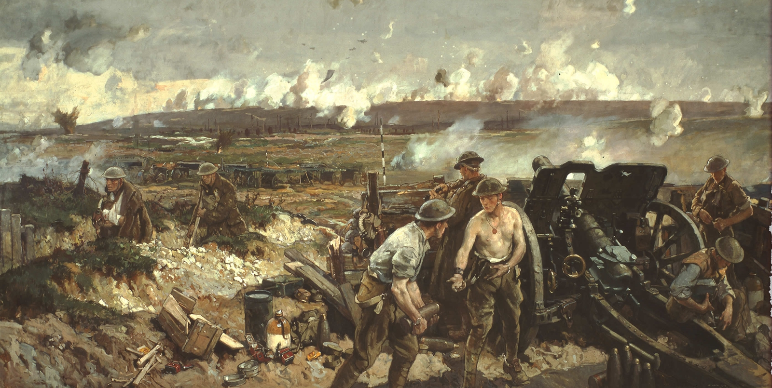
Zero Hour:
At 5:30 AM, April 9, 1917, the attack commenced.
Within 48 hours, the ridge was in Canadian hands.
Notes:
= Artist Richard Jack’s “The Taking of Vimy Ridge, Easter Monday 1917” : Point out the tunnel entrance, wounded soldiers, rum ration, the ridge, light rail, etc.
= Note the attack commencement first thing in the morning.

Slide 10
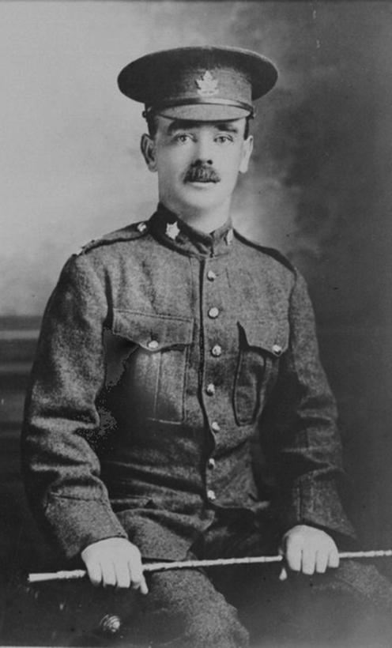
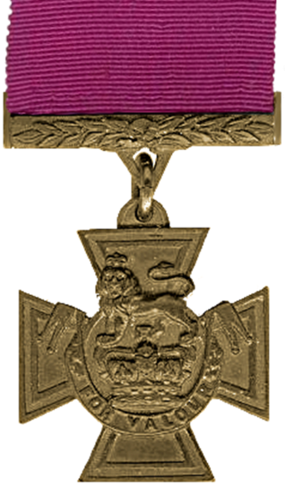
Victoria Crosses at Vimy
Awarded for acts of valour
“in the face of the enemy”.
4 men at Vimy were decorated
for their heroism.
Pte. William Milne, Moose Jaw, SK
Sgt. Ellis Sifton, Wallacetown, ON
Maj. Thain MacDowell, Brockville, ON
Pte. John Pattison, Calgary, AB
On day 2 at “Hill 145” his unit was held up by withering machine gun fire. He jumped shell hole to shell hole, then bombed + bayoneted the machine gunners, and taking their position.
Notes:
SLIDE 1 of the 4 Vimy VC winners. (the other three are at the end of this slideshow)
= Tell his VC story, while acting it out (Pattison jumping from shell hole to shell hole) -> always reengages the audience.
Other options: denied first attempt to enlist because he was too short (5’2”); he enlisted in order to ensure his son came home safely; etc.
Pattison was hit by an exploding shell a few months after Vimy and his body was never recovered.

Slide 11
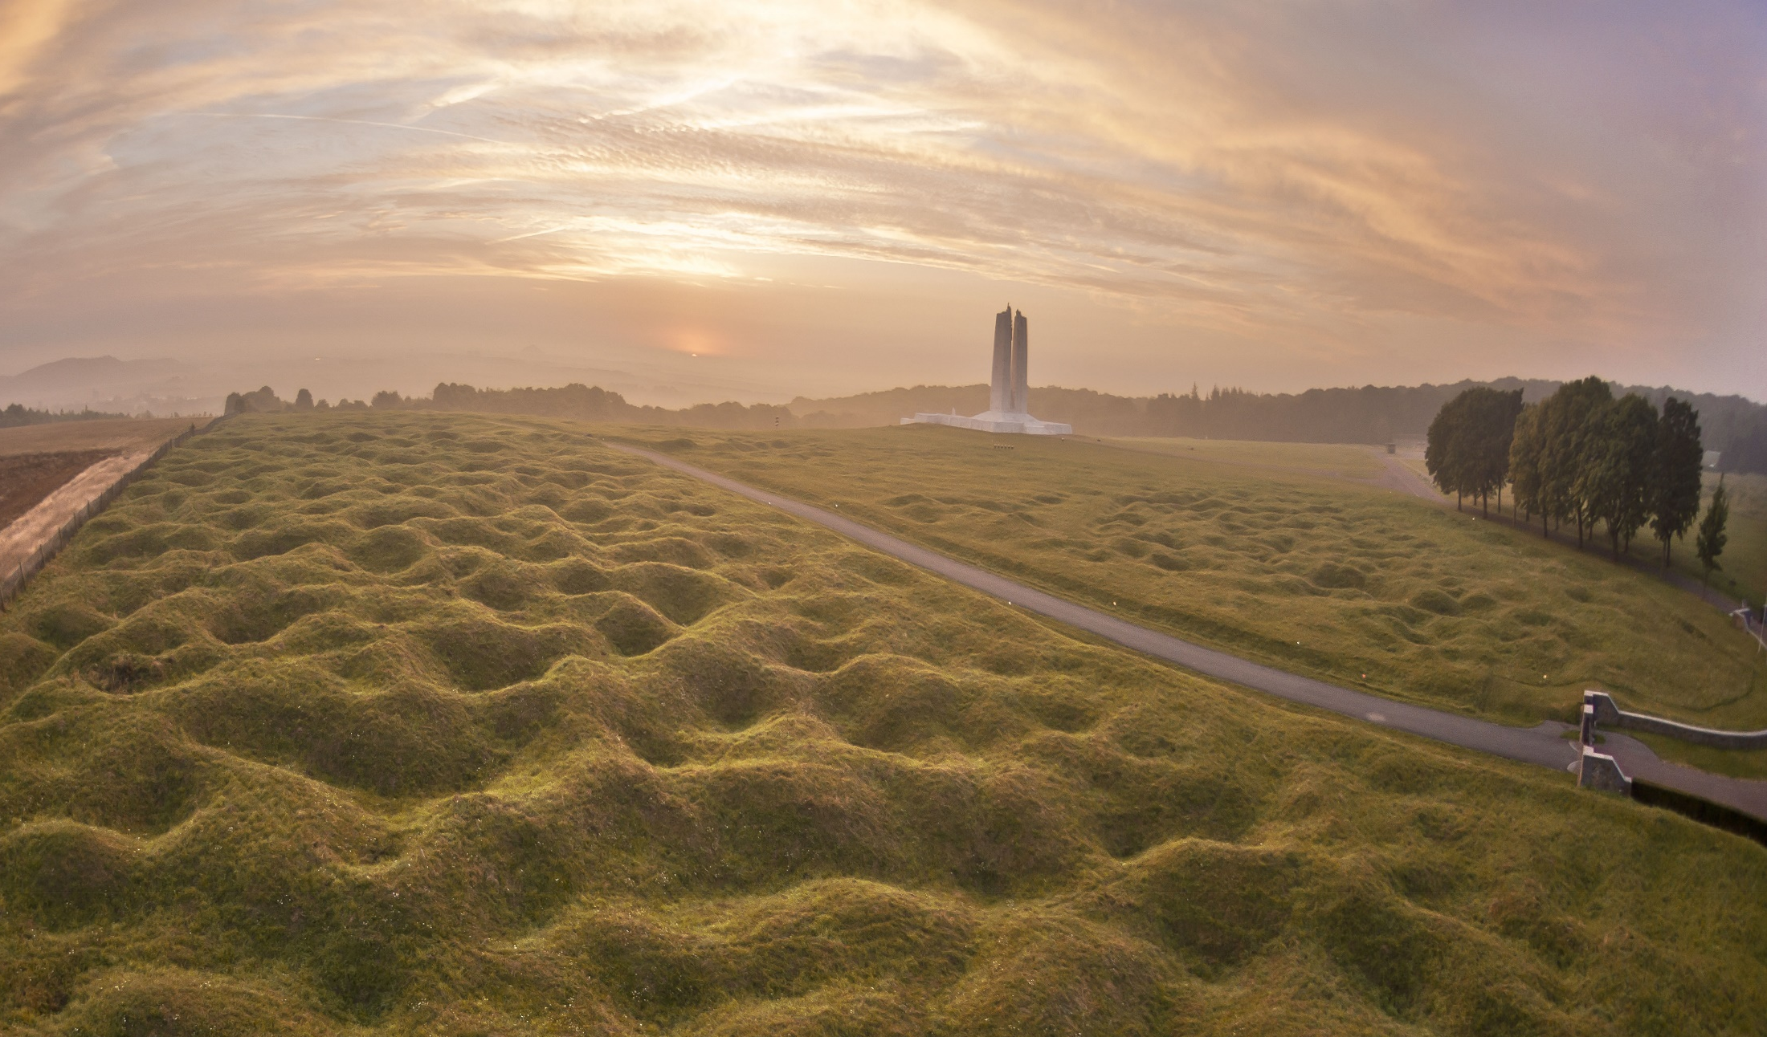
Shell holes at Vimy
Notes:
= Note the Vimy shell holes after 100 years of erosion. Point out that the farmer’s field (far left) would have been identical but has been plowed over and over for 100 yrs.
= Sheep and goats cut the grass because of unexploded shells still in the ground. French farmers are still hitting old shells and exploding (Legacy of War).

Slide 12
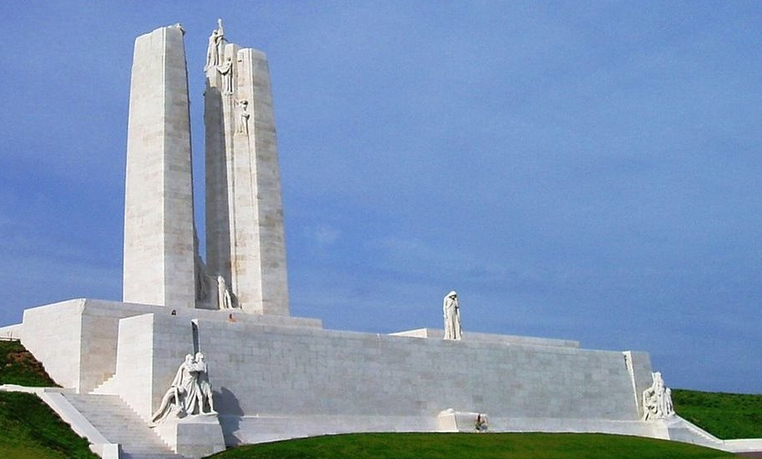
The Cost:
3598 Canadian soldiers died.
That is one every second in an hour (60 min x 60 sec).
There were over 10 000 Canadian casualties.
Notes:
= Note that each sculpture on the monument has a story/meaning. Urge students to go online and do their own research. Entice them with a description of the central Mother Canada who mourns the loss of her sons.
= Around the base of the monument are the names of almost 11,300 Cdns who lost their lives in France and have no known grave.
= Walter Allward designed the monument.

Slide 13
Questions ?
Notes:
0

Slide 14
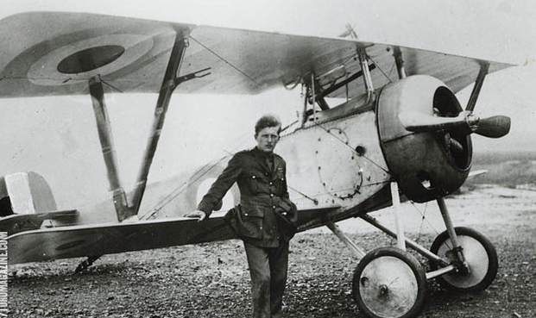
Canada’s FWW
flying ace:
B_ _ _ _
B_ _ _ _ _
Battlefield Reconnaissance
Your Activity
Goal: to duplicate the placements of soldiers and strongpoints at Vimy.
Notes:
= Who is shown in the picture? (Billy Bishop)

Slide 15
Battlefield Reconnaissance
Each group will have:
• 1 all-time Mapper at HQ (Headquarters)
• 3 - 5 Reconnaissance Pilots
Roles:
• Pilots fly one at a time and have 20 sec to study the battlefield and then 20 sec to describe it to the Mapper.
• The Mapper must wait until the pilot’s directions are finished, then they have 60 seconds to arrange the items as described.
REMEMBER- NO POINTING, NO PHONES !!
Notes:
Activity Instructions, Rules, and Roles: (12-15 min)
1. Explain to the groups, now named a “Corps”, that there are 2 roles in this activity. Each Corps must select only one “Headquarters (HQ) Mapper” who will place their group’s objects/blocks on the “3. Blank Map” at the direction of the “Reconnaissance Pilots” (the remaining group members). Explain that the “Pilots” of each Corps act individually, so they should order themselves to “Fly” first, second, third, and so on. PILOTS ARE NOT ALLOWED TO POINT WHEN DIRECTING THE MAPPER! Hint: it’s a good idea to ask the Mappers to raise their hand once selected by their group, that way you know when they’re ready to begin.
2. When all Corps are ready to begin the exercise, the facilitator calls up the first “Pilot”, from each Corps concurrently, to study the battlefield layout for 20 seconds.
3. Once the 20 seconds has expired, the “Pilot” has another 45 seconds to return to their Corps’ HQ and to communicate to their respective “HQ Mapper” how to reproduce the facilitator’s battlefield layout while the “Mapper” arranges the items as directed. Only the pilot may talk to the Mapper at this time. The others must stay silent. ! REMEMBER: without pointing and without cell phones (pictures)!
4. After each arranging attempt, the facilitator checks each HQ’s map. If any Corps’ map has the correct arrangement of all items, that Corps wins, but if all HQ’s maps remain incorrect, the second “pilot” of each Corps “flies” up to study the Facilitator’s battlefield for another 20 seconds… and the cycle continues (with individual pilots flying timed sorties over the battlefield and then reporting their findings) until a winner has been declared.
5. Once a winner has been declared, project the solution using the PowerPoint slideshow.

Slide 16
Solution:
Notes:
0

Slide 17
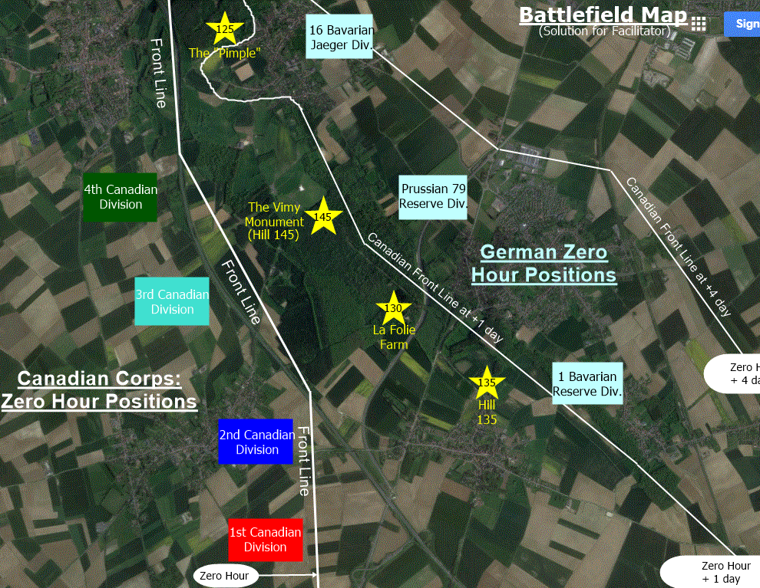
Notes:
= Talk through the solution as shown on the slide.

Slide 18
Describe any communication challenges experienced by the pilots and/or the mapper.
How could those challenges be avoided?
Which character traits were most important for the mapper or pilot to possess?
What tools could a team use in order to better ensure success for the operation?
Debrief
Notes:
= Debrief
Debrief Key Idea 1: Battlefield Reconnaissance
Build understanding of the learning process experienced by the Canadian Corps in WW1: Explain to the participants that new technologies that became prevalent in the FWW presented all belligerents with problems that had never been faced before. Consequently, the armies had to develop brand-new solutions to these challenges and many of these solutions were discovered through trial and error. In other words, the military men at all levels had to learn their way through the “fog” of war, much as you and your group just learned your way through that activity.
• Ask: Describe any communication challenges experienced by the pilots and/or the mapper and how could those challenges have been avoided?
• Ask: Which character traits were the most important for the mapper or the pilot to possess? <ALL TRAITS can be explored here>
• Ask: Which tools could be used to ensure better success for the operation? Participants might say language (e.g. Military Alphabet), math (e.g., map grid + coordinates), measuring tools (e.g. compass + ruler), photos (e.g., air photography), a process (e.g., complete part A, then B, then C, etc.), etc. <Thoughtfulness can be explored here>
Debrief Key Idea 2: Battlefield Reconnaissance
Make sure to communicate the gravity of the pilot situation to the participants: Explain to the pilots that they would have been doing this under rifle, machine gun, and artillery fire and that their life expectancy as a pilot was only a few weeks.
• Ask the students what might happen if there was a mistake on the map? What if they were the person that ordered a group of soldiers into an area thought to be clear but wasn’t, so your comrades walked into an ambush? How would you feel? How could you best prevent that from happening? What if you were ordered by a superior to take something that you thought would cost more than 10,000 of your men? (Insert Currie + Passchendaele sidebar if there’s time) <ALL TRAITS can be explored here>

Slide 19
Notes:
0

Slide 20
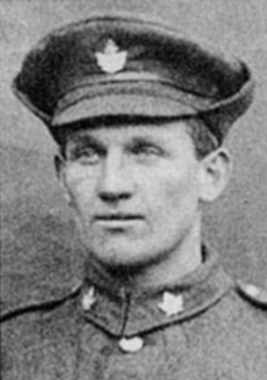
Victoria Crosses at Vimy
Awarded for acts of valour “in the face of the enemy”.
4 men at Vimy were decorated
for their heroism.
Pte. William Milne, Moose Jaw, SK
Pte. John Pattison, Calgary, AB
Maj. Thain MacDowell, Brockville, ON
Sgt. Ellis Sifton, Wallacetown, ON
With his unit being held up by heavy machine gun fire he jumped into the enemy trench, overturned their gun, and bayoneted the enemy. Then he held off a counter attack by using his rifle like a club. His unit held the position, but Sifton was shot during the exchange and died later that day.
Notes:
Tell the story of Sifton’s actions.
= Sifton died later that day.

Slide 21
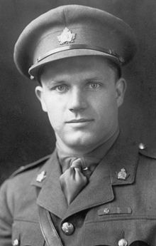
Victoria Crosses at Vimy
Awarded for acts of valour
“in the face of the enemy”.
4 men at Vimy were decorated
for their heroism.
Pte. William Milne, Moose Jaw, SK
Sgt. Ellis Sifton, Wallacetown, ON
Pte. John Pattison, Calgary, AB
Maj. Thain MacDowell, Brockville, ON
At the “Pimple”, he took a machine gun nest, descended into a deep dugout (55-step ladder), and took 75 prisoners! MacDowell survived the war.
Notes:
Tell the story of MacDowell’s actions
= MacDowell is the only Vimy VC winner who survived the war. He is buried in Brockville, ON.

Slide 22
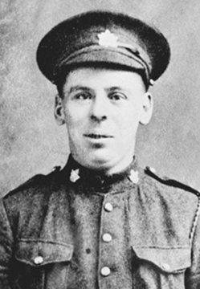
Victoria Crosses at Vimy
Awarded for acts of valour “in the face of the enemy”.
4 men at Vimy were decorated
for their heroism.
Maj. Thain MacDowell, Brockville, ON
Sgt. Ellis Sifton, Wallacetown, ON
Pte. John Pattison, Calgary, AB
Pte. William Milne, Moose Jaw, SK
Twice during the battle, after crawling on hands and knees, then throwing Mills bombs, Milne took machine gun nests. Shortly after taking the second, Milne was hit by fire. His body was never recovered.
Notes:
Tell the story of Milne’s actions.
= Milne did not survive.

