Slide 1
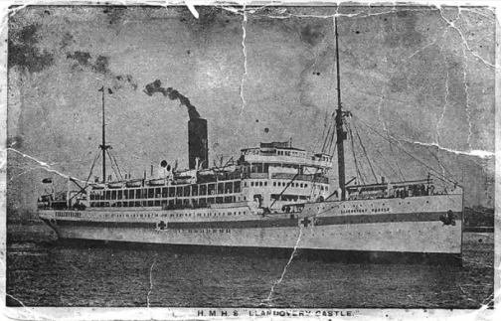
LLANDOVERY CASTLE
The Tragic Sinking of HMHS
Notes:
= Ask the students to identify what type of boat is shown.
HMHS Llandovery Castle is a passenger ship (a steam-powered ocean liner) converted into a hospital ship.
It has a crew of 258. Ninety-seven (97) of the crew were medical staff and 14 of the med staff were Nursing Sisters.

Slide 2
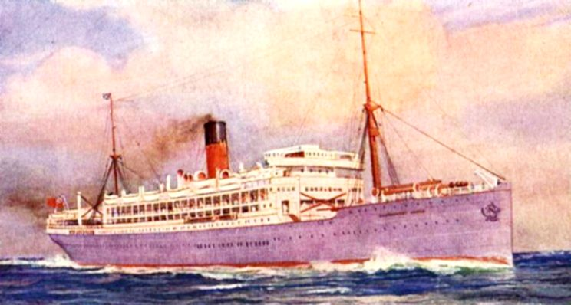
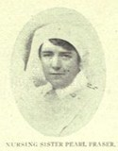
Hospital ships must have 3 things
The hull must be painted with Red Cross markings
They must not travel in a convoy (a group of ships)
It must have bright red and green lights on at night
Notes:
= Note the features that identify a Hospital Ship.
Rules of War: Hospital ships can’t be attacked because they hold non-combatants. Hospital ships are also not allowed to carry munitions or weapons. The enemy is permitted to stop, board, and search hospital ships to ensure that the rules are being followed.
= Llandovery had just dropped 600 wounded in Halifax and was heading back across the Atlantic Ocean to Britain.
= Portrait of Matron Fraser: What does Matron mean? She was the head nurse (boss) on the Llandovery.
can’t be attacked). (Llandovery had just dropped 600 wounded in Halifax and was heading back to Britain).

Slide 3
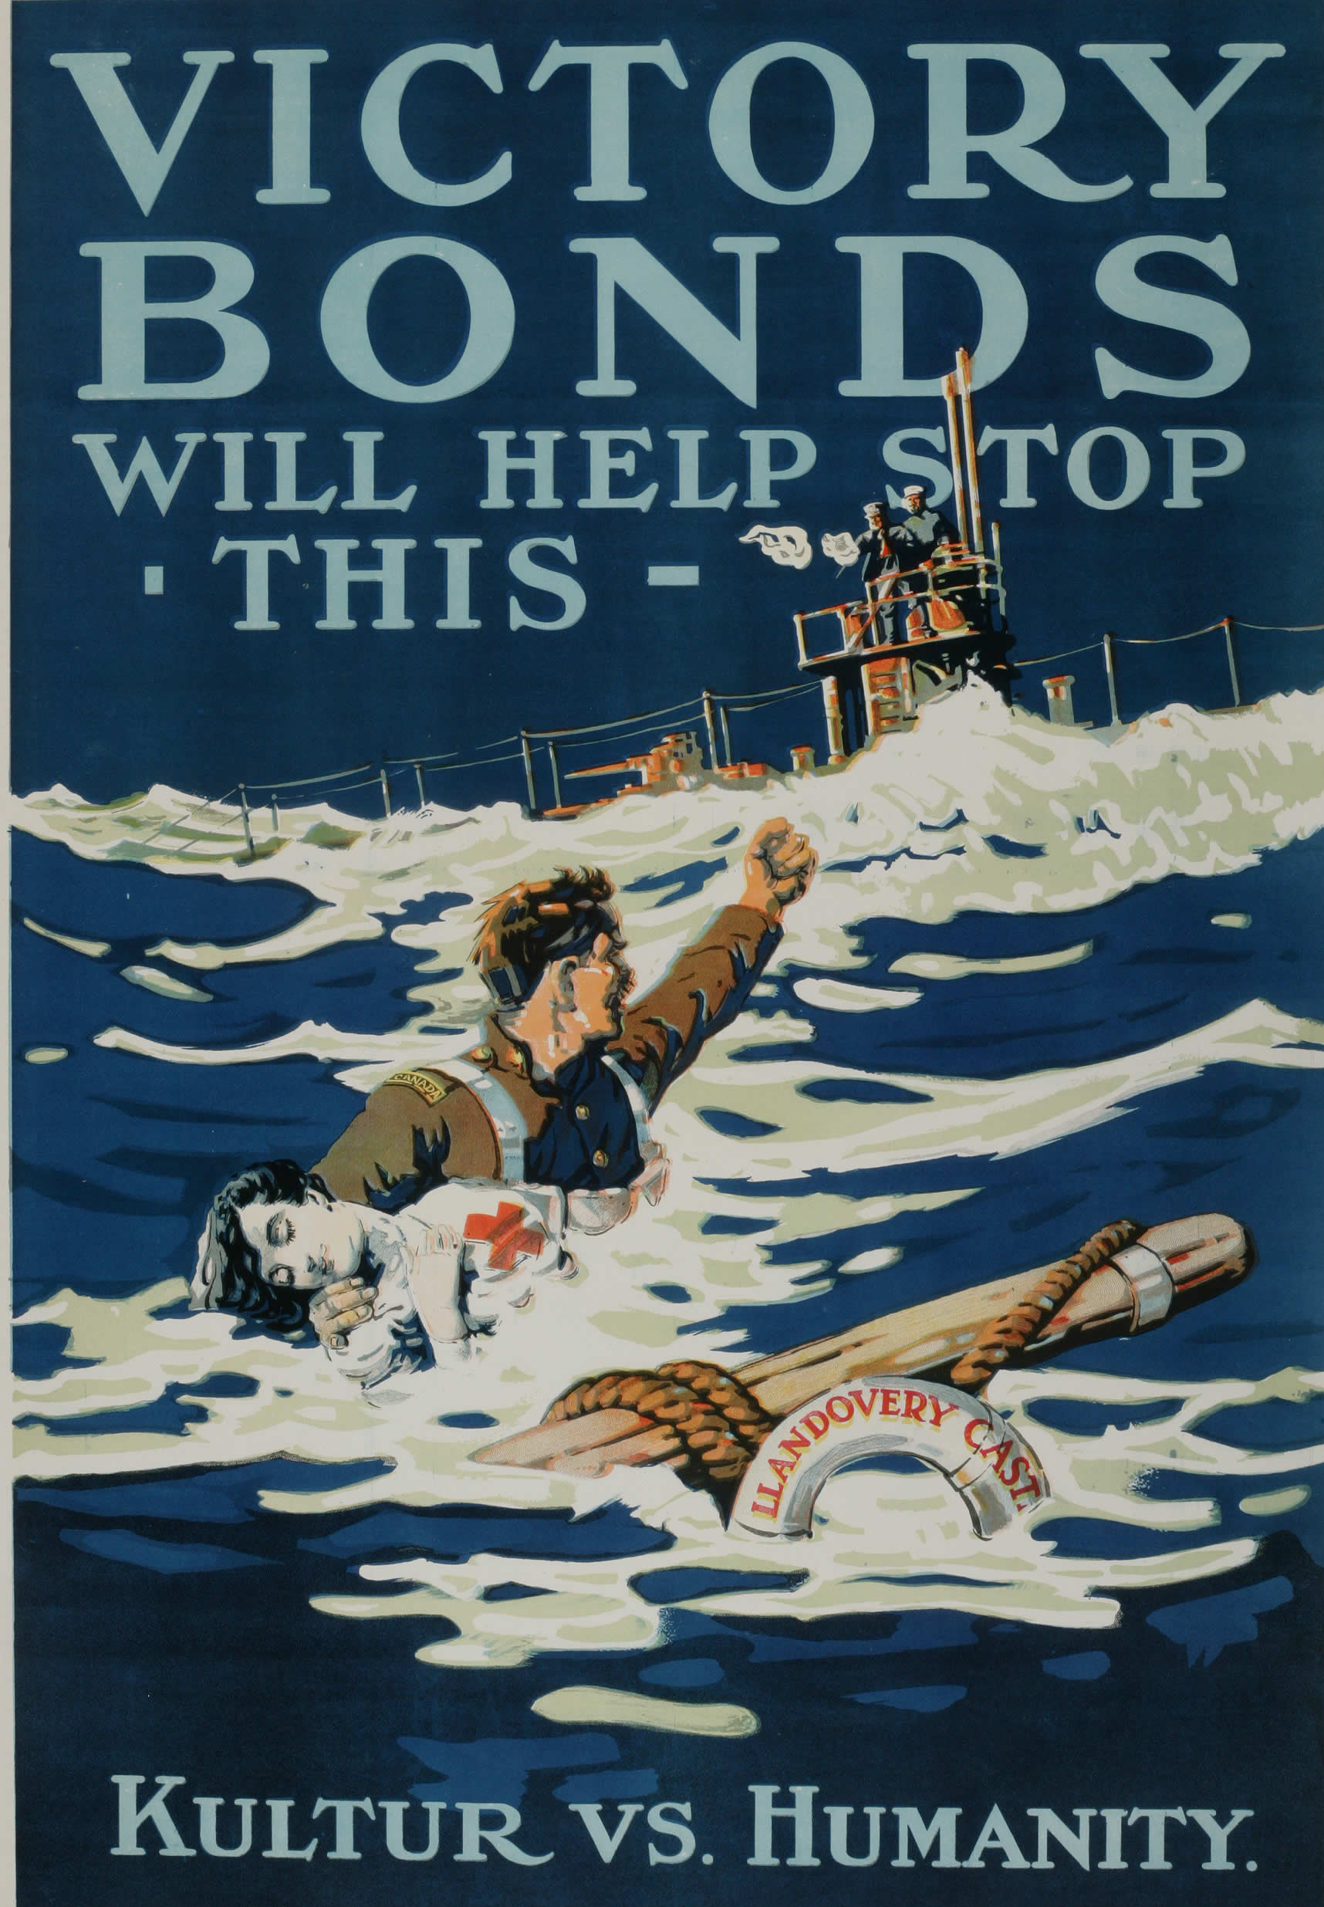
The torpedo immediately killed or injured an unknown number, but the survivors launched as many as five lifeboats.
One lifeboat was sucked into the sinking ship’s whirlpool but at least three got away.
Sgt Knight’s diary entry
Notes:
= Tell the story of how Llandovery was sunk and the events that followed.
= Note that if Llandovery was following the rules, its sinking was a war crime.
= Read the following to the audience:
Sergeant Arthur Knight wrote in his diary of his final moments with Matron Margaret Marjory Fraser. This is what he wrote: “To save the (life) boat we tried to keep ourselves away by using the oars, and soon every one was broken . . . The suction drew us quickly into the vacuum. There was not a cry for help or any outward evidence of fear. In the entire time I overheard only one remark when Matron Fraser, turned to me and asked: "Sergeant, do you think there is any hope for us?" I replied, 'No,'. The last I saw of the nursing sisters was as they were thrown over the side of the boat. It was doubtful if any of them came to the surface again. I myself sank and came up three times, finally clinging to a piece of wreckage and being eventually picked up by the captain's boat.”

Slide 4
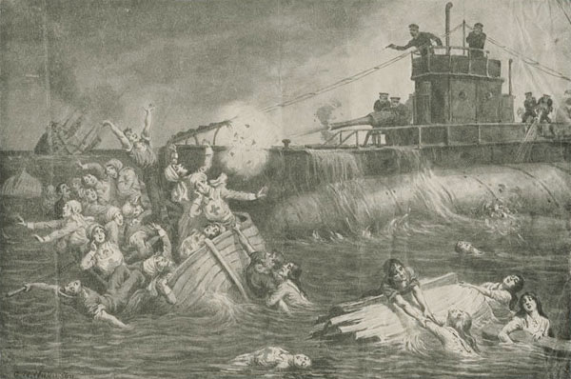
Notes:
= Ask the students to identify what is happening in the war painting (G.W. Wilkinson: The Llandovery Castle Lifeboat Murders).
This shows what happened after the Llandovery sunk. The U-boat surfaced and shot at the remaining survivors. (Ask the participants what they see in the painting). Only 24 survived of 258!
= Note that firing upon helpless innocents is another war crime.

Slide 5
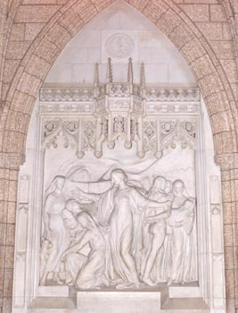
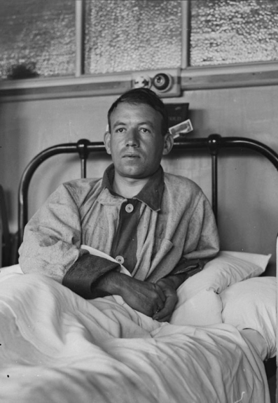
What happened after the War?
Notes:
= The aftermath: Sergeant Knight (left photo), Ship’s Captain Sylvester (middle photo), Nursing Sister Memorial in Ottawa’s Parliament buildings (right photo).
= The German U-boat Captain disappeared and never faced trial. His 2 second-in-command officers were charged after the war ended and during the trial it was found that they had changed the U-boat’s logbooks to show that they were nowhere near the sinking. The evidence was quite clear that they were lying and that a crime had been committed. The 2 officers spent 4 years in prison before being busted out by German Nationalists in 1928.
= Note that some in Germany felt that the U-boats sailors were heroes rather than war criminals. Ask the students if their feelings would change if there was evidence that munitions/weapons were on board Llandovery.

Slide 6
Your Activity
You are aboard HMHS Llandovery Castle almost a thousand kilometres off the coast of Ireland when it is torpedoed by the German U-boat 86 (27 June 1918).
The ship is quickly sinking. It appears that there is very little chance for you and your friends to survive!
But you have character!
COURAGE, RESPONSIBILITY, RESILIENCE,
COMMUNICATION, COOPERATION,
THOUGHTFULNESS
So you and your friends split up to scavenge some gear
Notes:
Activity
Explain the scenario: SEE SLIDE

Slide 7
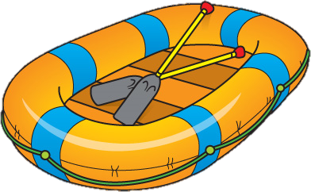
Your Activity
Within sixty seconds you have found an inflatable life raft as well as a box of matches and decide that you should prepare the raft for escaping from the ship once your friends return.
As soon as you’ve inflated and launched the dinghy (raft), your friends are tossing equipment to you. One has salvaged 9 items; another scored 6. Your other friends return empty-handed, but perhaps there is a chance for your group after all!
Notes:
Activity:
1. (cont’d) Further explain the scenario. MAKE SURE TO POINT OUT THAT THEY HAVE MATCHES in addition to the items on their list. (Hint: the matches might be usable with another item).

Slide 8
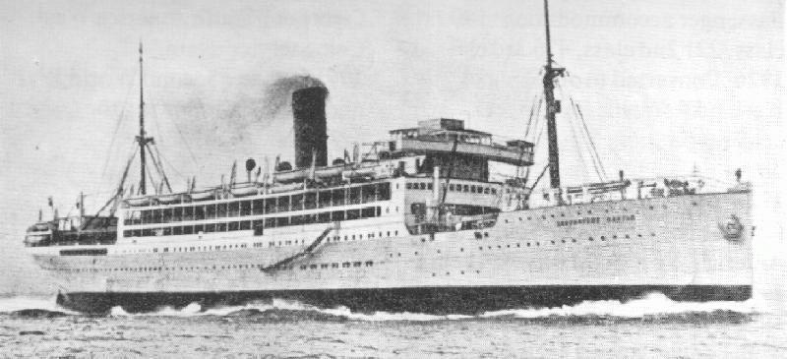
Your Activity
For this scenario, assume 3 things:
that U-86 has departed and is not a threat,
that your ship’s location was unknown when sunk, and
that you, your friends, and your dinghy are all that’s left.
Notes:
Activity:
1. (cont’d 2) Further explain the scenario.

Slide 9
Your Activity
Part 1 As an individual, complete Part 1 by ranking the 15 salvaged items. (5 min)
“1” being the most important, “2” being the second most important, all the way to the least important (ranked “15”). It may be best to write a few notes describing your reasoning beside each item. Don’t forget that your group has matches!
Part 2 Complete Part 2 by ranking the same list of items as a group. (10 min) (Note: all group members should have the same rank #’s)
Part 3 Record the professional sailor ranking. Figure out your individual score (3 min) (Pt. 4) and your team score (Pt. 5) by totaling the differences (addition of positive #’s).
Last Reflect on the challenges of the activity and the advantages/disadvantages or working as an individual or within a group. Be prepared to discuss.
Notes:
Explain the task: SEE SLIDE
Complete Part 1 (column #1) of the Activity- see Handout (as individuals, 5 min). Ensure that the participants understand the ranking process by reviewing that: a rank of “1” denotes “most important”, “2” = “2nd most important”. Also review that each number 1 through 12 must be used once (i.e., you can’t have three items ranked “1”). Note: If groups have not yet been determined, the facilitator will walk around during those 5 minutes and assign a number to each participant so that they can easily group-up into 5’s or 6’s at the transition between Part 1 and Part 2 of the Task.
Complete Part 2 of the Activity (as a group, 10 min) and remind everyone to ensure that their group rankings match (All group members should have the same rank #’s in Part 2).
Facilitator will communicate Part 3/Solution (the “Pro Ranking” on slide 11, 1 min).
Lastly, the participants will complete Parts 4 and 5 on their handout (2 min) and sum those 2 columns. The facilitator should state that the “differences” (re: Part 4 and 5) are only to show how far your ranking is from the pro’s, therefore, there aren’t negative numbers. Also, remind them that they all should have the same Part 5 column because, like Part 2, it is their group score.

Slide 10
Notes:
0

Slide 11
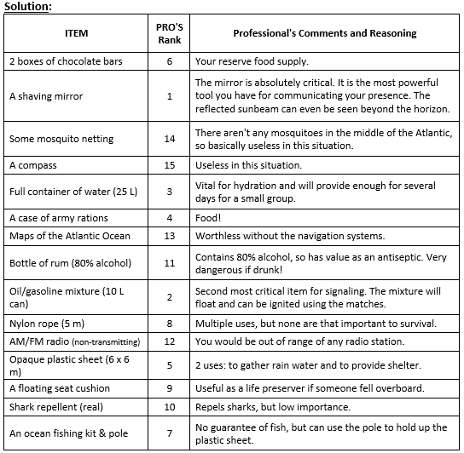
Solution:
Notes:
(Sometimes it speeds things up to dictate the rank #’s to the participants so that they can scribe as you speak).
= Note that these answers are given by a professional sailor not the presenter.

Slide 12
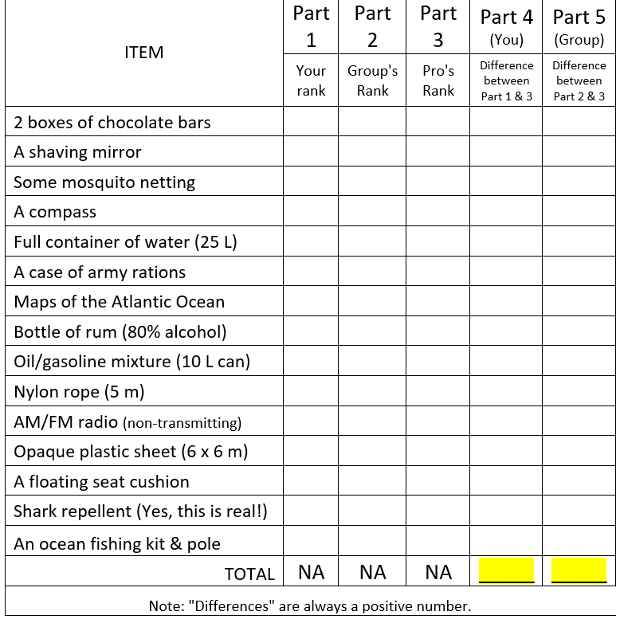
Sample Scoring:
1
3
6
5
3
Notes:
(It will likely be helpful to click through this slide to help the participants complete their scoring.)
= Note that they need to find the ‘differences’ in numbers, so all #’s will be a POSITIVE number.
E.g. 8 - 5 = 3 AND 5 - 8 = 3. (both have a ‘difference’ of 3)
(Advanced students will blast through this math.)

Slide 13
Scoring
Over 70: You are fish food! None survive.
56-70: You barely survived. One group member died.
46-55: You’re thinner and thirsty, but you all made it.
33-45: You’re all worse for wear, but in decent shape.
26-32: Above average survival skills. Nice work!
0-25: Too easy! Just another day at the office!
Notes:
= Scoring: Whichever group has the lowest score (their rankings were closest to the “Professional Rankings”) wins this activity.
= Ask the participants:
(1) if any individuals had a lower score than 60? 50? 45? Etc. to determine which single student had the best score
(2) if any groups had a lower score than 60? 50? 45? Etc. to determine which group won the activity

Slide 14
Debrief
If your personal score was better than the team’s, why do you suppose that happened? In contrast, why do you suppose that the team’s score was better than your individual score?
What were some noted advantages/ disadvantages while completing this exercise individually/as a team?
Did your group have a leader? If so, how was the leader chosen? If not, how did your group manage the discussion?
Which 3 characteristics are most important for a good teammate to possess? How about on the raft?
Notes:
= Debrief Questions and Prompts: (5 min) SEE SLIDE
The Key Idea is to introduce the participants to the differences between individual and group work, as well as the skills required to work productively within, and as, a group. (This is a good warm-up activity).
= (Optional) Note that sometimes being a leader in a group means stepping back while the others in the group take the lead.

Slide 15
Notes:
0

