Slide 1
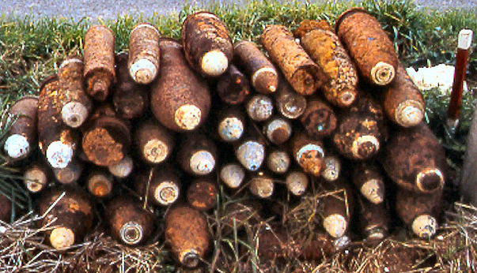
THE LEGACY OF WAR
Notes:
0

Slide 2
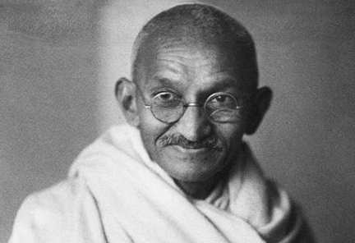
“What difference does it make to the dead, the orphans and the homeless, whether the mad destruction is wrought under the name of totalitarianism or in the holy name of liberty or democracy?” -Mahatma Gandhi
Notes:
= Ask the students to read this quote to themselves and think about what it means.

Slide 3
Canada follows international law to fight as humanely as possible.
Law of Armed Conflict (aka International Humanitarian Law) includes:
Hague Convention (of 1899 & 1907) – army war-fighting conduct and restrictions
(e.g. settling disputes, declarations of war, war crimes, etc. )
Geneva Convention –protects victims of war, military and civilian.
ICRC governs and enforces (International Committee of the Red Cross)
Ottawa Convention – Anti-personnel mine Prohibition (i.e. Land-mine)
Notes:
= Canada, as a country, has decided that at certain points in time we may be called upon to stand up and fight for what we, as a country, believe in.
= Canada endeavors to fight honorably and is governed by Humanitarian Law, e.g. by 3 Conventions: Hague, Geneva, Ottawa
= Ottawa Convention is something that Canada took the lead on because our country felt that too many children were being injured or killed by landmines years after a conflict had ended. Not all western countries have signed on to this (e.g. the U.S. has not signed on)
= Countries that do not follow these rules can be found guilty of war crimes.

Slide 4
Aftermath: Afghanistan (2001-14)
Afghanistan bears the scars of decades of war.
Over 31 000 Afghan civilians have died (2001-present).
Many Afghans have faced decades of poverty and political instability, and all that goes along with those challenges.
40 000 Canadians have served in Afghanistan and 158 Canadian soldiers were killed. Many more have been or still are casualties.
Canadians focused on security, humanitarian assistance, reconstruction efforts, and training Afghan troops (2001-2014).
Notes:
= Reiterate main points on slide (# served, # deaths).
= Almost ¾ of Cdn COMBAT deaths (132) are from IEDs.
= The U.S. is still in Afghanistan.

Slide 5
Aftermath: Korea (1950-53)
The far-reaching impacts of the Korean War still affect the world today.
Approximately 5 million lives were lost during the War in Korea
Tensions remain high between North and South Korea, families remain separated across the DMZ, and American and North Korean nuclear weaponry are a continuing threat (no Peace Treaty was ever signed)
Almost 27 000 Canadians served in Korea, 516 Canadian soldiers died
Canadians served as a part of a police action under UN Command until 1953, then stayed in Korea as military observers until 1956.
Notes:
= Reiterate main points on slide (# served, # deaths).
= Korea (Canada supplied the third-most support to the UN Command, behind US and UK)
= Perhaps the most widely know Cdn engagement was the Battle of Kapyong.

Slide 6
Aftermath: Second World War (1939-45)
The Second World War was the most destructive war ever seen.
Between 50 and 80 million lives were lost during the Second World War and the genocide known as the Holocaust
The war resulted in massive physical and psychic trauma, millions left homeless, vast areas of Europe and Asia destroyed, and global tension (known as the Cold War)
1.1 million Canadians served in WW2, over 47 000 were killed
Total war: the Second World War impacted every Canadian.
Notes:
= Reiterate main points on slide (# served, # deaths).
= WW2, compared to WW1, 2.5x as many Canadian served in WW2, but had only ¾ of the deaths.

Slide 7
Aftermath: First World War (1914-18)
The First World War was the first industrialized war.
Approximately 20 million people died in the First World War, half were soldiers, half were civilians
Of the 10 million combatants who died, 2/3 of their death were battle related, and the rest were due to the flu pandemic in 1918
Approximately 424 000 Canadians served in the First World War out of a population of 8 million people, 61 000 died (more than in WW2!)
Canada fought as a dominion of Britain and won the respect of many camps .
Notes:
= Reiterate main points on slide (# served, # deaths).
= WW1, compared to WW2, less than half as many served, but had 1.3x the deaths)

Slide 8
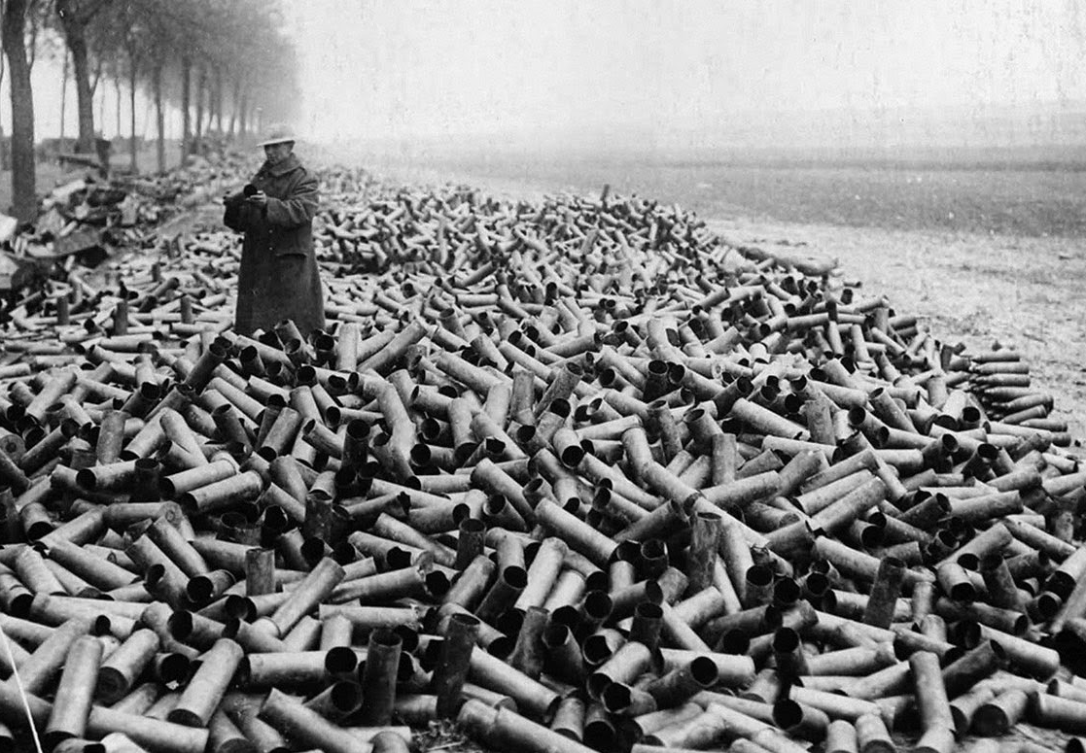
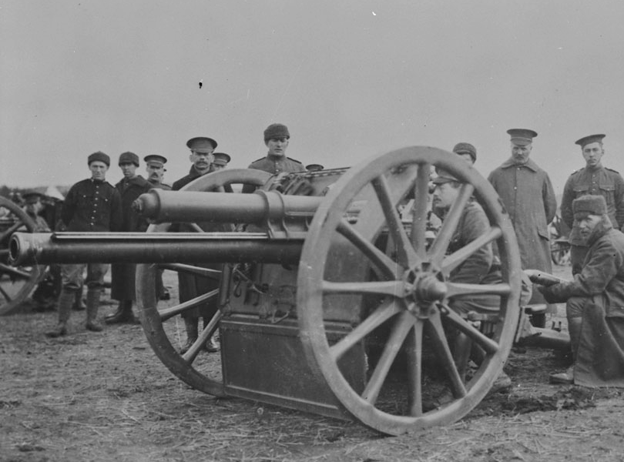
First World War (1914-18)
For every square meter on the Western Front, one ton of explosives were fired
Mounds of empty shell casings on the Canadian side at Vimy.
1 ton = 907kg (9 Aaron’s)
Artillery killed 75% of those who died in battle
Notes:
= WW1 is the first industrial-scale war; artillery causes ¾ of soldier combat deaths
= Explain how much 907 kg weighs in terms of people weight in one metre squared
PHOTO: A Canadian soldier near Vimy (note the duds stacked on the right side of photo).

Slide 9
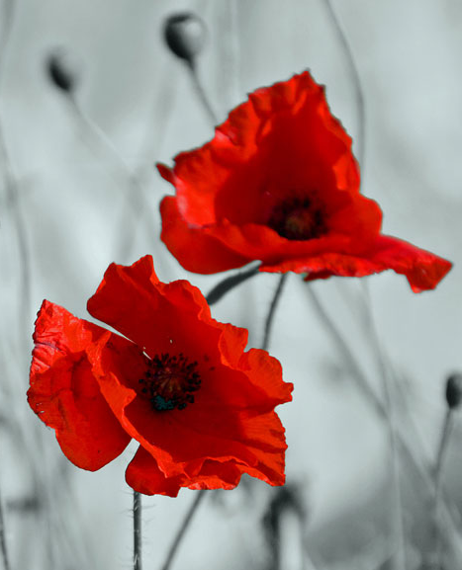
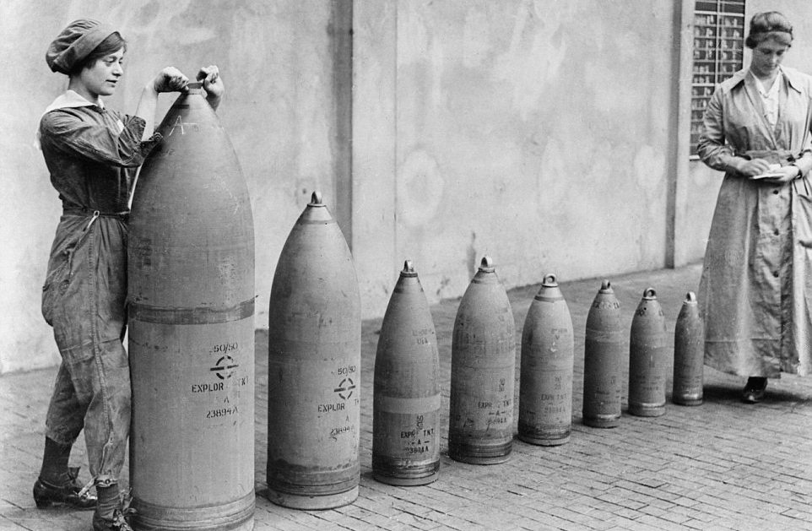
People are still dying from the impacts of wars that most of us consider as ‘history’.
In Europe on the old battlegrounds, the First World War kills civilians every year!
Notes:
= Note different sizes of shells and how much each might weigh and the shell hole they might cause
= Explain “Iron Harvest” (on next slide)

Slide 10
The Iron Harvest
Every spring when the farms on the Western Front (WW1) are tilled, another munitions crop comes to the surface.
It is estimated that 1 in 3 WW1 shells did not detonate. This is equivalent to 300 M duds!
Hundreds have died from the Iron Harvest in the century since the First World War
Notes:
= Millions and millions of shells- scientists say 1/3 are duds.
= Iron Harvest – every spring when the frost comes out of the ground, metallic objects work their way to the surface, only for farmers to hit them with their plows once the fields have dried up.
= When a farmer finds a shell, they are supposed to call a bomb disposal crew, but because farmers find so many they feel it is inefficient to always call bomb disposal
PHOTO: Members of a bomb disposal company that collect duds that a farmer has collected and tucked inside a concrete telephone pole.

Slide 11
Notes:
0

Slide 12
Your Activity
Munition Disposal
Goal:
Neutralize the munition by pouring it into the disposal bucket as a team.
There are 2 Parts to the Activity:
Part 1: Group Planning
2 minutes to plan WITHOUT TOUCHING equip
Part 2: Group Action
10 minutes to complete the task
Notes:
Activity Instructions and Rules: (10-15 min)
1. Explain to all participants that we are going to play a team problem solving activity that will require all of the skills and character traits that we’ve explored today. OR
2. Invite the participants to come and stand beside a station that has already been set up and explain the rules (shown on slide 13). (The visual cues at hand during this rule description will facilitate a better explanation by the facilitator and will lead to a better understanding of the directions and the rules by the participants.)

Slide 13
Rules:
There are 4 “No Go” zones. They are:
Inside the cylindrical planes above/below the 2 rope circles.
Above/below the 2 buckets.
Entering any “No Go” zone will result in injury or death. Touching the bucket or contents is immediate death.
Failure to complete the task within 10 minutes = annihilation.
Your Activity
Notes:
3. Clearly explain the following Rules to the participants (2-3 min):
The goal is to neutralize the faulty munition by pouring the contents of the bucket into the neutralizing container in the “Safe Area” using only the equipment provided. Placing the filled bucket inside the empty bucket does not qualify; the contents must be poured.
The faulty shell will explode if not transported within 10 minutes from starting point.
There are 4 “No Go” zones. Two are inside the cylindrical plane above and below both rope circles. The other two are inside the cylindrical plane above and below both buckets. Think of these areas as “mustard or chlorine gas” zones that extend into the air above both the roped areas and the buckets. Anyone that ventures into that area will suffer severe injury or even death.
Breaking the plane of any “No Go” zone with an appendage (hand, arm, leg) will result in you losing that body part for the remainder of the activity. If a head breaks the plane: instant death and sitting out the remainder of the activity.
Touching the bucket or the contents within will result in immediate death and sitting out the remainder of the activity.
Any partial spillage of water or balls will result in the death of your team. Complete spillage will result in the annihilation of your neighbourhood.
Failure to complete the task or spillage of the entire contents will cause the death of your teammates and your neighbourhood.

Slide 14
Was your group successful? Was there any spillage (injuries/deaths)?
How well did your group cope with this challenge? Which skills were required for successful completion?
Did your group have a leader?
If so, what was it that made that person an effective leader? In that case, how did the rest of the group work?
If your group didn’t have a leader, how were you able to coordinate your work together?
What did you learn from this activity and how could your new understandings and skills be applied to future situations?
Debrief
Notes:
= Debrief
Debrief Key Idea: The importance of everyone on a team pulling together in the same direction toward a shared goal: • Ask: Was your group successful? Was there any spillage (Were there any injuries/lives lost)?
<Cooperation, Communication, Resilience, Thoughtfulness can be explored here>
• Ask: How well did your group cope with this challenge? Which skills were required for successful completion? <All Traits can be explored here>
• Ask: Did your group have a leader? If so, what was it that made that person an effective leader? In that case, how did the rest of the group work? If your group didn’t have a leader, how were you able to coordinate your work together? <All Traits can be explored here>
• Ask: What did you learn from this activity and how could your new understandings and skills be applied to future situations? <All Traits can be explored here>

Slide 15
Notes:
0

