Slide 1
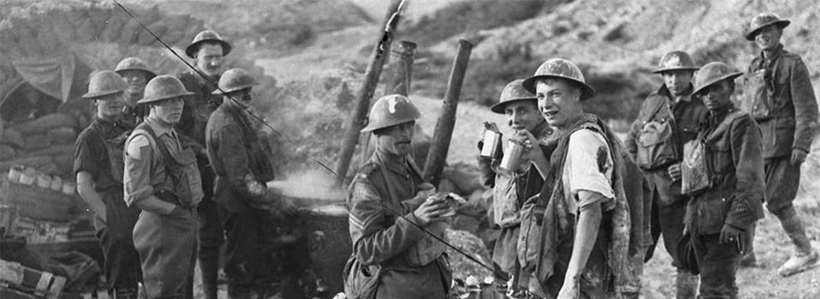
The Canadian Corps during the First World War: A Learning Organization
Canadians, wounded and non-wounded, near Hill 70 in August 1917.
Notes:
0

Slide 2
Video:
The Battle of Hill 70: Lost Battlefields Video (9 min)
Watch for the following in the video:
What were some of the things that made the Canadian Corps so formidable during 1917 and up to the war’s end?
Are any of the 6 character traits that we’ve discussed (Communication, Cooperation, Courage, Resilience, Responsibility, Thoughtfulness) described or referenced in the video? And if so, within what context do we find them?
(Video credit: Footage from Norm Christie’s “Lost Battlefields” Series)
Notes:
= Prompt: Watch for the following 2 things in the video:
What were some of the things that made the Canadian Corps so formidable during 1917 and up to the war’s end?
Are any of the 6 character traits that we’ve discussed (Communication, Cooperation, Courage, Resilience, Responsibility, Thoughtfulness) described or referenced in the video? And if so, within what context do we find them?”

Slide 3
Insert video:
https://www.youtube.com/watch?v=vbMUaJ5yGUM&t=2631s
Watch to 1h:00
(43m:50 – 1h:00m)
Notes:
0

Slide 4
• What were some of the things that made the Canadian Corps so formidable during 1917 and continuing until the war’s end?
• Recall Learmonth and Brown, the two Victoria Cross recipients mentioned in the video. Which character trait(s) did they exhibit? Can you anticipate any situations in your own daily life where behaving in such a way might help or hurt, you or the team?
• Did the Hill 70 video glorify war? Why or why not? (include examples with your answer). Did your group become divided during this discussion? Why or why not?
Debrief
Notes:
= Questions and Prompts (3-5 min) (Ask the participants the questions on the slide or have them discuss in groups).
= Debrief:
Debrief Key Idea 1: The Canadian Corps was becoming consistently effective because of the characteristics they and their leaders were increasingly embodying.
• Ask: What were some of the things that made the Canadian Corps so formidable during 1917 and continuing until the war’s end?
<ALL TRAITS can be explored here>
• Ask: Recall Learmonth and Brown, the two Victoria Cross recipients mentioned in the video. Which character trait(s) did they exhibit? Can you anticipate any situations in your own daily life where behaving in such a way might help or hurt you or the team?
<ALL TRAITS can be explored here>
Debrief Key Idea 2: War is a difficult topic, not only to discuss, but also to evaluate as an idea. We all must educate ourselves so that when our society/nation decides whether or not to send our soldiers into harm’s way, our conversations are truthful, just, and compassionate.
• Ask: Did the Hill 70 video glorify war? How about the awarding of a Victoria Cross? Why or why not? (include examples with your answer). Did your group become divided during this discussion? Why or why not?
<Thoughtfulness, Responsibility can be explored here>

Slide 5
Notes:
0

Slide 6
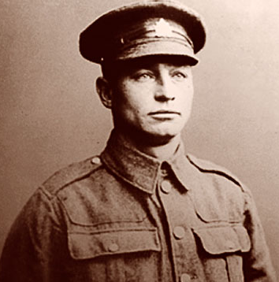
Canadian Corps in WW1: A Learning Organization, Placemat Activity
For this activity, your group will be given two things:
1) 5 incomplete pages, 1 for each year of WW1
2) a small envelope with paper strips and photos inside
Your task is to arrange the pieces found in the envelope in the appropriate order on the incomplete pages.
Private Harry Brown, VC
NOTE: This is a logic puzzle more than a knowledge puzzle!
Your group should be able to solve it using the process of elimination and reasoning.
YOU SHOULD SEE IMPROVEMENT IN THE CANADIAN CORPS AS WW1 PROGRESSES
Your Activity
Watch for clues given in the text!
Notes:
= Setup and explain the activity:
1. The participants, in groups of 4, 5, or 6, are provided with the 5 pages of the “4. Learning Org Handout” and the envelope containing the prepared strips from “4. Solution”.
2. Explain to the participants that the goal of the activity is to take the strips that are inside the envelope and place them in the appropriate location on one of the 5 handouts.
3. Review this slide taking care to reiterate the main points within the red box, e.g.,
i- It’s more of a logic puzzle, than a knowledge or memory puzzle.
ii- Canadian Corps improvement through time is visible in the strips.
iii- Each year page has at least one image. No year has 3 images. (shown on next slide).

Slide 7
Canadian Corps in WW1: A Learning Organization, Placemat Activity
HINTS:
1) To start, a thoughtful group will:
- assign part of the team to arrange the incomplete papers in order: 1914, 1915, 1916, 1917, 1918
- assign the rest of the team to organize the strips into piles of the same heading (e.g. a pile of “Battles”, a pile of “Context”s, etc.)
2) Every year has at least one picture. No year has 3 photos.
3) Did I mention this?
You should see the Canadian Corps improving through time.
Your Activity
Notes:
4. Tell the participants: “DO NOT WRITE the appropriate year on the top of the page; use the strips! There should not be any blank spaces beside any of the left column headings.”
5. Once a group believes that they are finished, all members of the group must raise their hands and wait quietly for the facilitator to come and evaluate their work. (Note: the facilitator should tell them how many strips they have in the incorrect location and to keep trying.)
= BEGIN the activity
= The first group to successfully complete the exercise wins the contest.

Slide 8
Notes:
0

Slide 9
Solution:
1914
Notes:
= Show the solution to the groups (this slide and the next 4)

Slide 10
Solution:
1915
Notes:
0

Slide 11
Solution:
1916
Notes:
0

Slide 12
Solution:
1917
Notes:
0

Slide 13
Solution:
1918
Notes:
0

Slide 14
• After reflecting upon the learning process and the growth experienced by the Canadian Corps during the First World War, can you anticipate or speculate upon any difficulties that the soldiers may face towards the end of the war or after the war? Thinking about your own learning so far in your life, what similar difficulties might you later face?
(In other words: reflect on your own life experience and growth up to this point and then ask yourself what you might have to be wary of in your future?)
• Do you think that the Canadian Corps grew and learned gradually, or do you think there was a “turning point”? If you think it a gradual change, why do you suppose that occurred? If you had to choose a “turning point” for the Canadian Corps during the First World War, what would it be? Explain.
Debrief
Notes:
= Questions and Prompts (5 min) (Ask the participants the questions on the slide or have them discuss in groups).
= Debrief:
Debrief Key Idea:
To facilitate thoughts about the learning process (and the time required) among the participants.
• Ask: After reflecting upon the learning process and the growth experienced by the Canadian Corps during the First World War, can you anticipate or speculate upon any difficulties that the soldiers may face towards the end of the war or after the war? Thinking about your own learning so far in your life, what similar difficulties might you later face? (In other words: reflect on your own personal experience and growth in your own life up to this point and then ask yourself what you might have to be wary of in your future?)
<ALL TRAITS can be explored here>
• Do you think that the Canadian Corps grew and learned gradually, or do you think there was a “turning point”? If you think it a gradual change, why do you suppose that occurred? If you had to choose a “turning point” for the Canadian Corps during the First World War, what would it be? Explain.
<ALL TRAITS can be explored here>

Slide 15
Notes:
0

