Slide 1
Hello Don Bosco School Students

Slide 2
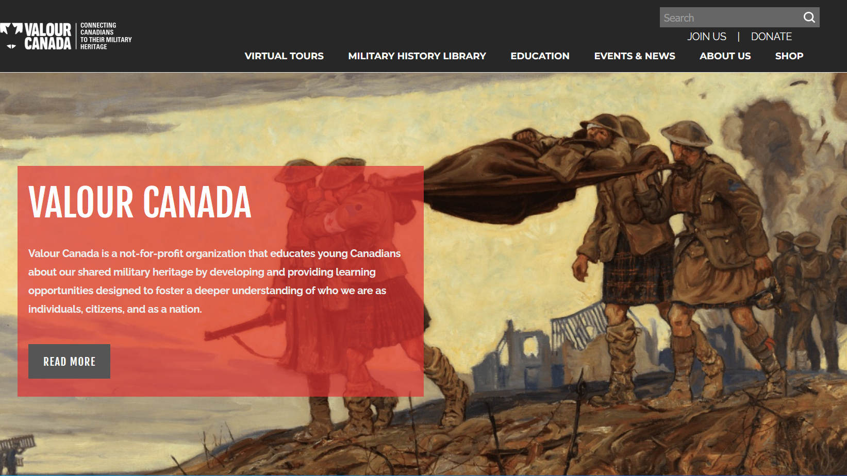
Our Commitment to Education:
Website:
ValourCanada.ca
Notes:
“Our primary goal is to educate youth about Canada’s military history and heritage.”
Why? → “To nurture a better informed, thoughtful, and critical thinking populace.” - I’ll come back to this in a few slides.

Slide 3
How does an airplane fly?
The 4 Forces of Flight

Slide 4
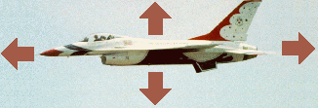
The 4 Forces of Flight:
Lift
Thrust
Drag
Weight

Slide 5
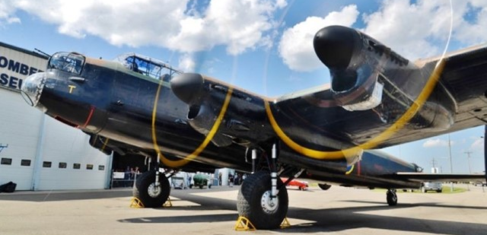
1. Weight (Gravity)
What pulls the airplane down?

Slide 6
2. Lift
What holds the airplane up?

Slide 7
3. Thrust
What pulls the airplane forward?

Slide 8
4. Drag
What holds the airplane back?

Slide 9
Activity:
Making a Paper Airplane

Slide 10
Rules:
1. Safety !!!
- Glasses
- Respect
2. Follow Directions
- Listen Carefully
We will test our planes together at the end!

Slide 11
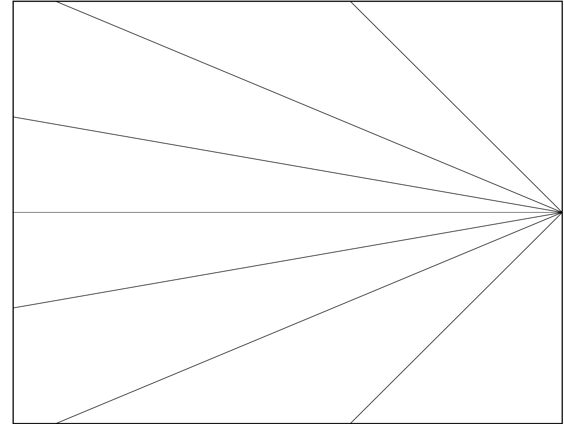
Fold 1:

Slide 12
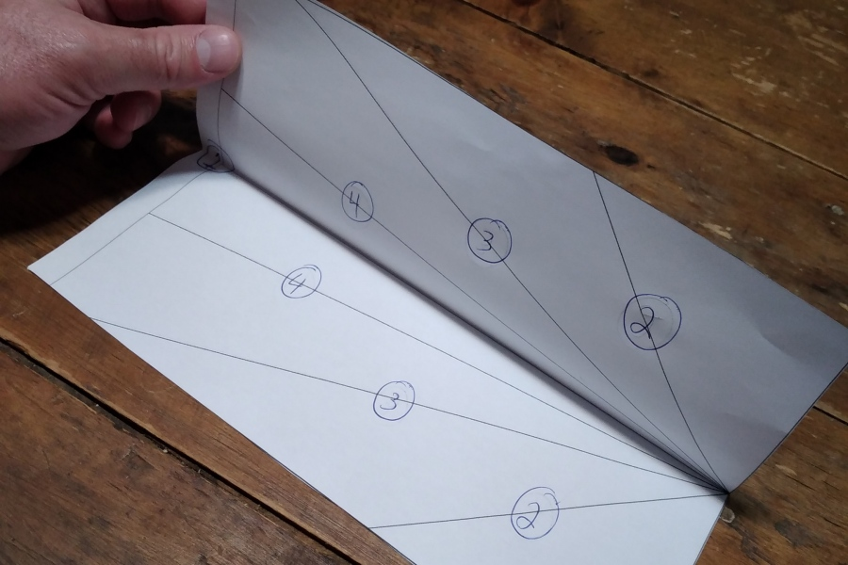
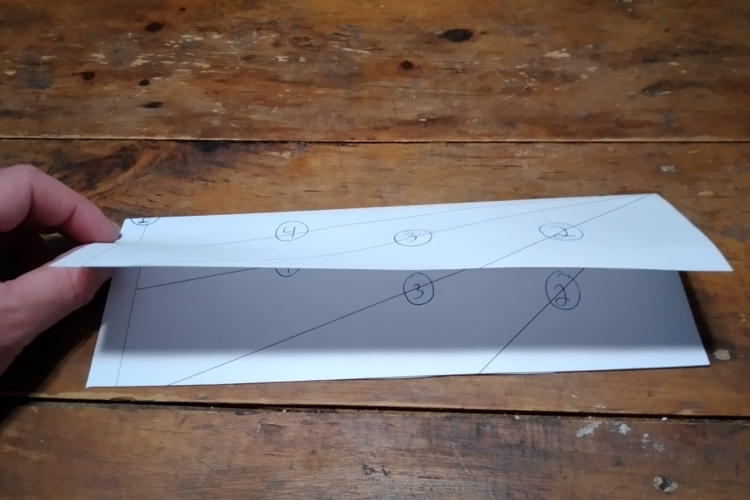
Fold 1:
Find the line with the # 1 and fold along that line.

Slide 13
Fold 2:

Slide 14
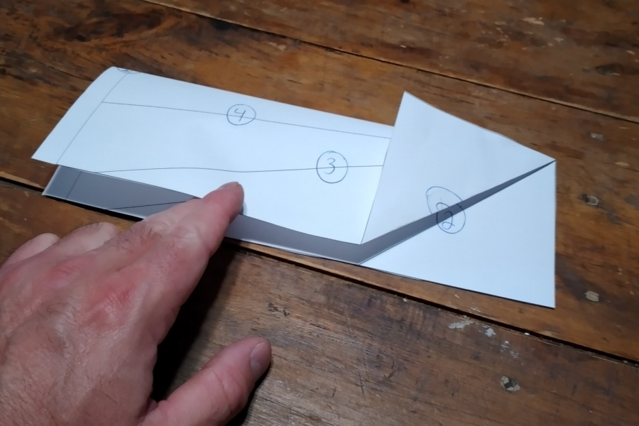
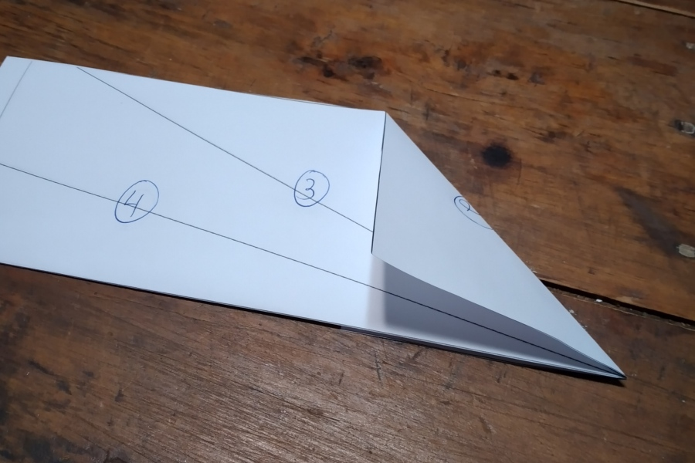
Fold 2:
Find the lines with the # 2 and fold along those lines.

Slide 15
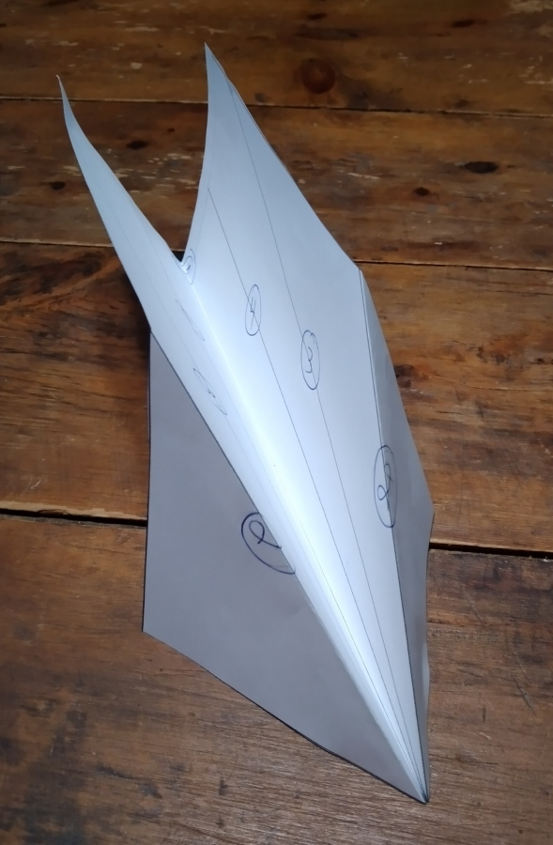
End of
Step 2:

Slide 16
Fold 3:

Slide 17
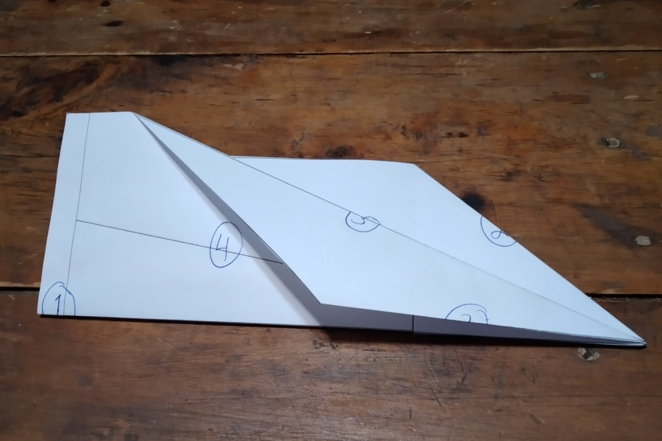
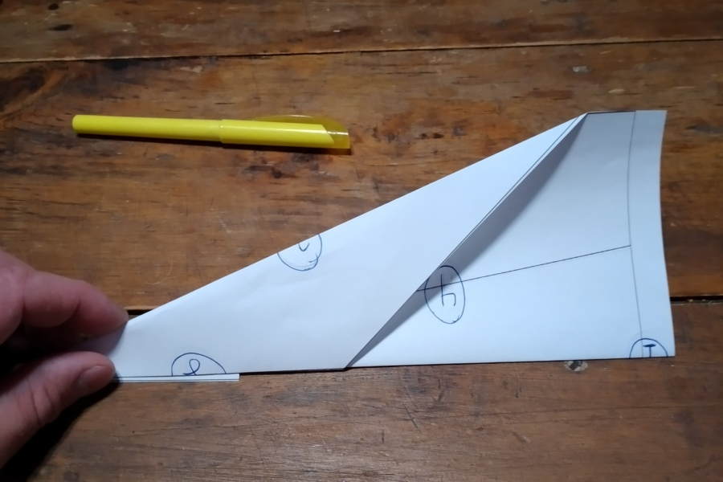
Fold 3:
Find the lines with the # 3 and fold along those lines.

Slide 18
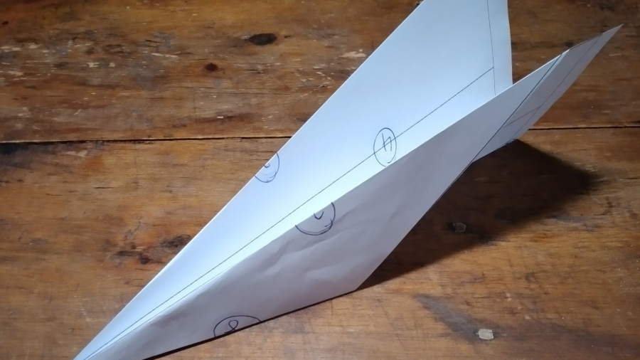
End of
Step 3:

Slide 19
Fold 4:

Slide 20
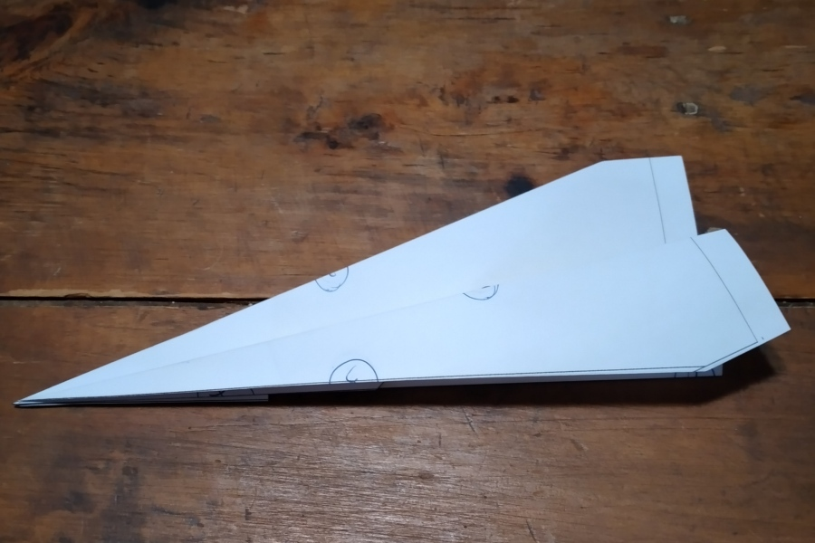
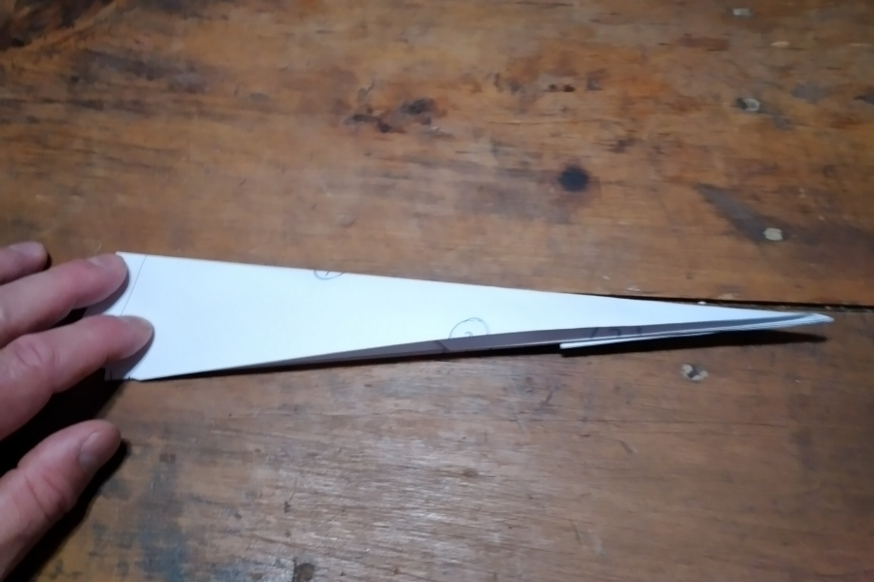
Fold 4:
Find the lines with the # 4 and fold along those lines.

Slide 21
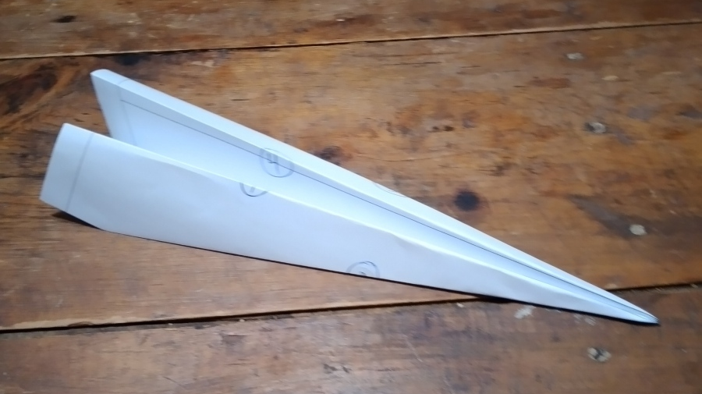
End of
Step 4:

Slide 22
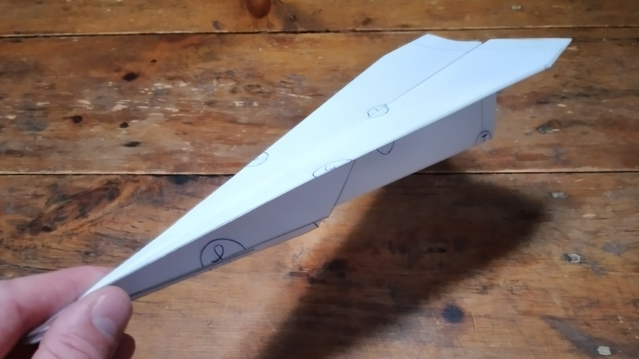
Finished Airplane:

Slide 23
Glasses On!

Slide 24
Review: The 4 Forces of Flight
Lift
Thrust
Drag
Weight

