Slide 1
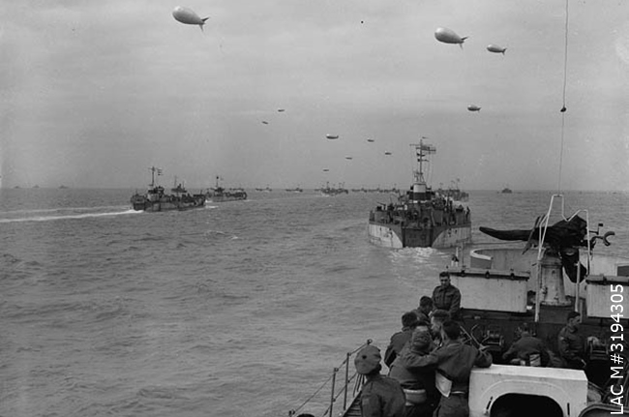
June 6, 1944
D-Day
Notes:
0

Slide 2
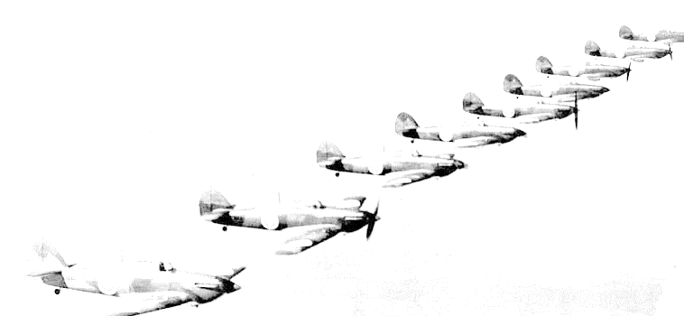
World War 2: 1939 – 42 Key Events
1939 - Germany invades Poland and “Phoney” war begins (Sep.)
1940 - Blitzkrieg (“lightning war”) Holland, Belgium, France surrenders
- Dunkirk evacuation (May/June); Battle of Britain (July - Oct)
- Germany invades U.S.S.R. (Barbarossa) to take Moscow, but a
hard winter stymies further German advance
- Hitler begins strengthening coastal defenses in France
- a lot of fighting in countries surrounding the Mediterranean
- Japan on the rise; Pearl Harbour; U.S. enters the war
- the war turns global (Pacific Ocean); Battle of Hong Kong
1942 - U.S.S.R. stops Germany; Holocaust’s “Final Solution” initiated
Notes:
= Green highlights show main events and/or winning side in that year
= Blue text show events involving Canada
= Battle of Britain (Cdn airmen) in ‘40
= Nazi supply lines are stretched and winter prevents them from taking Moscow
= Battle of Hong Kong
= Early dominance of Germany, 1942 is balanced (There are wins and losses on both sides)

Slide 3
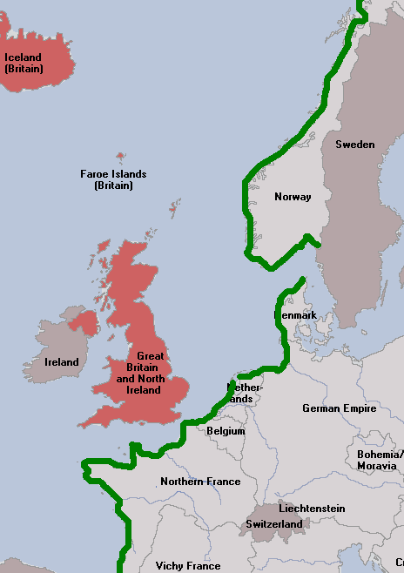
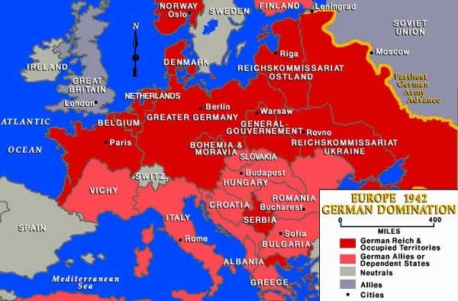
The Atlantic Wall
Nazi Dominance
Notes:
= Nazi Germany is dominating Europe into 1942
= Hitler’s Atlantic Wall – designed to stop an Allied invasion that would be attempted at some point in time

Slide 4
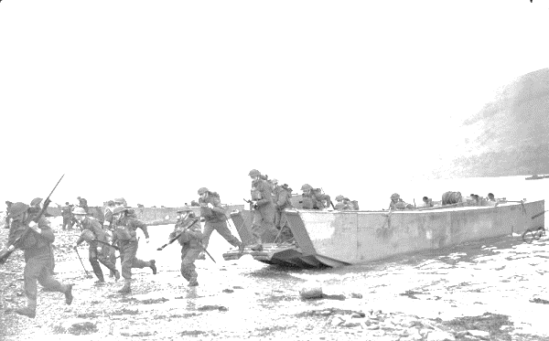
World War 2: 1942 – 45 Key Events
1942 - (cont’d) – Dieppe; Battle of the St. Lawrence
1943 - U.S.S.R. pushes back and retakes many of its cities
- Operation Husky (Allies invade Sicily)
1944 - Allies land at Anzio, Italy; Soviets continue westward
- Normandy Invasion (D-Day), then Battle of the Bulge
1945 - Allies and Soviets are rolling; Auschwitz liberated by U.S.S.R.
- Soviets win race to Berlin; Hitler commits suicide
- MAY 8th = V-E Day (E=Europe)
- U.S.A. “A”-Bombs: Hiroshima (Aug 6th) and Nagasaki (Aug 9th)
- AUG 15th = V-J Day (J=Japan) → War Ends
Notes:
= 1942 key Cdn battles: Dieppe Raid and The Battle of the St. Lawrence
= 1943- the tide has turned; U.S.S.R. pushes Nazis back (eastern front); Operation Husky (southern front); . . . A successful amphibious landing in France, were it to happen, would open a western front
= vice-like situation is being set up to squeeze the Nazis
= 1944- D-Day happens

Slide 5
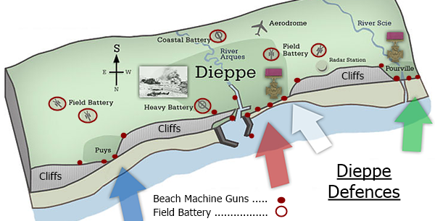
Dieppe, Operation Jubilee, 1942 August
Objective: To seize, hold, destroy an enemy-held port.
Why?
Gain intelligence
Morale
Notes:
= explain the key and the direction (N arrow) to the audience. Describe machine gun and artillery placement, and explain how they are aimed (e.g. machine guns down the beaches) and for what purpose
= Point out that attacking cliffs is a fool’s errand, therefore, attacks must occur at beaches
= Ask how the battle turned out (before flipping to next slide)

Slide 6
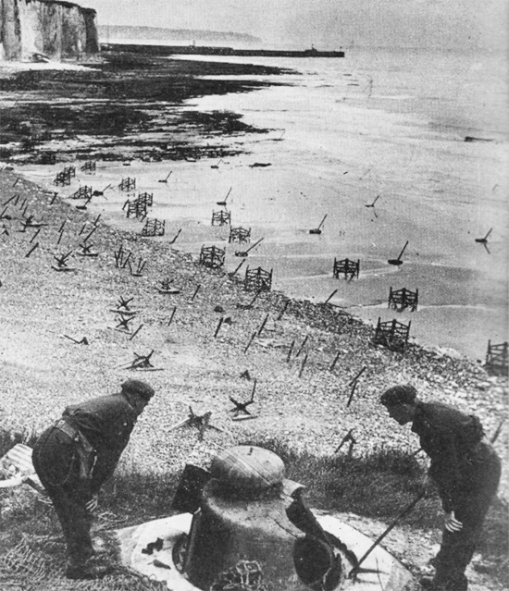
Dieppe: Operation Jubilee, 1942 August
Result:
6000 soldiers (5000 are Canadian) repelled
60% killed, wounded, or captured
Lessons Learned:
Surprise and secrecy (and deception)
Planning and preparation
Casualties inevitable on beach (need speed)
Solid ground required to land machinery
Coordination between air, sea, ground
Harbours will be sabotaged by the enemy
Seize key bridges inland at same time
- - REMEMBER THESE LESSONS! - -
Inspecting the Dieppe defences months after D-Day
Notes:
= Dieppe: Result and Key lessons learned (see slide and review/explain these to the audience because they will need to keep these in mind for the activity)

Slide 7
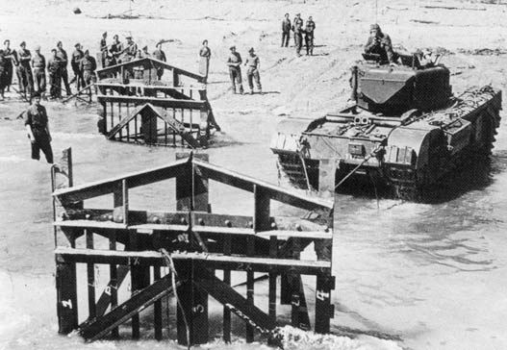
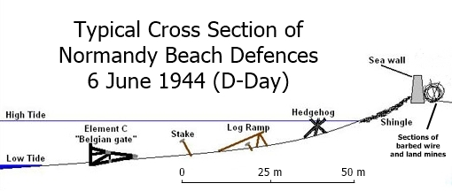
German Defences: “Fortress Europe” and the “Atlantic Wall”
Notes:
= Describe the German Defenses: Fortress Europe and the Atlantic Wall
= Point out the explosives on the obstacles and explain why an amphibious assault must happen at or near low tide
= Remind that machine guns and artillery are firing upon the beaches non-stop

Slide 8
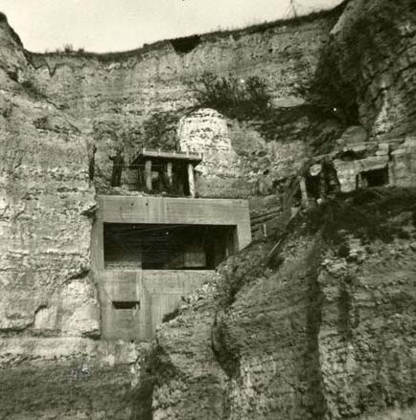
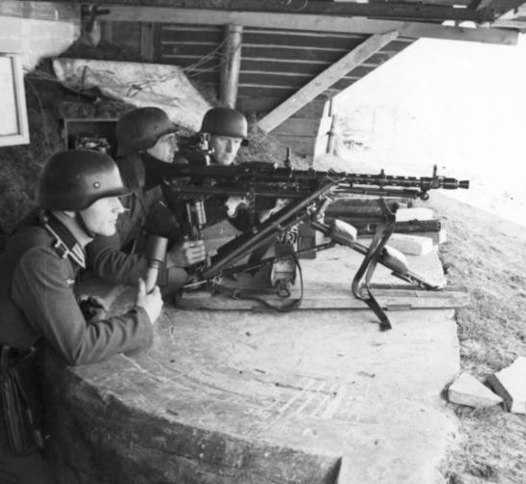
German Defences: “Fortress Europe” and the “Atlantic Wall”
Machine-gun Emplacement
(Normandy, beach unknown)
Cliffside Emplacement
(Normandy, beach unknown)
Notes:
= Describe photos
Left- Note yellow arrow pointing at a person standing on the bunker (for scale)
Right- German soldiers (note the helmet covering their ears) with a Maxim machine gun and potato masher

Slide 9
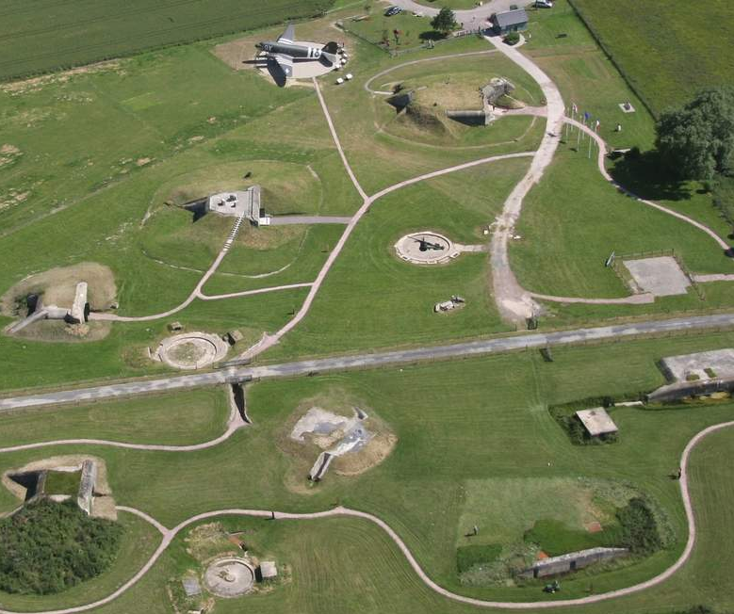
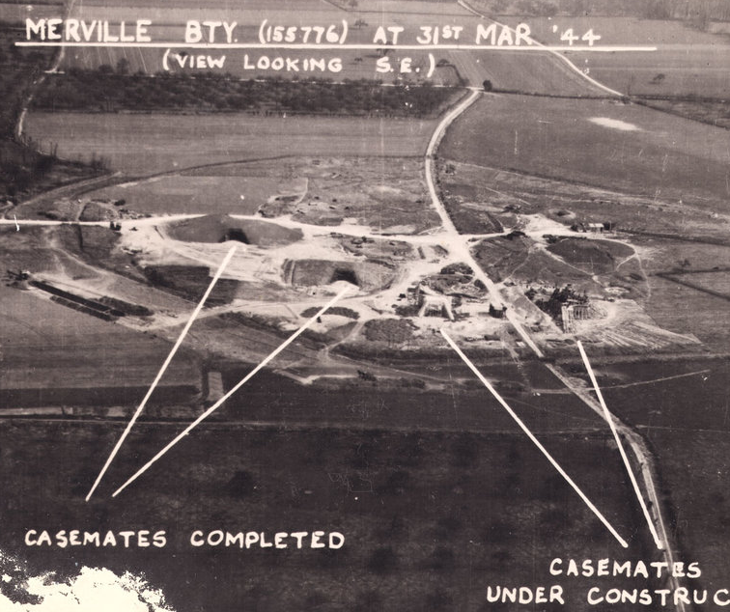
German Defences: “Fortress Europe” and the “Atlantic Wall”
Merville Battery (near Sword Beach)
Credit: Project 44
Modern view
31 March 1944 Reconnaissance Photo
Notes:
= Describe a Battery
= Highlight that the image on the right is a top-secret photo of the Merville Battery while under construction (1/4 turn and it lines up with the image on the right)

Slide 10
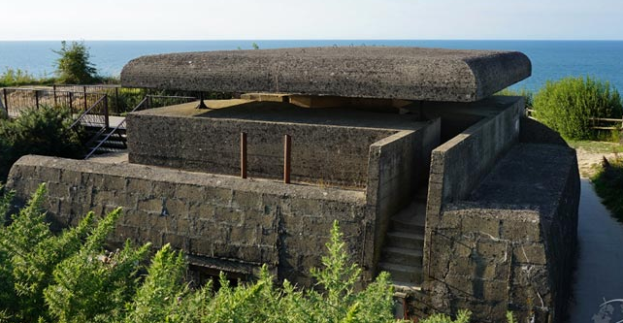
German Defences: “Fortress Europe” and the “Atlantic Wall”
Longues-sur-Mer Battery Command + Ranging Post (near Gold and Omaha Beaches)
Notes:
= Note the thickness of the concrete and the clear view of the English Channel

Slide 11
D-Day (6 June 1944):
Operations OVERLORD and NEPTUNE
Canadians coming ashore at Juno Beach after the coast has been secured.
LAC M#3205311
Notes:
0

Slide 12
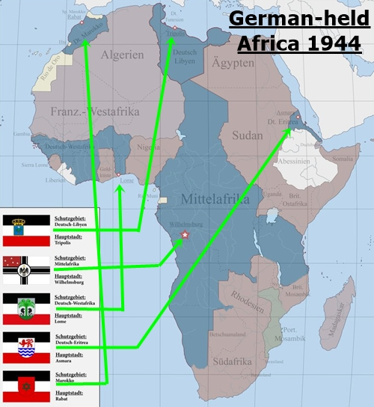
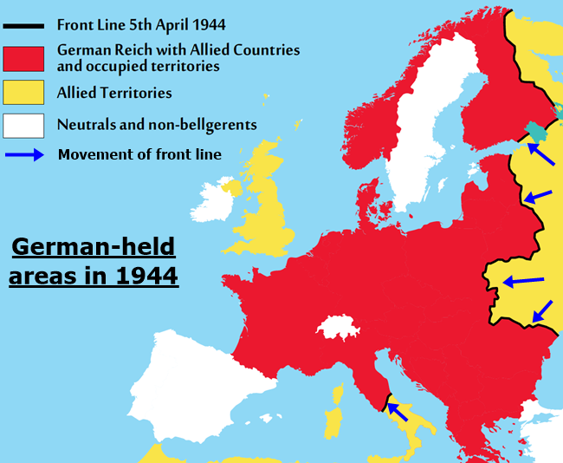
Invasion on D-Day: Two Intertwined Operations
1- Operation OVERLORD 1944 Jun. -- OVERLORD is the all-inclusive plan --
GOAL: To successfully land soldiers and equipment in German-held France so that a western front is opened versus the Wehrmacht (take and hold to the Seine River).
Notes:
= Explain the difference between: Operation OVERLORD (see slide)

Slide 13
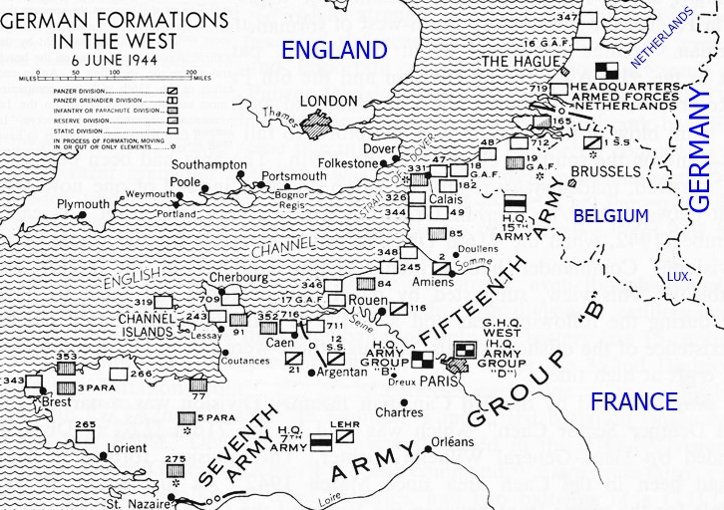
Invasion on D-Day: Two Intertwined Operations
2- Operation NEPTUNE
This is the coastal “assault” by the Allies. NEPTUNE is the water portion of OVERLORD.
GOAL: To land 130,000 soldiers, 30,000 vehicles/ artillery (from England) on the French coast
Activity:
Decide where to land and how to do it.
Notes:
= And Operation NEPTUNE (see slide)
(Neptune is the water portion (1-2 days) of Overlord (multi-week plan))

Slide 14
Operation NEPTUNE/OVERLORD: Where will you land?
At your disposal:
300,000 British, American, and Canadian army soldiers (Recall Dieppe = 6,000)
4,000 aircraft (including all necessary pilots, crew, etc.)
10,000 ships/watercraft (including all necessary sailors, support staff, etc.)
a finely-tuned industry that can create almost anything for your Armed Forces
Notes:
= Present the activity: This is what you have at your disposal

Slide 15
Operation NEPTUNE/OVERLORD: Where will you land?
Some points to consider when choosing where to invade:
Weather and sea tides - Remember: you need to land at low tide.
Aspect - Will your soldiers be looking into the sun as they move forward?
Moon phase - Do you intend to perform any night operations?
German defences- On land? Their airspace control? Control of the sea?
Your equipment requirements and availability.
Can you trick/deceive them into thinking something incorrect?
These are only some of the things the D-Day planners needed to account for.
Directions:
With your group Review YOUR MISSION and answer Q’s # 1-5.
Make sure to record your reasoning on the Worksheet.
Be prepared to explain your group’s answers and reasoning to the class.
Notes:
= Present the activity: This is what you need to consider
(Use this slide to get the audience’s brain-wheels turning. Be mindful to avoid overwhelming them with info, but also be mindful that they need to understand how complex the D-Day landing was)

Slide 16
Activity # 1: Where will you land?
HINTS- When choosing a location, think about these factors:
Distance from your ports in England
(travel and resupply distance)
Enemy defences and distance from
their reinforcements
- Access to travel infrastructure
after landing (i.e. roads, railways, etc.)
Where does the enemy think
an invasion is most likely?
(think of the previous 4 pts)
It is possible, but dangerous, to travel
through Naval minefields (green)
Notes:
= Present the activity: Go for it!
(Quickly review map and provide hints on the slide)

Slide 17
Notes:
0

Slide 18
Solutions: Activity # 1 (the Warmup)
Q # 1- Why were the soldiers, equipment, etc. spread throughout England?
Q # 2- Should you use all your resources or keep some in reserve?
Q # 3- How will the soldiers and equipment get across the beach? Difficulties faced?
Q # 4- Invasion Time of Day? Why?
- Reduce potential for major loss if one collection is bombed.
- Reduce potential that the enemy would think that a major action (attack/invasion) was coming.
- Almost always a good idea to have ‘some’ in reserve. Why? Often unpredictable things happen. Also, England should keep some behind in case they’re attacked.
- On foot. Very few are in tanks. Some arrive after the initial assault in wheeled vehicles.
- Facing heavy fire with almost zero cover. Many obstacles, mines, etc. If sand is soft, vehicles can get stuck.
- 06:30 – 08:00 (early morning)
- Darkness during “preparatory movements” and travel across English Channel.
- Light upon arrival allows everyone to see obstacles and routes of attack.
Notes:
= SOLUTION for Activity #1 (No formal debrief. Discuss answers as they are given. Note that blue text will popup as the slide is clicked through)

Slide 19
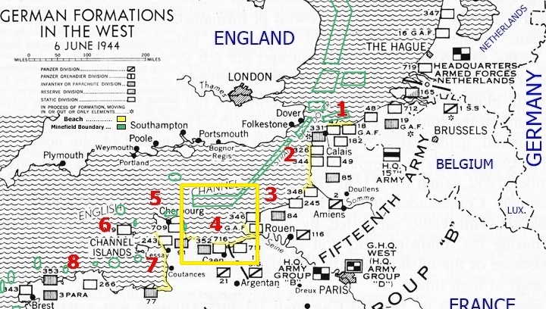
Q # 5 Solution: The Normandy area of France
# 4
Notes:
= SOLUTION for Activity #1 – “Real-life” answer is #4 (Bay of Normandy)

Slide 20
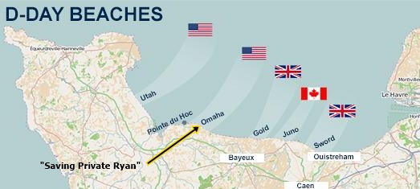
Why Normandy?
The Commanders and Planners thought it was a favourable location because:
not an obvious location to the enemy - beaches have low topography
sand compaction will hold tanks - many options for expansion after landing
big enough area to land a lot at once = multiple simultaneous threats to enemy
2 deep water ports in play (Cherbourg and Le Havre)
Bay of Normandy shelters assaulting boats from winds
within flying range of fighter planes
easier to resupply from west if taken
(Atlantic Ocean- the U.S.)
Notes:
= SOLUTION for Activity #1
Interesting points:
> Hitler always suspected Normandy, but his senior Generals disagreed
> “Frogmen” were sent in to test the sand prior to the planning (Lesson from Dieppe)
> both ports were destroyed by the Nazis
> Temporary harbours set up at Omaha and Gold, named Mulberry ‘A’ and ‘B’ respectively
> Locations 9 & 10 were too far from England

Slide 21
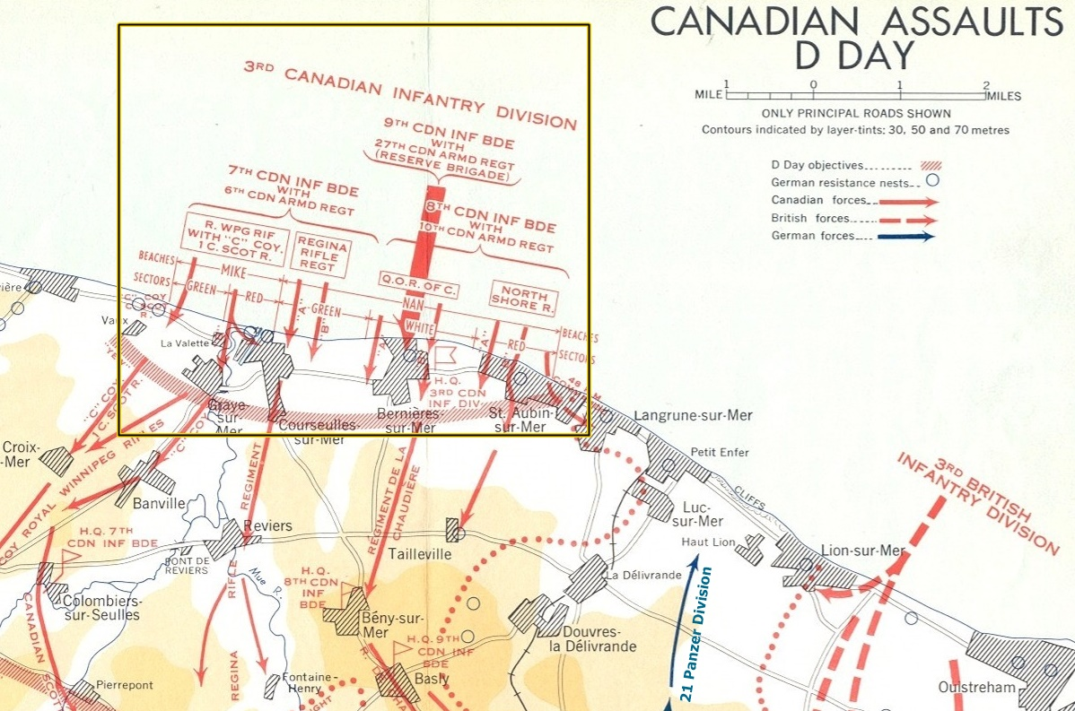
Notes:
(This is the invasion plan for Canadians assaulting Juno Beach)

Slide 22
Notes:
0

Slide 23
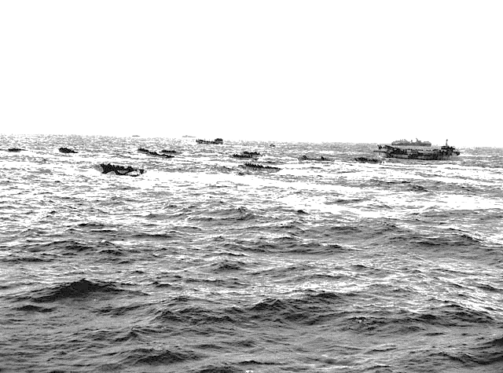
Operation Neptune: Activity # 2 (the Real Deal)
How do you move across the English Channel and land the soldiers and equipment (get a foothold on Europe) successfully?
Your group is going to get the opportunity to come up with a plan . . . On the double soldiers!
Notes:
= Present Activity #2: Create an Invasion Plan for Normandy
“
C- Scoring: • 1 point for each correct Allied card (it must have at least 1 correct action/idea) • 5 points for a correct summary (the summary must have the entire order correct) TOTAL: 10 Pts (5 for the cards, plus 5 for the summary) Whichever group has the most points wins the module. - For the optional “Going Deeper” section (see slides 32-33), each question is set at 2 pts. and should be applied as bonus scores. Bonus total: 4 pts. (2 questions x 2 pts). -
Options for increasing/decreasing difficulty: 1. This activity is aimed at Gr. 8+ but can be tried with Gr. 6+7 if using “6. D-Day - HINT sheet”. 2. It’s important to give hints/highlight key points while presenting slide 1-13 as well as to monitor group discussions and give more hints where necessary, e.g. small Dieppe invasion force; enemy over-confidence in their defensive capabilities (i.e. Atlantic Wall); etc.
3. The facilitator should walk around and observe the groups as they work through the questions and the problem solving. If a group is stuck or struggling, the facilitator can provide help through prompting questions, hints, or analogies.

Slide 24
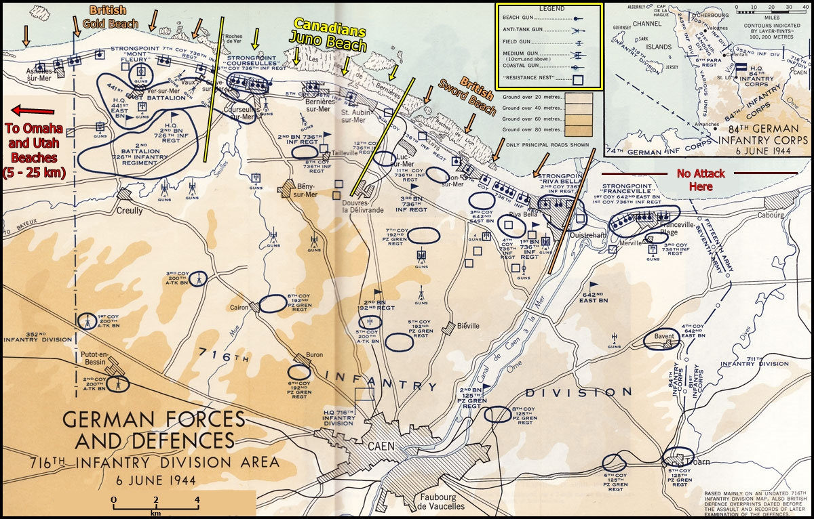
Activity # 2: Create an Invasion Plan
Part 1 and 2:
Read the instructions beneath YOUR MISSION
Part 1- TASKS:
1 scorekeeper
1 writer
1 timekeeper
(3 min per card, 6 cards)
TIMING:
• 18 min to complete all 6 cards
• 5 min to summarize
Part 2- GOING DEEPER:
TIMING:
• 5 min for each question
Scorekeeper: After activity, each scorekeeper moves to the adjacent group to track their score.
Notes:
= Explain the roles for the activity:
> The writer: this participant records the group’s ideas and solution on the worksheet.
> The timekeeper: this participant tracks time- 3 minutes per card (6 cards) and 5 min to summarize.
> The scorekeeper has the job of marking their neighboring group’s answers as they come up on the screen.
= Directions:
> Explain using the information on the slide.

Slide 25
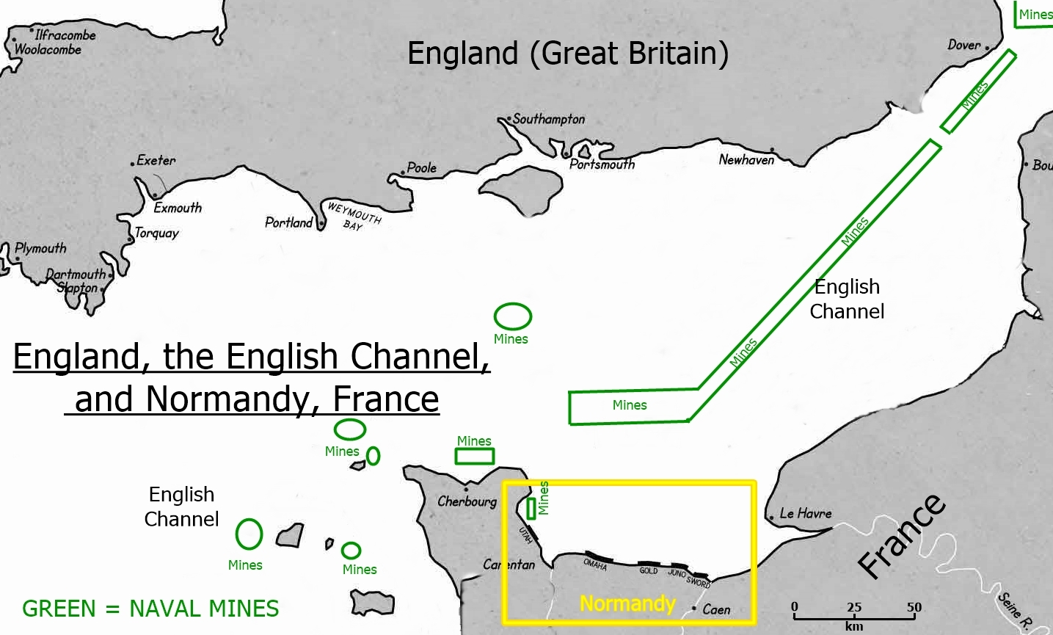
Activity # 2: Create an Invasion Plan for Normandy
Notes:
= Explain the map, the worksheets, and the cards (handouts) as necessary

Slide 26
Notes:
0

Slide 27
Solutions: Activity # 2 (the Real Deal)
Allied Air Power:
Allied Warships:
- Bombing airfields, plane factories, reserve units – easier to acquire air superiority
- Bombing enemy defences – to weaken enemy, but needs to be done carefully
- Reconnaissance (Scouting) of defences – accurate maps, plans, anticipate enemy actions
- Insertion of airborne soldiers inland – to take/hold bridges for road/rail/canal control
- Patrol during assault – to maintain air control over the beaches
- Pound coastal defenses, particularly gun emplacements
– reduce firepower directed at assault
- Clear the English Channel of boats/planes
– to reduce risk to invasion fleet
- Escort valuable cargo across the Channel
– reduce risk to invasion fleet
Haida on D-Day: Vice Admiral Harry DeWolf, Halifax, NS
Notes:
= SOLUTION for Activity #2 (No formal debrief. Discuss answers as they are given. Note that blue text will popup as the slide is clicked through)

Slide 28
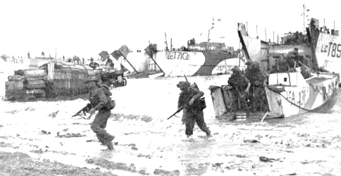
Solutions: Activity # 2 (the Real Deal)
Allied Minesweepers:
- Clear the Channel of any naval mines
– reduce risk to invasion fleet
and shorten route for fleet
3rd Canadian Infantry Division soldiers landing at Bernières in the Juno Beach sector
Caraquet on D-Day:
Rear Admiral Anthony Storrs of Victoria, BC
Allied Assault/Landing Craft:
- Take soldiers, vehicles, equipment to the beach – protected from enemy for as long as possible
Notes:
= SOLUTION for Activity #2 (No formal debrief. Discuss answers as they are given. Note that blue text will popup as the slide is clicked through)

Slide 29
Solutions: Activity # 2 (the Real Deal)
Allied Intelligence Operations:
Four Goals:
1) Create diversions – to focus attention away from Normandy
2) Provide cover – protect real airborne soldiers
3) Delay enemy reinforcements (see # 1, 2, 3)
4) Confuse enemy radar (see # 1)
How?
Using visual cues, sounds, fake communications, spies + double agents
- Operation FORTITUDE North (Norway) and FORTITUDE South (Calais)
Alongside NEPTUNE were: Operations TAXABLE, GLIMMER, MANDREL, TITANIC
Notes:
= SOLUTION for Activity #2 (No formal debrief. Discuss answers as they are given. Note that blue text will popup as the slide is clicked through)

Slide 30
Summary of your Invasion Plan:
Generally speaking,
First, you’ll use your Intelligence Operations to deceive
Second, you’ll use your Air Power to weaken the enemy
. . . D-Day, 6 June 1944 arrives . . .
Third, your Minesweepers will clear a path across the Channel
Fourth, your fleet will leave for Normandy with your Warships on the lookout (and will fire on coastal defences once within range)
Fifth, your Assault/Landing Craft will move to the beaches
Notes:
= SOLUTION for Activity #2
SUMMARY in plain language

Slide 31
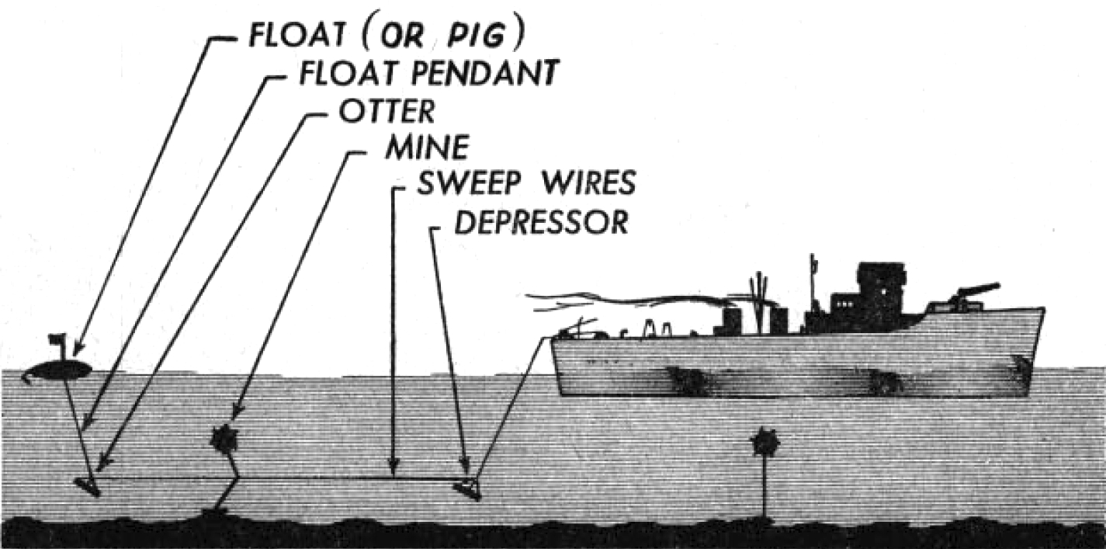
Debrief: Operation OVERLORD AND NEPTUNE
Thinking about D-Day and the challenges faced by the Allies, which of the 6 character traits do you feel were most important for their success? Are they the same as those needed by your group to complete this exercise successfully?
Do you think that modern communications (texting, email, etc.) would make D-Day planning and coordination easier or more difficult? Why?
Which parts of the activity had the biggest impact on you and why?
“Deluxe” Shelter
Notes:
= Explain how minesweepers work and the role the RCN played in D-Day
= Debrief (slide 30): Operation NEPTUNE
> Key Idea: To build the participants’ understanding of the extensive challenges faced by Allies in the matter of successfully landing thousands of soldiers, materiel, and vehicles in Normandy.
• Ask: Thinking about D-Day and the challenges faced by the Allies, which of the 6 characteristic traits do you feel were most important for their success? Are they the same as those needed by your group to complete this exercise successfully? <ALL TRAITS can be explored here>
• Ask: Do you think that modern communications (texting, email, etc.) would make D-Day planning and coordination easier or more difficult? Why? <Thoughtfulness, Communication can be explored here>
• Ask: Which parts of the activity had the biggest impact on you and why? <ALL TRAITS can be explored here>

Slide 32
Skip to final 2 slides, if inadequate time for “Going Deeper” Q #1 and 2
Notes:
0

Slide 33
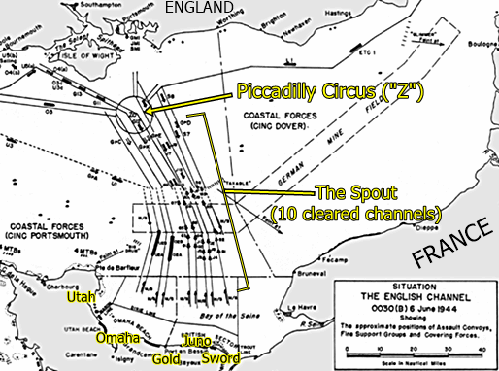
GOING DEEPER Q # 1
How do you suggest the attacking/invading boats should depart their English ports and then move across the Channel to Normandy?
1. Minesweepers prepare 10 channels the night before.
2. Five task groups, 1 per beach, leave to meet at Piccadilly Circus in the early morning. Utah Force departs first.
3. Task groups “pour” through the spout (cleared channels), timed to exit slightly after dawn.
(At dawn, naval barrage begins targeting coastal strongpoints)
Discussion . . . Ideas?
Notes:
--Optional-- GOING DEEPER Q #1, (answers appear as slide is clicked through)

Slide 34
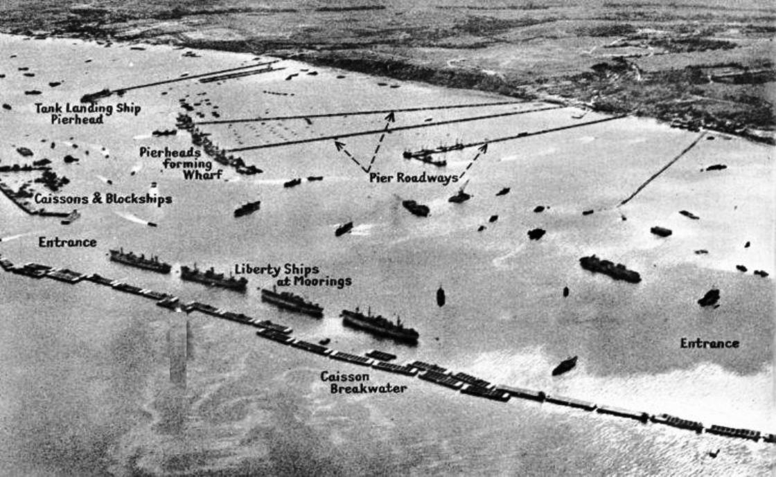
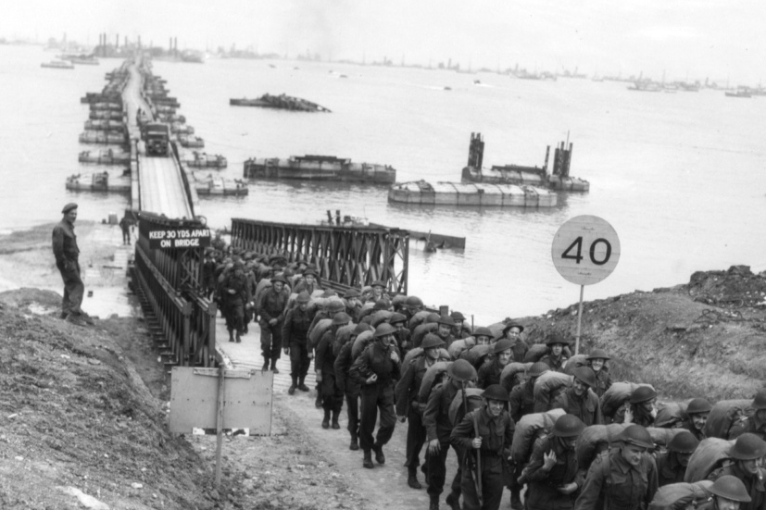
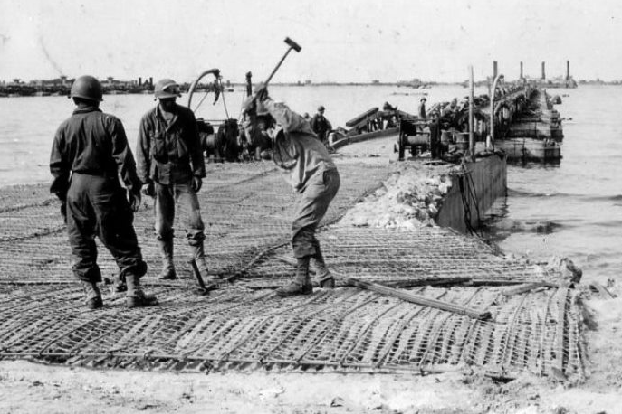
GOING DEEPER Q # 2
Thinking about your “finely-tuned industry”, if you could build something helpful for your invasion, what would it be?
Mulberry A + B Harbours:
- ‘A’ at Omaha, ‘B’ at Gold
- constructed piers
- Sections are floated to Normandy, assembled, and used to offload equipment and supplies
- ‘B’ used for 5 months, landed 2,000,000 soldiers, 500,000 vehicles,
4,000,000 tons of supplies
Discussion . . . Ideas?
Notes:
--Optional-- GOING DEEPER Q #2, (answers appear as slide is clicked through)

Slide 35
Notes:
0

Slide 36
Operation Overlord: The Result, The Cost
-- April + May, Air Forces: 12,000 casualties and 2,000 aircraft --
On D-Day (1 day):
10,000 Allied soldier casualties (4000-4500 deaths)
??? German soldier casualties (estimated as similar)
-- June naval losses: 60 ships, 120 others damaged --
Notes:
= Total cost of D-Day invasion (1 day)
Compare #’s to Vimy. Make sure to point out the 1-day cost versus the OVERLORD costs (next slide)

Slide 37
Operation OVERLORD:
6 June to 30 August, 1944 (Normandy to Seine R. = 86 days)
• 209,000 Allied, 216,000 Axis casualties • 15,000 civilian deaths
As the next year progressed, the Wehrmacht (German Armed Forces) would be pushed back into Germany by the US/Britain/Canada in the west and the Soviets in the east.
11 months after D-Day: V-E Day (May 8, 1945: Victory Europe Day)
Then on August 15, days after “Little Boy” (Hiroshima) and “Fat Man” (Nagasaki),
V-J Day (Victory Japan Day)
The Second World War has ended.
Notes:
= Total cost of Operation OVERLORD (86 days) and the End of WW2

Slide 38
Notes:
0

