Slide 1
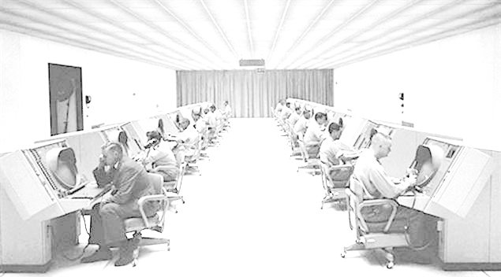
The Cold War
Notes:
= Photo: Soldiers monitoring radar screens.

Slide 2
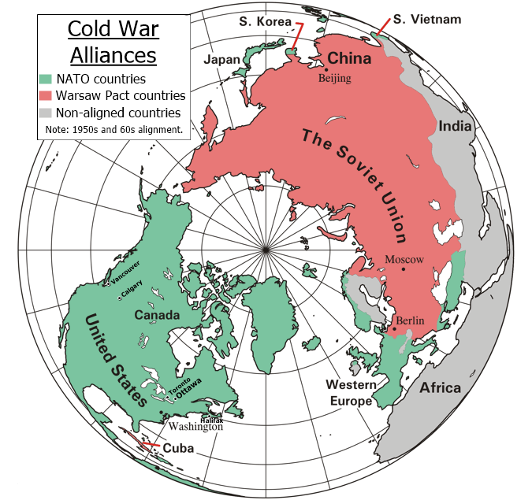
The Cold War: 5 W’s
When ? 1945 to 1991
Who ? U.S. (NATO) capitalists
versus
U.S.S.R. (Warsaw Pact) communists
What ?
An ideological struggle (a war of ideas) rather than a “hot” war that includes physical fighting.
Where ?
Mostly in eastern Europe, but the effects were often felt world-wide.
Notes:
= Quickly cover the 5 W’s of the Cold War

Slide 3
The Cold War: 5 W’s
Why ?
As WWII was winding down distrust between the U.S. and U.S.S.R. sprouted and a highly competitive arms race developed.
U.S.S.R. had proven over the last few years of the war that they were a powerful state.
The U.S. had the A-bomb (recall Japan).
At war’s end the eastern occupied lands were under control of the U.S.S.R. and the western lands were controlled by Britain, U.S., + France. Germany and Berlin were split into two.
Yalta (Feb. 45) and Potsdam (Jul. 45) Conferences decided this arrangement.
Notes:
= Quickly cover the “Why” of the Cold War

Slide 4
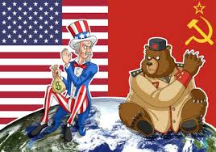
Systems: Capitalism and Communism
• Property owned by individuals
• Supply and demand markets
• Elections have different parties
• People are stratified into levels of wealth
• Freedom as long as you don’t negatively impact another person
• Property owned by the state/government
• Price fixing, production quotas
• One party state
• People are all at the same levels socially and economically
• Group success is primary, so many individual freedoms are eliminated
The two superpowers began acting to prevent each other from
getting stronger.
Notes:
= Compare and Contrast capitalism and communism

Slide 5
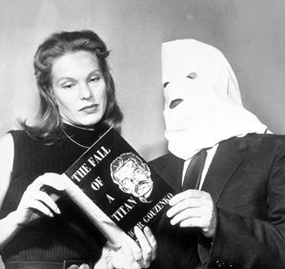
Trigger? The Gouzenko Affair
Igor Gouzenko was a cipher clerk at the Soviet Embassy in Ottawa. His job: send and receive coded messages to/from Moscow.
On Sept. 5, 1945, only days after WWII ended, he defected with a trove of documents that showed deep Soviet espionage (spying) in North America.
Many see this as the “trigger” that started the Cold War because it showed how deep the Soviet spy network was and what they had been able to achieve so far.
Keep in mind: Most of the world sees Canada as a “middle” power at this time.
Notes:
= Outline the Gouzenko Affair and how it can be seen as the trigger

Slide 6
Key Post-WWII Developments: Cold War begins
• Oct. 1945: United Nations created
(replaces the former League of Nations)
• 6 months after Gouzenko, U.K. Prime Minister Winston Churchill delivers the “Iron Curtain” speech in the U.S.
• 1948: UDHR (United Declaration of Human Rights)
• 1949: NATO (North Atlantic Treaty Organization)
Is this alliance similar to those prior to WWI?
• 1949: U.S.S.R. develops an A-bomb
Notes:
= Outline the first few events of the beginning of the Cold War
= AUDIO (1m:00)- Churchill’s Speech (click on speaker in slide)

Slide 7
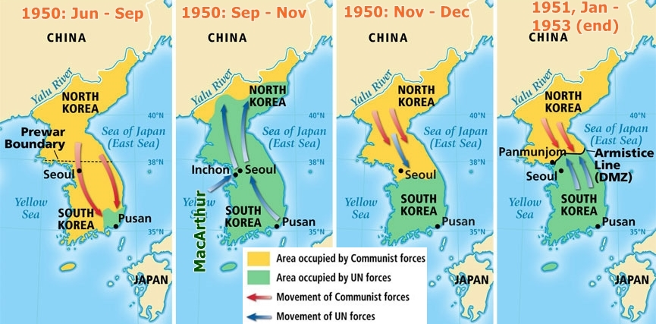
1950-53: The Korean War
Notes:
= Outline the Korean War:
> at the end of WW2 Korea was liberated (from occupying Japan) by the USSR and the US. They split the country in two, USSR administered the north half, the US the south. Due to developing Cold War tensions, each side was turned into its own state governed by its own Korean government – each government saw themselves as legitimate and the other as illegitimate.
- Image 1 of 4- in 1950 things boiled over. The North, supported by USSR and China, invaded the South in an attempt to re-unify the country.
- Image 2 of 4- the UN dispatched (US, UK, and Cdn soldiers) support to the South resulting in losses and a retreat by the North. (If not for the MacArthur’s amphibious assault near Seoul, the North would have won).
- Image 3 of 4- After nearly being pushed off of the peninsula, the North receives support from China i.e., China’s PVA (People’s Volunteer Army) is sent in and the South is pushed back to near the 38th parallel.
- Image 4 of 4- After little movement on the ground (war of attrition), both sides sign an armistice agreement, create the DMZ, and resolve to work towards a peace treaty.
= 3 million deaths, a large % were civilians. There is still no formal peace agreement on the peninsula.

Slide 8
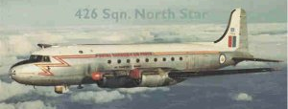
1950-53: The Korean War (cont’d)
• After WWII, Korea was divided into North (China, U.S.S.R.) and South (U.S.).
Both Koreas wanted a unified country but under their own government.
• 27,000 Canadians served in Korea: 516 died, over 1,200 were wounded
- Canadian Army Special Force (CASF), aka 25th Canadian Infantry BG
- 3 Destroyers: HMCS Athabascan, Cayuga, and Sioux, and
later Crusader, Huron, Iroquois, Nootka, and Haida were cycled through as part of the “Trainbusters Club”
- No. 426 “Thunderbird” Sqn.
• 1953 (July)- WAR ENDS.
DMZ created near 38th parallel.
Notes:
= Outline the role Canada played in the Korean War
> Canada sent the third most soldiers (US #1, UK #2)
> 516 Cdns died
= (could add a sidebar about the PPCLI at the Battle of Kapyong)

Slide 9
• 1953: Stalin dies
• 1955: Warsaw Pact (alliance)
Notes:
= the geographical setup

Slide 10
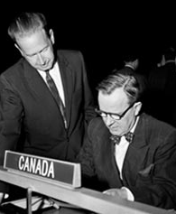
1956: The Suez Crisis
• Egyptian President nationalizes the Suez Canal (built by France and Britain in mid-1800s) to collect tolls to pay for the Aswan Dam (Nile River)
• Worries about economic impact if traffic was blocked (oil tankers). U.K., France, Israel seize the canal without telling NATO members (adds tension)
• Lester Pearson (PM St. Laurent’s Foreign Affairs minister) proposes a “peacekeeping force” to the UN
• UNEF (UN Emergency Force) is created and future PM Pearson is awarded Nobel Peace Prize
• Many Canadians feel that St. Laurent’s Liberals abandoned Britain = they lose the next election (to Diefenbaker’s Conservatives)
Notes:
= outline the Suez Crisis
> Pearson’s solution – UNEF
> interesting Cdn politics

Slide 11
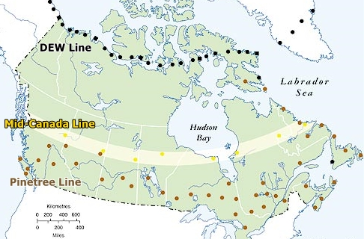
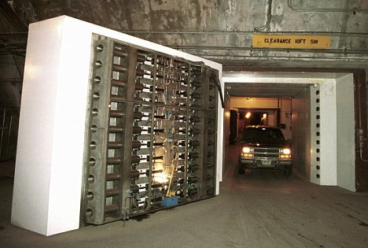
Radar Lines and NORAD Command
• 1955-57: DEW Line (Distant Early Warning) and Mid-Canada Line built
(Pinetree Line was the precursor, built in early 50’s; MCL turned off in 1965)
• 1957: NORAD begins
(North American Air Defense) Can. and U.S. Air Forces under joint command from Cheyenne Mountain (Colorado).
Notes:
= Outline the radar defense line

Slide 12
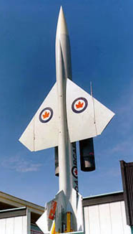
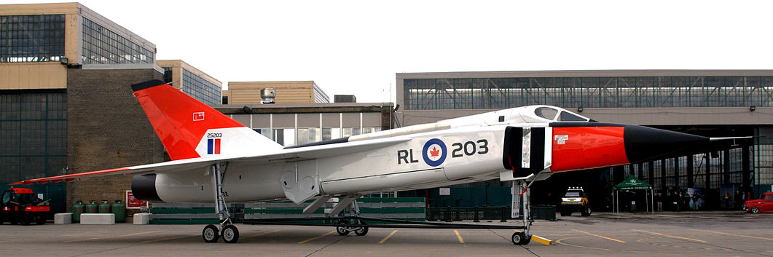
1958: AVRO Arrow vs. BOMARC Missiles
• During the 50’s Canada was developing a supersonic jet (A.V. Roe) that could intercept incoming Soviet bomber plane threats
• Canada was pressured by U.S. (NORAD responsibilities) to deploy their BOMARC missiles (Boeing)
• PM Diefenbaker agreed to 56 BOMARCs in 1958, then scrapped the AVRO
• North Bay, ON – 446 SAM Sqn. • La Macaza, QC – 447 SAM Sqn.
• 1960: Nuclear tipped ? Public says “No Way”. Cuban Missile Crisis (62) and Diefenbaker loses the 63 election to Pearson (who accepted the nuclear tips)
• PM Trudeau Sr. (68-79) signs “Nuclear Non-proliferation Treaty” in 1970 and BOMARCs are gone in ’72 (more excitement from that year to come later)
Notes:
= Outline Avro origination and the resulting choice of using Bomarcs
> interesting Cdn politics again
= Trudeau Sr. – Nuclear Non-proliferation Treaty signing

Slide 13
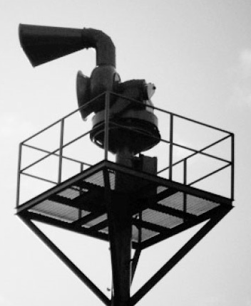
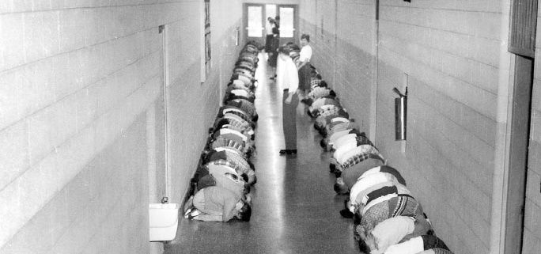
Key Cold War Developments
As the 1950’s ended, tensions ratcheted up.
Debrief:
When you first heard the siren, what did you think?
As it played, how did your thoughts/feelings change?
Do you think sirens and drills were useful? Why?
Notes:
= AUDIO (2m:44) – Emergency siren (try to let this play for the whole audio so that it sinks in). This sets the tone for the next few slides.
= Debrief: The siren
Key Idea: To have the participants understand through feeling and emotion what the atmosphere was like during the Cold War.
• Ask: When you first heard the siren, what did you think? As it played, how did your thoughts/ feelings change? Do you think sirens and drills were useful? Why?
<Courage, Resilience, Communication can be explored here>

Slide 14
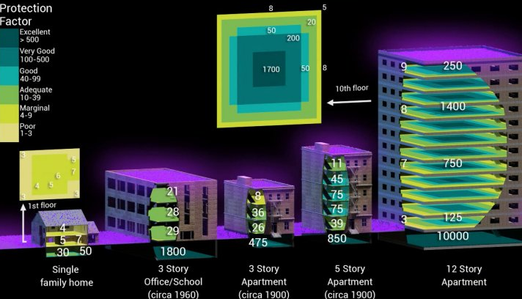
Nuclear Blasts: People, Fallout, Bomb Shelters
Main threat: The Initial Blast Secondary threat: Fallout (and fire)
Threat 3: Breathable Air Threat 4: Waste Disposal
Fallout (def.): radioactive dust that settles onto the ground following a nuclear explosion
3 factors determine the impact of fallout & radiation:
Distance 2. Shielding
3. Time (Within 2 weeks, the fallout radiation has declined to 1% of its original radioactivity.)
Given the constant nuclear threat, bomb shelters became mainstream!
Notes:
= Nuclear Fallout and Bomb Shelter introduction. (This info provides context for the activity)
> Be sure to reiterate the primary, secondary, tertiary, and quaternary threats to survival.

Slide 15
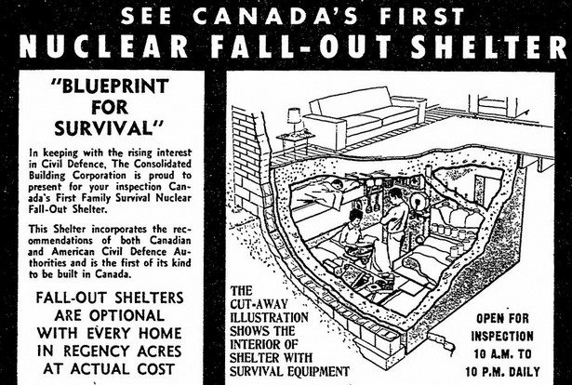
Activity: Surviving in a bomb shelter
Your Task:
A- List the top 4 threats to your survival while living in the shelter for two weeks. (5 min)
B- Make a list of items needed to survive in your bomb shelter for two weeks. (10 min)
Roles:
1 scorekeeper
1 writer
1 timekeeper
Timing:
• 15 min to complete part A and B
• plus 2 min to score your answers
Notes:
= Describe the Activity: Surviving in a Bomb Shelter (Make sure to cover the group member roles)

Slide 16
Notes:
0

Slide 17
SOLUTION: Surviving in a bomb shelter
A: The top 4 threats to your survival while living in the shelter for two weeks are:
1st: Initial Blast 2nd: Fallout (and fire) 3rd : Breathable Air (and staying cool)
4th: Waste Disposal 5th??: Adequate Supplies/Psychological/Other
B: Make a list of items needed to survive in your bomb shelter for two weeks.
Absolute Necessities:
◊ Food ◊ Water ◊ and Containers
◊ Bottle + can opener ◊ Multitool
◊ Fire extinguisher ◊ First Aid Kit
◊ Potassium iodide tablets
◊ Light source ◊ T. paper ◊ Toilet
◊ Bags (paper + plastic) ◊ Soap
◊ Air exchanger
Very Helpful Items:
◊ Eating utensils ◊ Bedding
◊ Clothing (+extra) ◊ Sewing kit
◊ Read-ables ◊ Sanitary napkins
◊ Radio (battery) ◊ Geiger counter
◊ Garbage cans + bins ◊ Bleach
◊ Whistle ◊ Legal documents/I.D.’s
3 points For Each
1.5 points For Each
Notes:
= SOLUTION and Debrief (answers will pop up as the slide is clicked through)

Slide 18
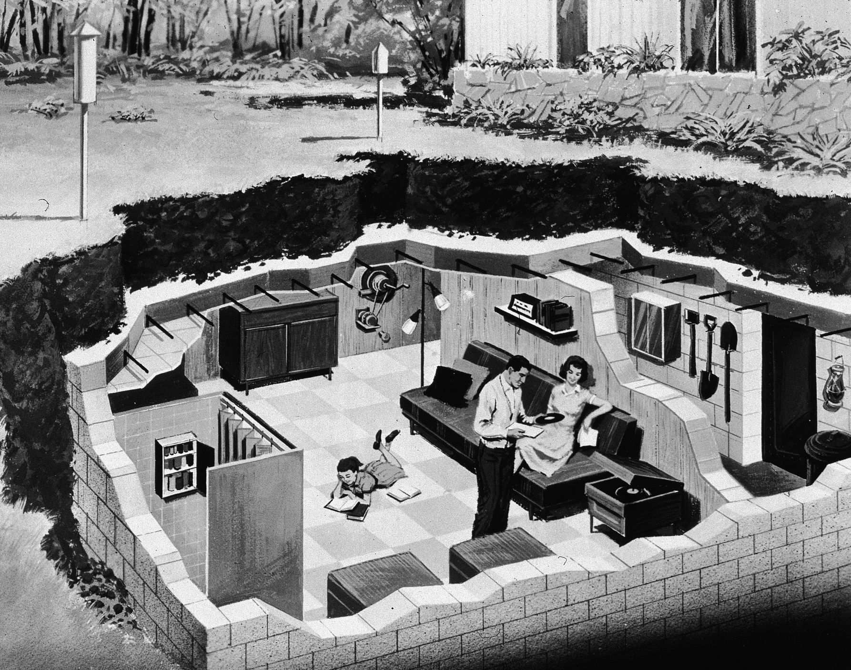
Debrief: Surviving in a bomb shelter
How did your group decide how to rank the top threats and your survival items and was your method productive?
In this activity, which 3 characteristics are most important for a good teammate to possess?
“Deluxe” Shelter
Notes:
= Debrief: Bomb Shelter
Key Idea: To give a real example of one potential Cold War outcome and how it could impact each participant.
• Ask: How did your group decide how to rank the top threats and your survival items and was your method productive? In this activity, which 3 characteristics are most important for a good teammate to possess?
<ALL TRAITS can be explored here>

Slide 20
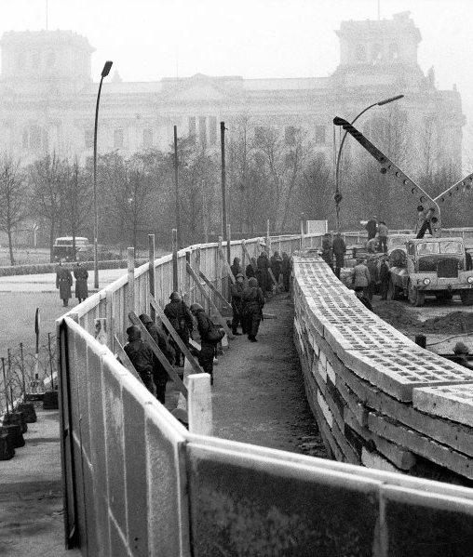
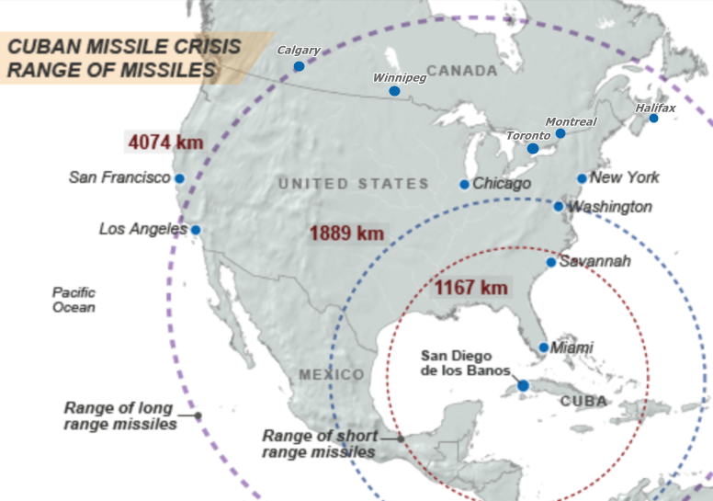
Key Cold War Developments
• 1961: Berlin Wall is built • 1962: Cuban Missile Crisis (1961 Bay of Pigs Invasion)
Notes:
= Introduce the Cuban Missile Crisis
- (the USSR was secretly setting up a nuclear missile site on Cuba, in response to a secret US installation in Turkey – the world public did not know about the Turkey installation)

Slide 21
Cuban Missile Crisis (1962)
• U.S.S.R. secretly placed nuclear missiles in Cuba that threatened the U.S.
• Kruschev would not remove them and the tension ratcheted up repeatedly during the negotiations.
• After 13 days (Oct.16-28) and DEFCON 2 (only twice: Oct. 24 and on 9-11), a deal was made to withdraw U.S. missiles from Turkey for those in Cuba.
Kruschev (U.S.S.R.)
Kennedy (U.S.)
Castro (Cuba)
Notes:
= Outline the Cuban Missile Crisis and its aftermath

Slide 22
Cuban Missile Crisis: Aftermath
The CMC took the world to the cliff-edge. Soon after, the world (and its leaders) seemed to collectively say “ (insert appropriate word/phrase here) !”
Ultimately, the tension was dialed back.
• 1963: A “hot” line (direct) between Washington and Moscow was installed
• 1964: First treaty signed. It facilitated trade • 1967: Moscow – NY flights begin
- - - - - - - - - - - - - - - - - - - - - - - - - - - - - - - - - - - - -
Don’t Forget Vietnam! In ‘61, U.S. begins supporting South Vietnamese. During the late 60’s there was a wide-spread Peace movement in North America.
- - - - - - - - - - - - - - - - - - - - - - - - - - - - - - - - - - - -
• 1969 - 79: SALT Treaties negotiated (Strategic Arms Limitation Talks). “Détente”
However, there is another Cold War Event that entered the Canadian Psyche . . .
THINK 1972 . . .
Notes:
= Present the aftermath of the Cuban Missile Crisis
• Ask: What happened in 1972 that was important to Canada?

Slide 23
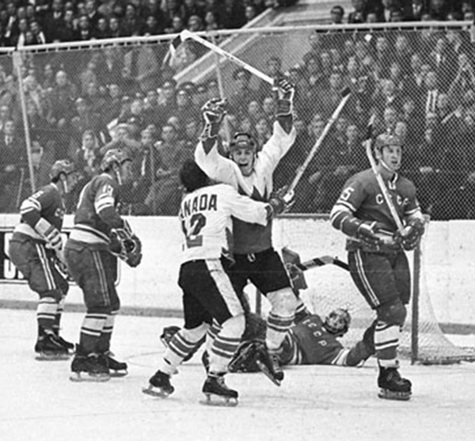
1972:
Sept. 28 . . . in Moscow . . .
?
Eight game series:
USSR 7 – 3 at Canada (Montreal)
USSR 1 – 4 at Canada (Toronto)
USSR 4 – 4 at Canada (Winnipeg)
USSR 5 – 3 at Canada (Vancouver)
Canada 4 – 5 at USSR (Moscow)
Canada 3 – 2 at USSR (Moscow)
Canada 4 – 3 at USSR (Moscow)
Canada 6 – 5 at USSR (Moscow)
Final:
Canada 4 Wins, 3 Losses, 1 Tie
The
Summit
Series
- 8 games in September 1972 -
• This was their system vs. ours. Intense NATIONALISM dominated both sides.
Notes:
(different items will pop up as the slide is clicked through)
= AUDIO (1m:16) Summit Series (Nationalism surged on both sides)

Slide 24
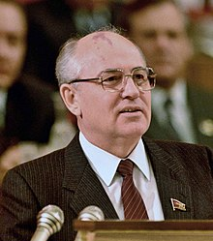
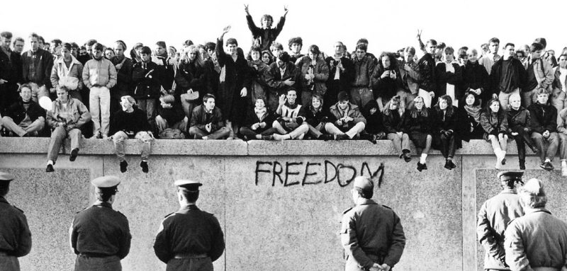
U.S.S.R. Liberalizes
• 1970’s – early 1980’s: “Détente”- relaxation of tensions
• mid-1980’s onward: U.S.S.R. liberalizes + democratizes (Mikhail Gorbachev)
“Perestroika” : restructuring of political and economic systems
“Glasnost” : transparency and openness
• 1989: Berlin Wall falls
• 1991: Dissolution of the U.S.S.R. into 15 independent republics (states)
Notes:
= U.S.S.R. liberalizes, then dissolves; Cold War ends (see slide)
= 1986 Chernobyl meltdown occurs, but it wasn’t for months before Russians learned the truth

Slide 25
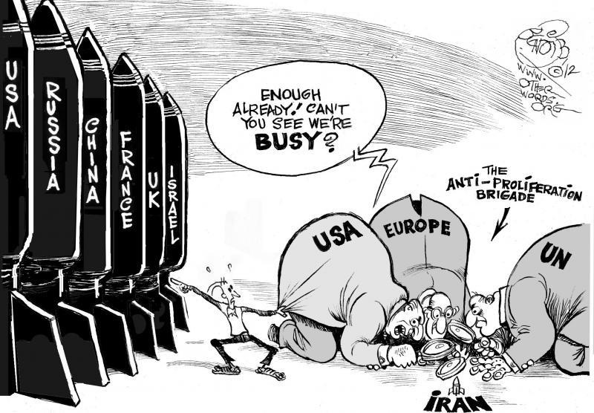
The End of the Cold War
The Cold War: a tense period in the 20th century that was characterized by an arms race, espionage, propaganda, sanctions, and small, non-nuclear conflicts.
Debrief:
Some say that history rhymes.
Do you hear any?
Notes:
= Summary
= Debrief: The End of the Cold War
Key Idea: To have the participants compare the current atmosphere to that in the 60’s, 70’s, and 80’s.
• Ask: Do you hear any rhymes? (e.g., weapons race, geopolitical maneuvering, nationalistic sporting events).
<Thoughtfulness can be explored here>

Slide 26
Notes:
0

