Slide 1
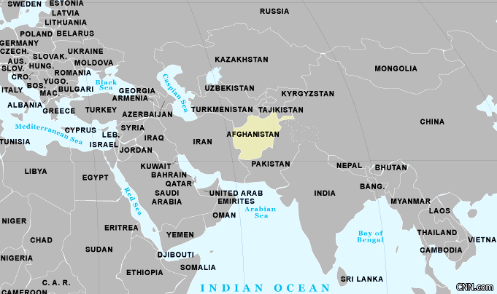
Afghanistan
2001 - 2014
Notes:
= Prompt the student to look at the map and ask: What can you say about Afghanistan from looking at this map?
= Population: 36 million, like Canada
>Key takeaways:
A- land-locked (no sea ports),
B- many ‘Stans’ surrounding, especially to the north (Russia/USSR? Poverty?)
C- central part of south Asia

Slide 2
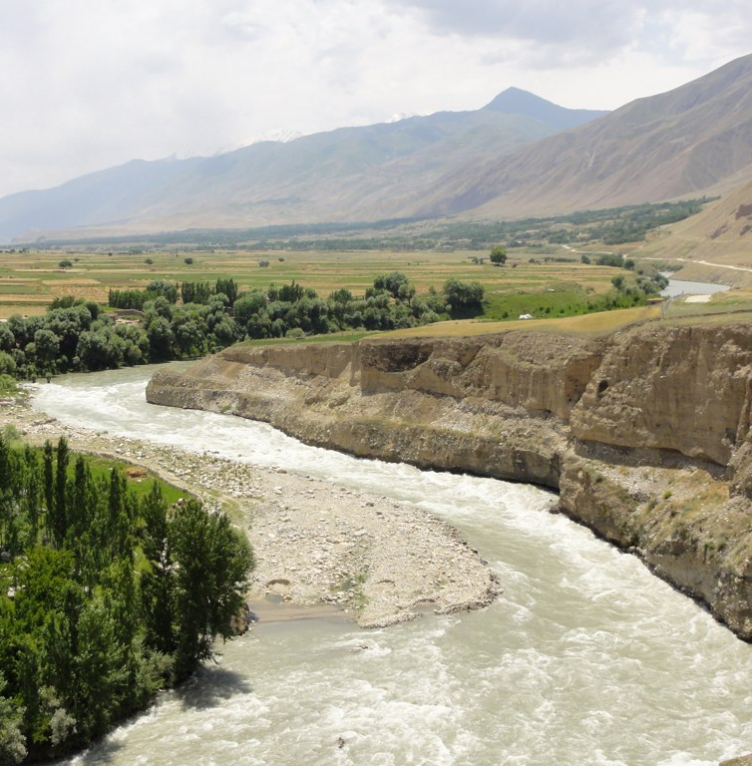
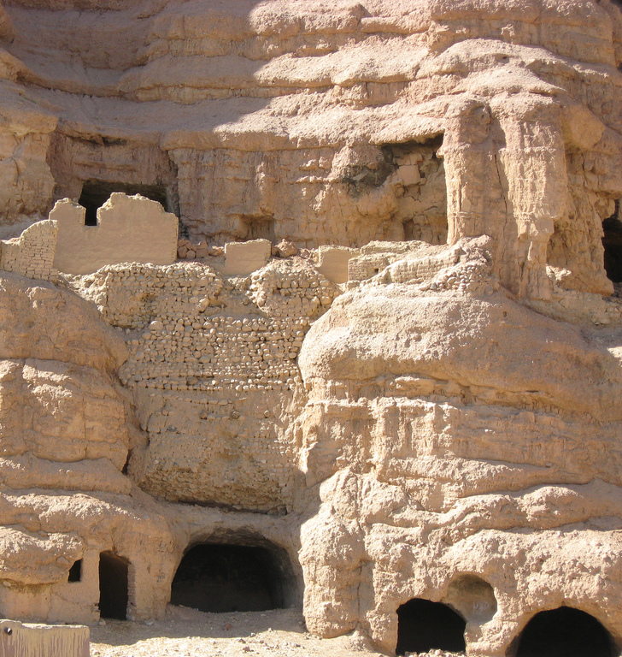
Rivers and Caves
Badakhshan Province
Bamiyan Province
Notes:
= Pieces of Afghanistan could be mistaken for place found in Canada.
= Afghanistan also has provinces, similar to Canada. E.g., Afghanistan and Saskatchewan are similarly sized.
Pronunciation- Badakhshan: Badaxshan Bamiyan: bæmiˈɑːn

Slide 3
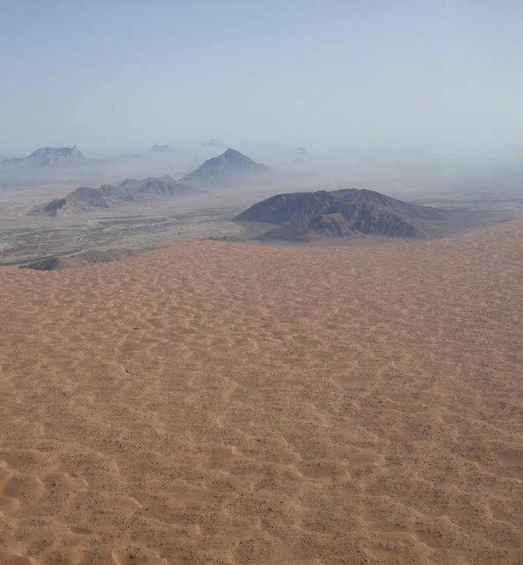
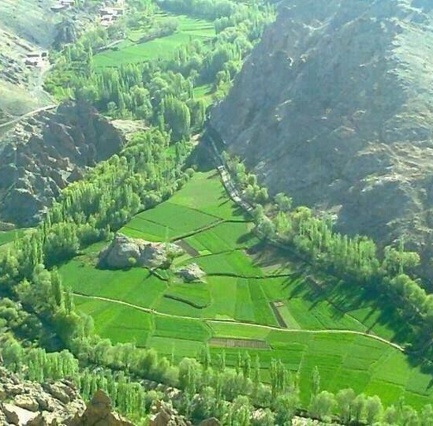
Deserts and Fields
Khandahar Province
Wardak Province
Notes:
= Khandahar (also spelled without the first ‘h’) is where most of Canada’s activities were situated.

Slide 4
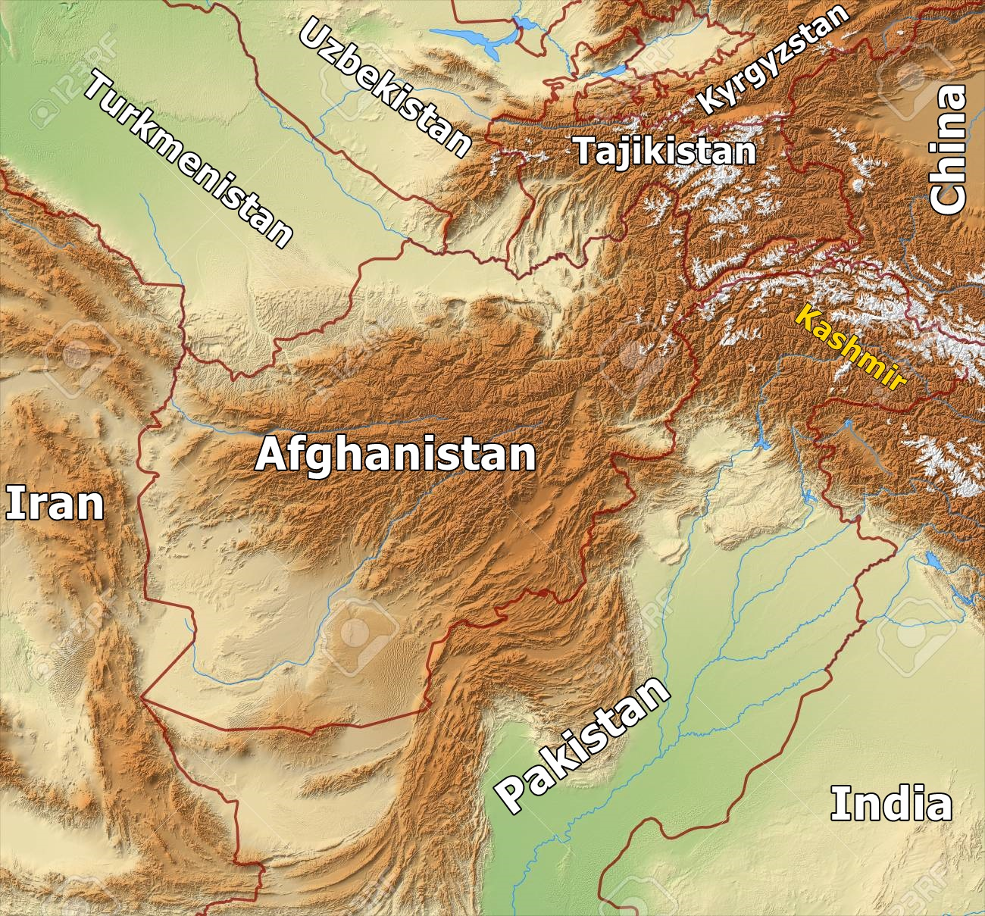
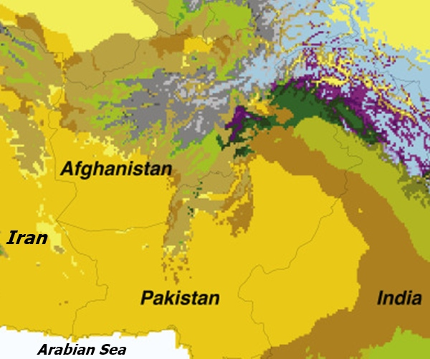
Mountains and Climate
Notes:
= Mountains and climate make Afghanistan a difficult area to travel in. However, it’s better than its southern neighbours.
> Hindu Kush Mtn Range in the N (near “K2” 2nd highest mtn in world), connects to Himalayans (Everest, 1st highest mtn) and is the source of Afghanistan’s two main rivers, both of which travelers followed.
(1) Helmand (south)- to enter eastern Iran. Helmand drainage is a closed system.
(2) Harirud (north) to access east/northeastern Iran/southern Turkmenistan.
Both rivers are referred to in the Rigveda (ancient Hindu text)
> Note climate image on right shows dryness (and mountains) prevent easy east/west travel in Pakistan and Iran (south of Afghanistan).

Slide 5
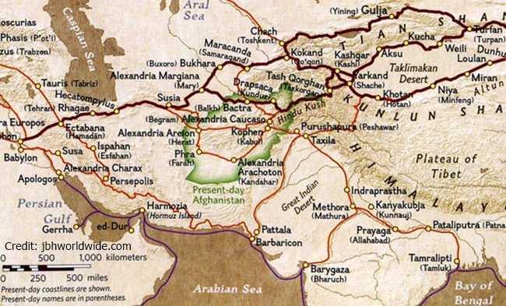
The Silk Road
Notes:
= Afghanistan is, and always has been, a cross-roads between east and west upon the “Silk Road”.
Note 1: that the green outlined area is Afghanistan.
Note 2: the dark red lines are the “true” Silk Road and that the lighter lines are secondary routes.
Note 3: the routes in Afghanistan follow the rivers (water!)
Note 4 (optional): the map doesn’t show a route between southern Afghanistan and “Harmozia”, but there was one

Slide 6
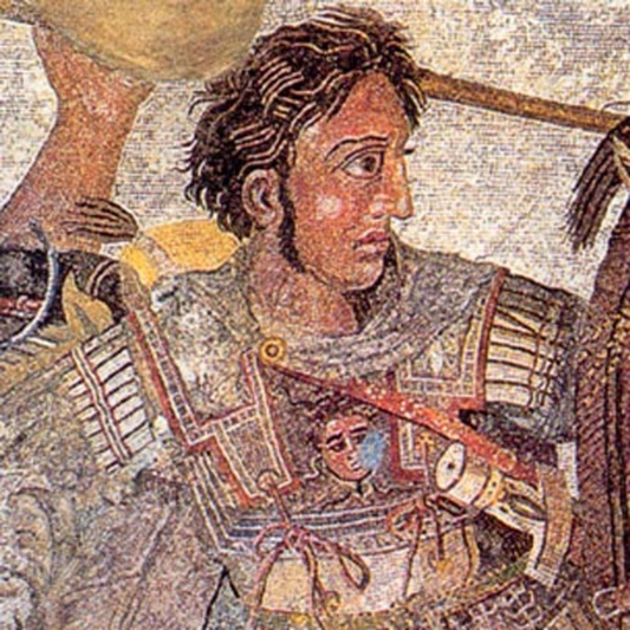
History of Afghanistan = Conflict
Darius 1 (Babylon)
2,500 B.P.
Alexander the Great (Macedonia)
2,300 B.P.
Mahmud (Ghazni)
1,000 B.P.
Genghis Khan (Mongolia)
800 B.P.
Anglo-Afghan Wars (Britain)
1839 - 1919
Notes:
= B.P. = Before Present (i.e. 1950 A.D. is considered the ‘present’ bc of nuclear weapons’ effect on radio carbon dating )
= Babylon = modern day Iraq; Macedonia = modern day Greece and Balkans; Ghazni was from Afghanistan;
Image: Alexander the Great. (Credit: no copyright)

Slide 7
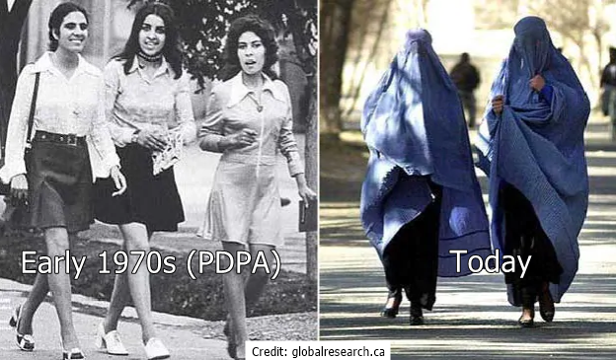
History of Afghanistan = Conflict
Soviet -Afghan War
1979 – 1989
PDPA vs.
Mujahideen
(CIA backed)
Afghan Civil War
1992 – 1995
Taliban Rule
1996 – 2001
Notes:
= Soviet-Afghan War was a proxy war between U.S.S.R. and U.S. – Kissinger (US politician) wanted to “give the Soviets their own Vietnam”.
= PDPA = Peoples Democratic Party of Afghanistan (quite liberal for the area)
Image: (left) Women in Afghanistan, early 1970’s (Credit: no copyright).
(right) Women in Afghanistan today (Credit: no copyright).

Slide 8
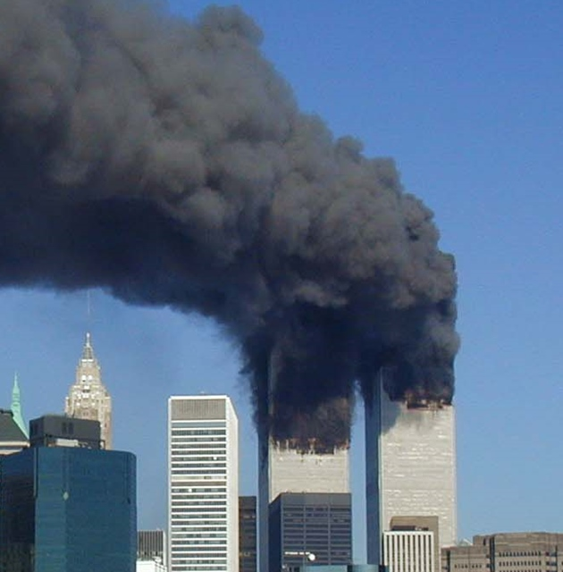
2001: Operation ENDURING FREEDOM
• al Qaeda = responsible for the 9-11 attacks (Sep. 11, 2001)
• Osama bin Laden (Saudi) is their leader. He was created by the CIA to fight against Soviets.
-- Blowback --
• U.S. demands Taliban turn over bin Laden. No response.
• Oct. – UN/NATO take action: Operation ENDURING FREEDOM
Notes:
= bin Laden was created by the CIA to fight the Soviets
= introduce and explain the term:
BLOWBACK – a term created by the CIA that refers to unintended side-effects, repercussions, or consequences.
Image: The Twin Towers burning on Sep. 11/2001. (Credit: no copyright)

Slide 9
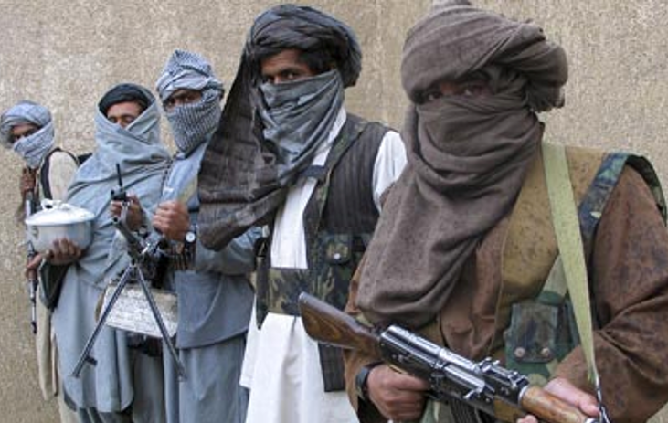
The Taliban and al Qaeda
• Militant Sunni Islamists, pro-Sharia, and desire physical Jihad
• 2011: bin Laden caught + killed. Ayman al-Zawahiri now leads
Notes:
= “Physical” jihad = armed conflict, as opposed to the “struggle within” (i.e. to live out the Muslim faith)
= Al Qaeda had bombed various US properties in the years leading up to 2001 (e.g. Embassies in Kenya, Tanzania; USS Cole)
= The CIA (Operation Cyclone –finance mujahideen against marxists) created al Qaeda during Soviet-Afghan War.
The Taliban had taken control of Afghanistan in 1996, right around the time al Qaeda started bombing US targets. The Taliban was created by Pakistan’s “Inter-Services Intelligence Agency”, the same group through which the CIA funded al Qaeda via Operation Cyclone.
Images: Left- Men of the Taliban. (Credit: no copyright). Right- bin Laden (Credit: no copyright)

Slide 10
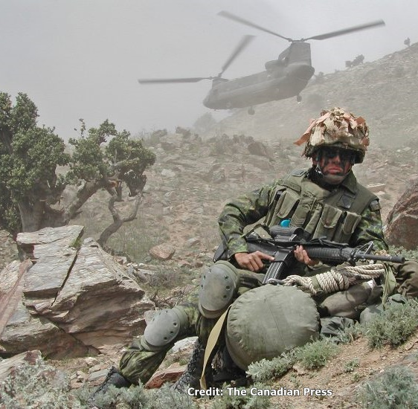
Canada enters Afghanistan
• October ‘01 – RCN supports with HMCS Halifax and Vancouver
• December ‘01 – JTF2 inserted.
Joint Task Force 2 is a super elite unit that was part of a 7-nation operation (K-Bar) to target Taliban
• February ‘02 – 3 PPCLI inserted. In Kandahar: Operation APOLLO
Canada’s “3D” goal:
Defence, Diplomacy, Development
Notes:
= JTF2: There was no confirmation of JTF2’s combat involvement until an ‘embarrassing’ picture was published showing soldiers escorting Taliban prisoners.
= Operation APOLLO – to assist and support US-led operations
Image: May 2002, a member of 3 PPCLI, sits atop his pack after disembarking from a U.S. Chinook helicopter in Tora Bora in eastern Afghanistan. (Credit: The Canadian Press)

Slide 11
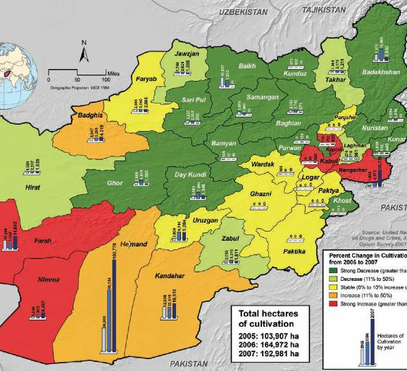
Problems in Afghanistan
• Recent wars
• Poverty
• Extremists and militants
• Opium Production
• Corruption
• Distrust of Foreigners
• NATO Air Strikes
- - - - - - - - - - - - -
• Strategic:
Location & Resources
Notes:
= Recent History of Afghanistan
> War + recent civil and Soviet-Afghan; > Poverty: lack of clean water+food;
> Corruption in communities, gov, police, military (i.e. widespread); > Distrust of foreigners: they never stick around and finish the job;
> NATO airstrikes: displace 80,000 Afghans (i.e. internal refugees) > Opium Production (Explain image)
Image: Opium production 2005-07. Note (i) that two largest producing areas are Canadian patrolled provinces, and (ii) Red=strong incr, Orange= incr, Yellow=stable, Light Green=decr, Dark Green=strong decr. (Credit: whitehousedrugpolicy.gov)

Slide 12
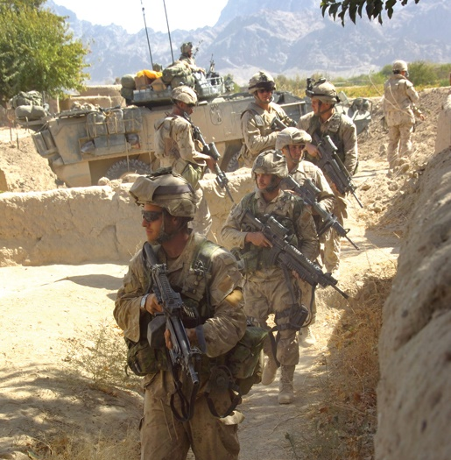
Canada in Afghanistan
• ’03 – ‘10 – Operations ATHENA, ARCHER, MOUNTAIN THRUST, MEDUSA, and others, involving
1 PPCLI, 1 RCR, LdSH, 2 RCR, 3 R22R, 5 CMBG, 3 PPCLI
• ‘05 – ’11 – KPRT (Kandahar Provincial Reconstruction Team)
• ‘11 – combat ends and all Canadian soldiers withdrawn
• ‘12 – ‘14 – CF training Afghan personnel for police and army
Notes:
= ATHENA (Kabul); ARCHER (Kandahar); MOUNTAIN THRUST (south/southeastern Afghanistan); MEDUSA (Kandahar/Panjwaii)
= RCR (Royal Canadian Regiment); LdSH (Lord Strathcona’s Horse Regiment); R22R (Van Doos); CMBG (Canadian Mechanized Brigade Group)
= KPRT helps meet 3D goals (Defense, Diplomacy, Development)
Image: Soldiers conduct operations in the Panjwai district. (Credit: Canadian Forces)

Slide 13
Afghan Outcomes
Canada’s Goals: Defence, Diplomacy, Development (3D)
Some say it was “3W” - War on Poverty, War on Terror, War on Drugs
Many Positive impacts by Canadian soldiers and agencies:
“Within 5 years, more than 6,000 schools have been rebuilt and 6 of 13 million children are now in school. Roads and bridges have been repaired, new roads have been built, and new wells have been dug. Access to health clinics is vastly better than it was 5 years ago and the infant mortality rate is beginning to drop. Programs in . . . transportation, safe drinking water, irrigation, and schools are among the 20,000 projects that are now underway.” -Stein and Lang (2008). The Unexpected War.
Notes:
= Riff on: “Goals are good to have, but they should be rooted in on-the-ground reality”.
= Read the blue quote to the audience (to assist slower readers).
[the goal of this slide is to communicate to the audience that Canada and its soldiers had a very positive impact on many Afghans and their communities]

Slide 14
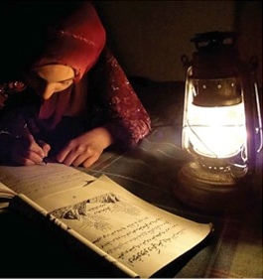
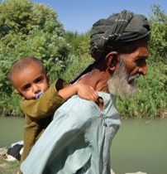
Afghan Outcomes
Notes:
Images:
Left: A young Afghan girl reading and writing (Credit: Dept. of Foreign Affairs, Trade, and Development Canada)
Right: Grandfather and grandson. (Credit: unknown)

Slide 15
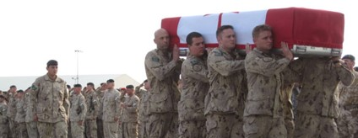
Canadian Cost
• 40,000 CAF personnel served and 5,000 civilians
• 158 soldiers killed, 2,000 wounded
• PTSD –155 active soldiers commit suicide between 2010-2019.
One in ten have PTSD
• $18 Billion ($18,000,000,000)
cost
• Operation MEDUSA: our largest operation = 1,000 soldiers
• Improvised Explosive Devices (IEDs) cause ~75% of combat deaths
Notes:
= 2006-2009 (in Kandahar) were Canada’s worst years: 115 deaths.
Of the 158 total soldier deaths, 83% are caused by enemy actions. IEDs cause 97 of 132 combat deaths.
The other 16%= non-combat accidents (15), friendly fire (6), suicide (3), illness (2).
Image: Canadian soldiers carry the flag-draped coffin of Lt. Justin Boyes, 26, 3 PPCLI (Edm) aboard a military transport plane at Kandahar Airfield on Oct. 29, 2009. (Credit: Associated Press)

Slide 16
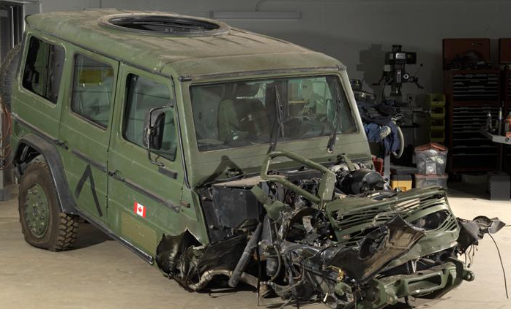
Improvised Explosive Device (IED)
Definition: “a homemade bomb designed to destroy, incapacitate, harass, or distract.”
• Activated by timer, button, switch, pressure, etc.
• Can be as small as a letter in the mail or as big as a delivery truck
• Detection and Protection?
Situational Awareness
Notes:
= IED Definition (shown on slide; credit: US Dept of Homeland Security)
There is an extremely wide range of devices that can fit inside this category.
Image (top): An IED in Baghdad, Iraq, and found by police in Nov. 2005. Four artillery shells and an anti-tank mine are wired together to detonate together. (Credit: no copyright)
Image (bottom): Dec. 12, 2005: 90 km east of Kandahar, the explosion of an IED blew this “G Wagon’s” engine 7 metres away from this part of the vehicle. The 3 soldiers and 1 journalist inside all survived with minor injuries. The “G Wagon” was introduced in 2004 to replace the lighter built Bombardier Iltis. (Credit: Canadian Forces)

Slide 17
Notes:
0

Slide 18
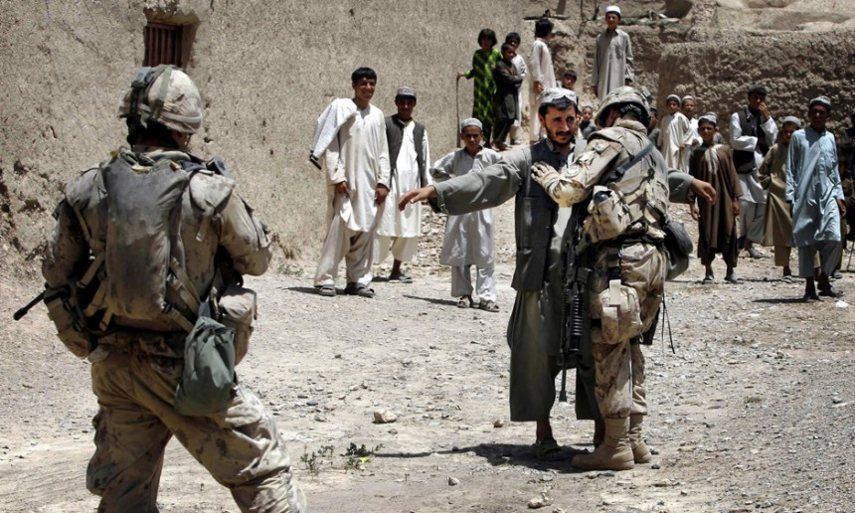
Situational Awareness Activity: KIM Afghanistan
Many professions require a high degree of situational awareness.
In this activity, you will get a look, a touch, and a smell of what Canadian soldiers in Afghanistan might have experienced.
Your Activity
KIM = Keep In Mind
Notes:
= Introduce Activity: “Situational Awareness” - KIM game
= Professions: Heavy equipment operator, race car driver, police officer, detective, firefighter, etc.
Image: A Canadian soldier searches a resident of Hajano Kali village in Arghandab district, southern Afghanistan, in July 2007. Many young Muslims feel they can't voice criticism of Canada's foreign policy without being branded as radicals. (Credit: Finbarr O'Reilly/Reuters).
That second sentence (in the photo credit) is a good one to draw attention to the difficulty of being perceived as apart from the group and/or criticizing the prevailing narrative/status quo. There are many modern examples. Perhaps the clearest is those who criticize Israel’s foreign policy are labeled anti-Semites immediately.

Slide 19
KIM Afghanistan: A Three Round Activity
Round 1 - Your task will be to remember what you see.
Round 2 - Your task will be to determine what is missing.
Round 3 – This task will require almost identical skills, but you will have to use logic to determine the correct answer.
Each group will have:
• 3 Handouts (One for each round) and a few pencils
This is a timed activity!
Notes:
= KIM is from Rudyard Kipling’s novel Kim, written at the very start of the 20th century.
The book is set after the Second Afghan War (1878-80), but in India (British-ruled at that time), and is about the orphaned son, now streetkid, of poor Irish parents. Kim is eventually trained in espionage and becomes a player in what Kipling called “The Great Game”, the ongoing competition between Russia and Britain in Asia.

Slide 20
KIM Afghanistan
Round 1
Step 1: Each group gathers around an “item” table together.
Step 2: Once the cover is removed, you have 90 seconds to study the objects (Yes, you can touch) before they will be covered again.
Step 3: Return to your table and using Handout 1, you have 3 minutes to record what you saw.
Remember to be specific!
Round 3
Step 1: Each group has a selection of 4 photos. Your goal is to review each of the photos as a group, paying close attention to all the small details.
Step 2: Select one photo that shows a scene that you think is safer than the other two and using Handout 3, you must provide at least 3 reasons why your selection is the safer scene.
You have 5 minutes to complete round 3!
Round 2
Step 1: Each group reconvenes at the same table.
Step 2: Once the cover is removed, you have 45 seconds to determine what is missing before the table will be covered again.
Step 3: Return to your table and using Handout 2, you have 90
seconds to record what you saw.
Notes:
= Explain the directions for the KIM game (each round will pop up as the slide is clicked through)

Slide 21
Thinking of Round 1 and 2, what did you find the most difficult? Why?
Thinking of Round 3, what did you find the most difficult? Why?
Describe how your group worked together to complete the tasks.
Suggest some ideas for training people requiring high degrees of situational awareness.
Debrief
Notes:
= Debrief

